Slide 1



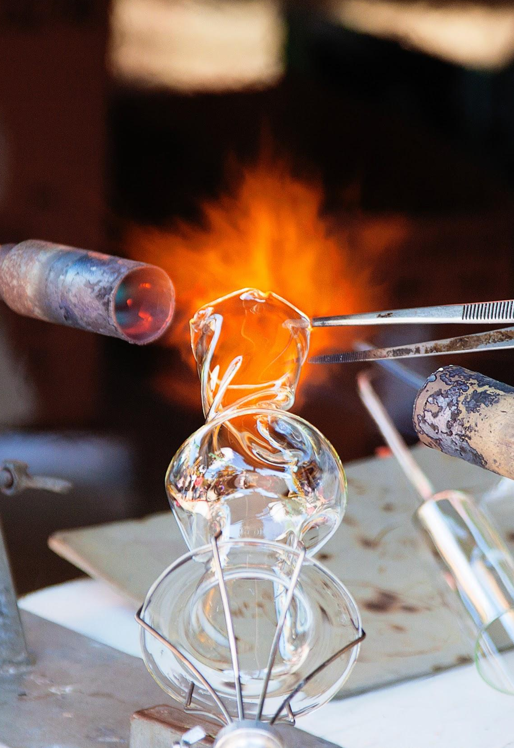
Fundamentals of ENTREPRENEURSHIP
Dr. Md. Sabur Khan, Chairman, BoT, Daffodil International University

Slide 2
Entrepreneurship?
Good Captain
Lifelong Learner
‘Durable’ as a Diamond
Tolerant as Mountain
Begins from a Seed

Slide 3

Entrepreneur???

Slide 4

Characteristics of
ENTREPRENEUR
Time Segmentation
Keep Note
Use of Technology
Absorb Criticism
Be a Doer
Leadership

Slide 5





Read
Learn
Share

Slide 6

Persistence
Vision
Personal Skills
Resilience
Initiative

Slide 7

Critical & Creative
Thinking Skills

Slide 8

Recognising
Opportunities

Slide 9

Problem Solving

Slide 10

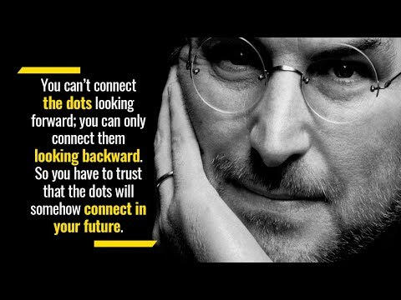
Learn from Failure

Slide 11
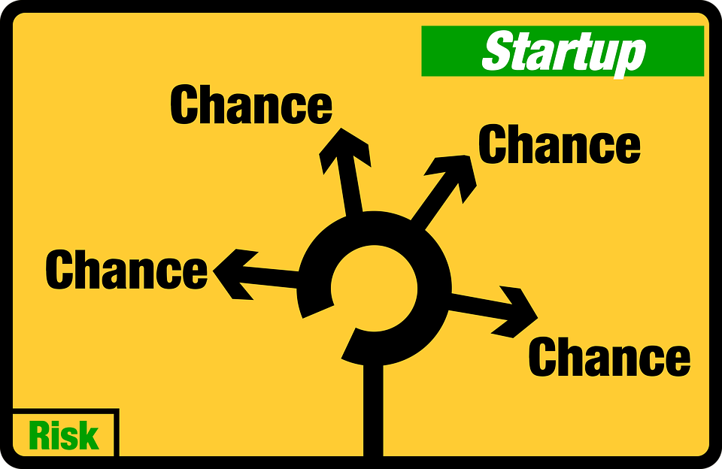

Slide 12

As an
ENTREPRENEUR
YOU
Have
To
. . .

Slide 13



Set
Your
GOAL!

Slide 14


Keep
Taking
NOTES

Slide 15


Use of
TECHNOLOGY

Slide 16


Remove
Fear
Of being
Failed
Because...

Slide 17


Slide 18


Remove
Your
EGO
and
Rudeness!

Slide 19

Think out of the box

Slide 20


Convince your FAMILY!

Slide 21




Problem
Opportunity

Slide 22






Start Your
JOURNEY
EXCUSES

Slide 23


Patient
&
Tolerance

Slide 24



Be a
RISK
Taker

Slide 25

Confident & Self-Motivated

Slide 26



Unique
Idea

Slide 27


Proper
Business
PLAN

Slide 28


Slide 29


What are you?
OR
ENTREPRENEUR
MANAGER

Slide 30





Classifications of ENTREPRENEUR
Type of Business
Use of Technology
Ownership
Size of Enterprise
Trading
Manufacturing
Agricultural
Technical
Non-Technical
Private
State
Joint
Small-Scale
Medium-Scale
Large-Scale

Slide 31


Let’s hear from an Entrepreneur

Slide 32


Never Give up, Believe in yourself!!

Slide 33

Risk Taking Skills
Prioritization
Hunger to achieve
Decision-making
Goal Setting
Adaptability
Courage
Planning and Organizing

Slide 34



Slide 35


Source
Content
Marketing

Slide 36





Slide 37

Source

Slide 38
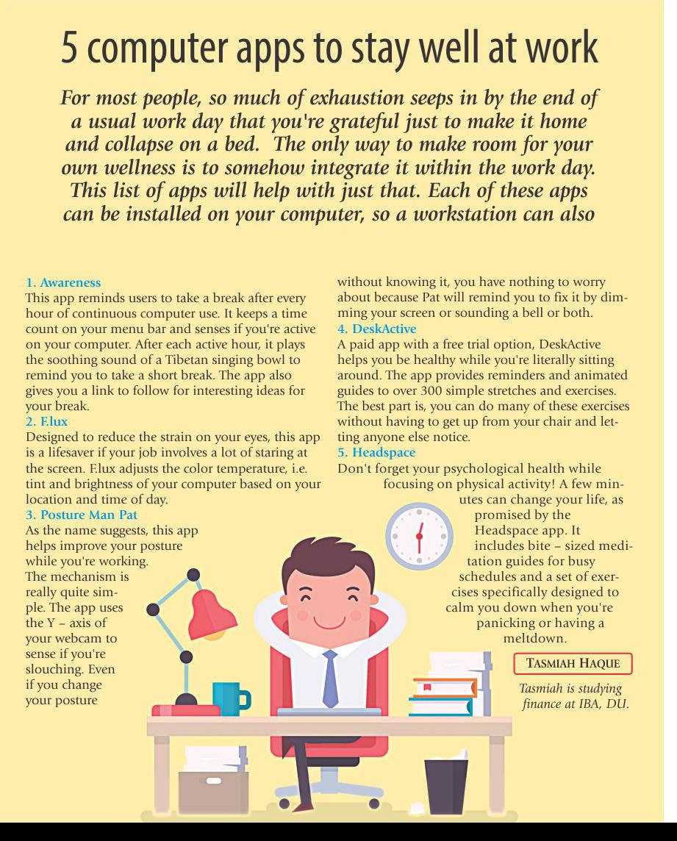
Source

Slide 39


Slide 40



Slide 41




Slide 42


Slide 43
THANK YOU!

