Slide 1




Modern Project and Research
Dr. Md. Sabur Khan, Chairman, BoT,
Daffodil International University

Slide 2

Students!
Do you Know What Opportunities
are there for YOU inside
Daffodil Family?

Slide 3









Slide 4

DAFFODIL SOFTWARE LTD.

Slide 5

Apps
Development
Software
Testing
Digital
Marketing
SERVICES
Software
Customization
Graphics &
Animation
Web &
E-commerce

Slide 6






Examination
Student Management
Information
Education ERP
HRM
Student Transport
Student Payment
Library Management

Slide 7








Patient Registration & Enquiry
Patient Treatment & Follow-up
Patient Appointment & Outdoor
Bed Allocation & Management
Pathology Lab Management
Nursing and Ward

Slide 8




Patient Payment Collection
Pharmacy Management
Order Processing & Billing
Personal Management Information System

Slide 9







Parking Management
Mobile Recharge (Top up)
Integrated 1Card Apps Service
One Card
1Card Recharge Service
SMS Notifications Service
Student Entrance-exit

Slide 10






Photocopy self-service System
Canteen Bill Management
Gym Management Service
One Card
Streamline LMS
Bus Fare Management
Alumni Management System

Slide 11
Public Listed Company (2003)
Bring some good idea which is implementable, competitive and give the revenue confirmation

Slide 12


Slide 13




Problem
Opportunity

Slide 14

You need to know WHAT probable OPPORTUNITIES are there!

Slide 15

Your Project Need to be IMPLEMENTABLE in the MARKET. Otherwise all of your efforts will go
IN VAIN

Slide 16










Students need
to
have...
Domain Knowledge
Software Requirement Specification
Documentation
System Design
Source Code
Prototype/ Product
Video Documentary
Continuous Development
Competitor Analysis

Slide 17


Earn Money
If you give continues effort, any student or industry can PAY you whenever they need your PRODUCT.

Slide 18











Source
Code
Finder

Slide 19


An Industry or Organization needs to get the CONFIDENCE that their ORGANIZATION will be BENEFITED by your SOLUTION/ SOFTWARE
NEED to PROVE

Slide 20
Industry: Problem IDENTIFY, STUDY & SOLUTION
Bring the Real World Problem
Project/ Solution
Students and Teachers: Talk to the Industry People
Study about the Problem
Part of EDUCATION (Credit/Marks)

Slide 21
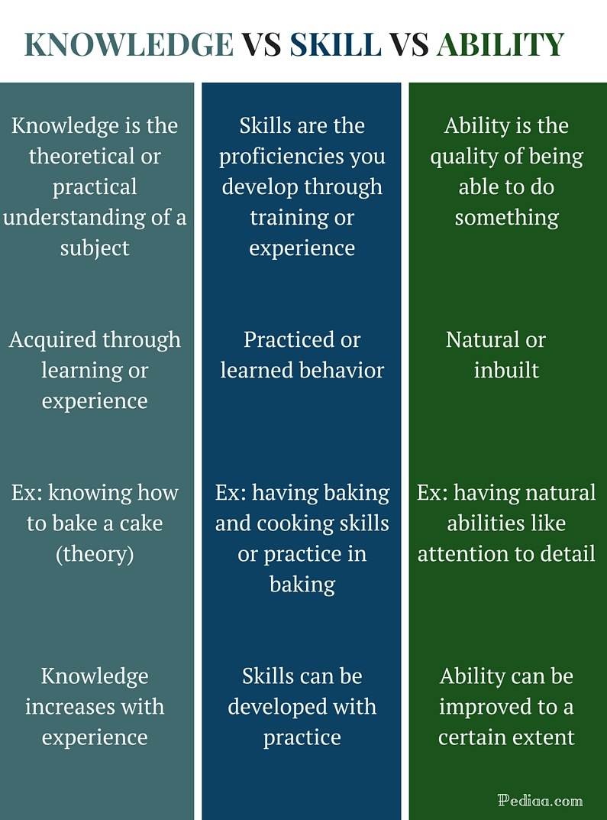


Case Study: Professional Development – IEEE/IET definitions
Interpersonal Skills
Capability
Technical Competence
Leadership
Seniority or Experience
Business Competence
Relationship

Slide 22

If you fail to PROVE your SKILLS through ABILITY, you will
fail to get your Desired JOB and Reach the Destination

Slide 23
Watch
What is
Upcoming
....

Slide 24


Slide 25
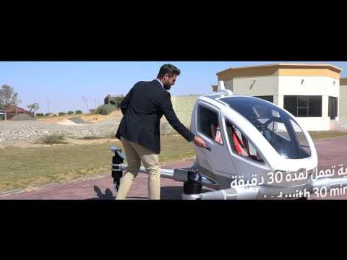

Watch
the
Video
....

Slide 26

Analyze the
UPCOMING TECHNOLOGIES
of your
DESIRED COUNTRY

Slide 27


University can move to DONOR/ GOVERNMENT/ FOREIGN Organization to get RESEARCH & FUND

Slide 28


If a FACULTY
involves STUDENTS to implement any NEW IDEA, s/he will be REWARDED

Slide 29
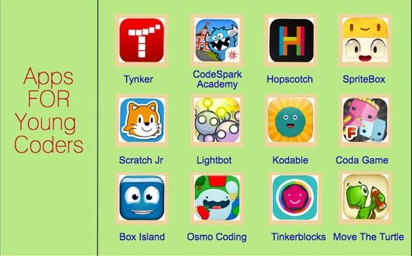
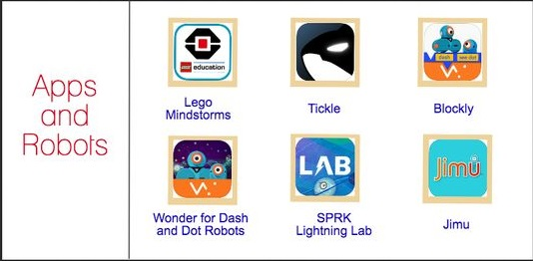

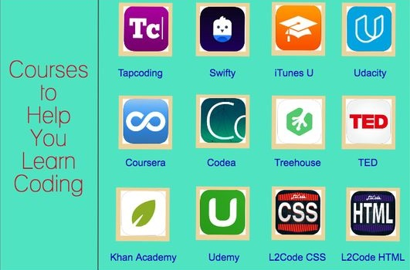
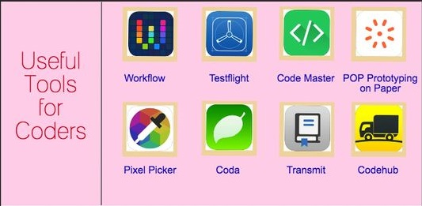

Slide 30




Slide 31
THANK YOU!

