Slide 1

Welcome!
We thank you for your time.

Slide 2

Before We Start, Prepare Yourself to Take Notes!

Slide 3
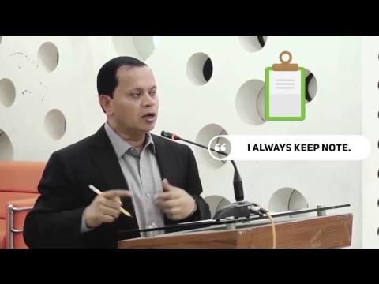

Slide 4
Now let’s Recall
Our Last Meeting

Slide 5
Meeting on August 17, 2016
Exit Plan

Slide 6
Say ‘We’ Instead of ‘I’

Slide 7
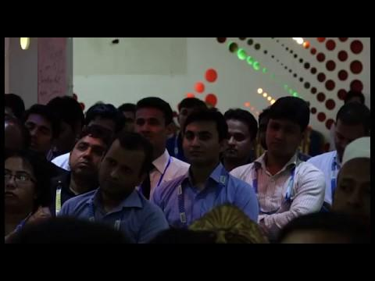

Slide 8
Identify and Inform About Specific Problems or Problematic People

Slide 9
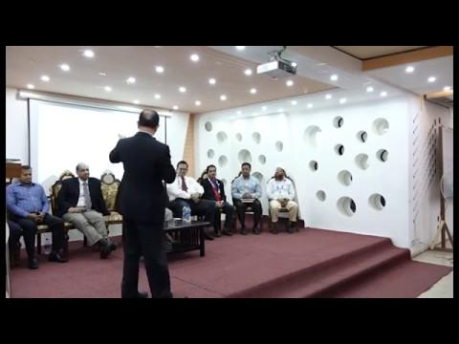

Slide 10
Correct People
or
Release Them

Slide 11
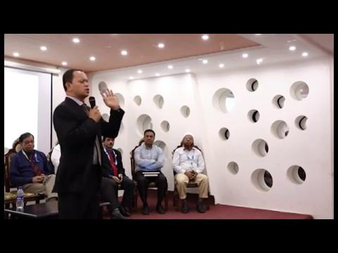

Slide 12
Take Lead
&
Find Solution

Slide 13
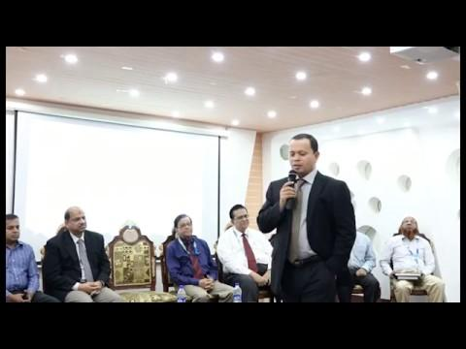

Slide 14
No Grouping,
Act as a Family

Slide 15
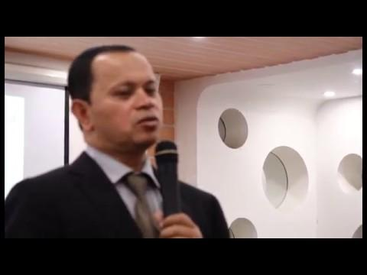

Slide 16
Nurture Students through Apprenticeship Program

Slide 17
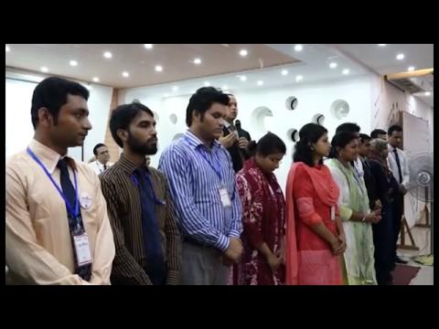

Slide 18
Do not keep people in CC/BCC in Emails without relevance

Slide 19
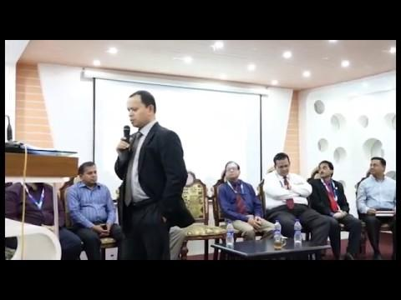

Slide 20
Establish/Circulate Daffodil Family

Slide 21
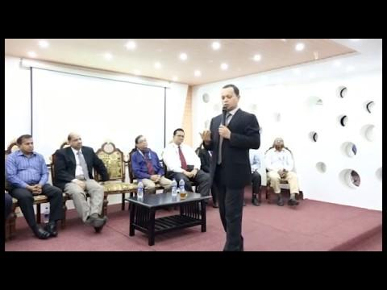

Slide 22
Speech from Pro-VC, DIU

Slide 23
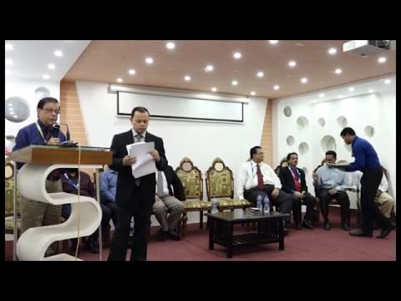

Slide 24
We will recognize that one person who would work for implementation
Let’s see the following image as an example

Slide 25
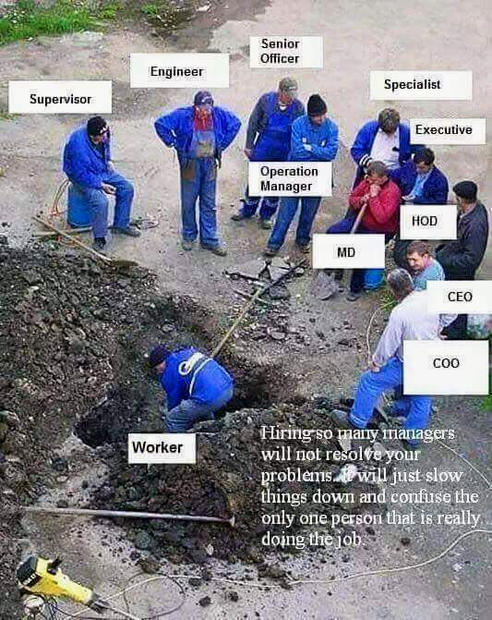

Slide 26

Forecasting, Outcome and Honesty
Forecasting must be met with honesty and outcome. We will evaluate people, group, concerns and organizations based on these two key factors.

Slide 27

Special Announcement

Slide 28

Congratulations!

Slide 29

Professional Guidelines
Getting the best from the organization

Slide 30

Table of Contents
Personality Management
Belongingness
Leadership
Personnel Management
Asset Management
Technology Adaptation

Slide 31

Personality Management

Slide 32

Make yourself look small
Sometime managers express their ego and in the process make others look small. This results in demoralizing the team and ultimately becomes the core reason behind organization’s loss. So, if the manager wants to win big, it is wise to discard ego and make himself/herself look small to others to create more access and openness.

Slide 33

Don’t be bias in judgment
Many in the organization may come to you with a lot of proposals or complaints. In such cases, it is wise to first go in depth of the proposal and complaints to know what may be the consequences or truth. Otherwise, what seems to be justice may actually be a great injustice and that may result in a great loss for the organization.

Slide 34

Virtue and Patience
Always keep goodwill for the organization and its people. It will ultimately return to you. You will find more supports in the organization and it will help you to make your works easier. Also, take time to listen to others and have patience. Take time to analyze their problems and help them if it’s within your capabilities. Also follow your religious values.

Slide 35

Manage your time
It is a universal truth that we will die at some point of our lives. Neither can we escape it nor can we predict it. So it is better to manage your time for your works so that you can no regrets before you leave this world. Time is precious and it values more than any amount of money. Please spend it wisely.

Slide 36

Leave Arrogance and Pride
Arrogance and pride can never win you anything. These can only bring loss and this process continues as long as you have them. So, leave them.

Slide 37

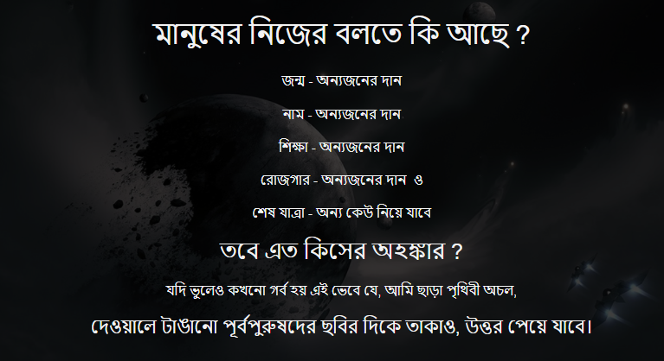

Slide 38

Enjoy your Work.
Work
One of the top most tips for career success is to enjoy your work. From top to bottom, it is true for all. Do not keep your works pending, try to do your works on time and manage the deadline. If for any reason, it is not possible to maintain the timeline, track the issues and solve it. If you cannot solve it alone, take support from your team or others relevant. This may sometimes be challenging and drain your stamina, but if you enjoy your work, you will be able to recover it well.

Slide 39

Keep your eyes open always
Always keep your eyes open and learn from the success of other people and organization and accordingly utilize your knowledge to add value for your organization. Also, remain open to finding new opportunities or threats to take preparation or precaution relatively.

Slide 40
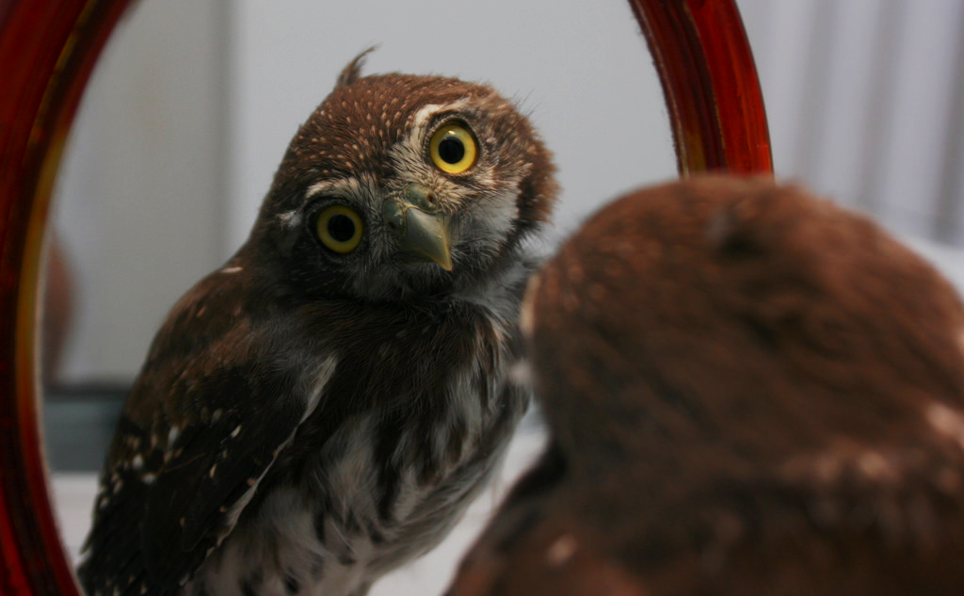
Individual Evaluation
The best person who can judge you, is yourself. No one else can do it better. Therefore, you need to track your own progress and evaluate yourself continuously. Only then you can push yourself towards success.

Slide 41

Manage Your Workload
Sometimes you will have challenge managing your workload but without managing your workload you cannot get progress. If you have a lot of works, try to delegate some works among your teammates or colleagues or subordinates. Prioritize your works and focus on most important ones and get them done. Keep tracking your works till they are all done.

Slide 42

Never take Revenge
Do not take revenge against anyone. It will create a chain that will keep coming to you. It will also be a loss of your time and energy that is valuable for your works. Ignore any problematic character and focus on solving the problem by achieving success. Success is the best revenge you can take and without causing any harm to yourself and others.

Slide 43

Take Care of Your Health
Your works are important but remember that your health is even more important. You need to take short breaks after working for long hours. Take some time to do light exercises or walk for five minutes. It will refresh you from stress and bring back your concentration and at the same time be good for your health.

Slide 44

Belongingness

Slide 45
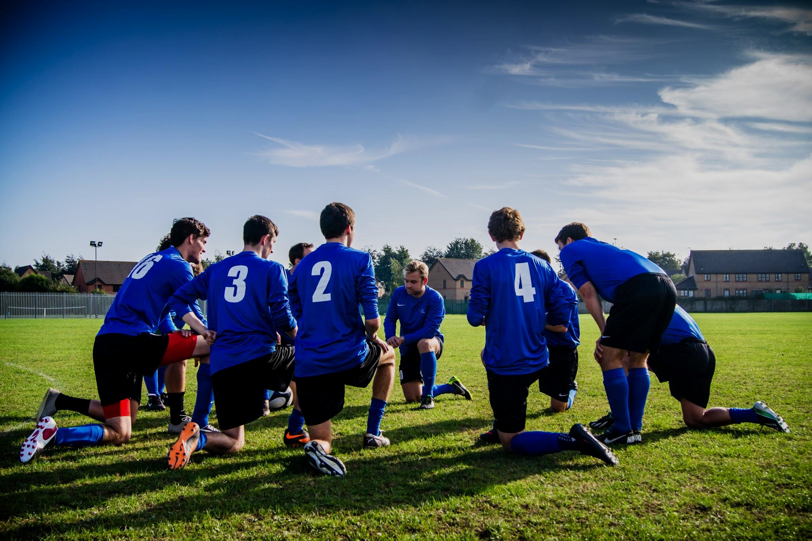
Team Spirit Development
Maintain a strong team spirit within the organization. Without strong teams working in different sections or areas in the organization, success cannot be ensured. Also feel proud for your organization and love the fact that you work there. Help each other just like you would to your family members.

Slide 46

Family Value for Your Organization
Treat your organization like your family. You spend a major portion of the day in your organization. You need to own it and give it the same value as your family. Otherwise, you will feel demoralized and drained and cannot contribute much which will ultimately be a barrier to your success.

Slide 47



Office and Family Balance
Make a balance between your office and family. It is important to share about your office life with your family members and make them understand your efforts for them. That way your family members will also help you to put your concentration on your works when required. Also after a long term work, go on a vacation to spend some quality time with your family members. It will energize you, motivate your family members and also help you understand if you could manage a proper delegation for your works.

Slide 48

Leadership

Slide 49

Developing System
To create sustainability both for career and organization, developing system is necessary rather than creating dependency on people. System should be developed in such a way that it guides the people in the organization to stay on the right track and automate the processes.

Slide 50

Expand Leadership
Leaders create more leaders and expand their leadership. Sustainability of the organization depend on this process very much. If this is done correctly, organizational growth expands by many folds.

Slide 51

Listen more, Speak Less, Do More
A leader speaks less and listen more and helps others to perform well. Doing so, enable them to generate more outcome and be in lead automatically.

Slide 52

Leaders are Intrapreneurs
Leaders function like entrepreneurs from within the organization and continuously create values by introducing different innovation and finding out opportunities. They are called Intrapreneurs.

Slide 53

Quick decision
Leaders take quick decision yet thoughtfully. They do not let any opportunity to miss out. So they do not keep their decisions pending and keep the flow of the organization.

Slide 54

Establish Equity
Leaders do not be bias and establish equity throughout the organization. No matter what background they have, they treat every people and concerns they work for with equal perspective but at the same time appreciate diversity.

Slide 55

Personnel Management

Slide 56

Accountability
Accountability of the individual employees must be ensured by the leaders. It can be achieved by properly delegating the works and tracking the progress. If anyone fails to perform their works properly, he/she should be held accountable for it. Try to find out whether they are failing for lack of skills or because of the existing system and take necessary steps accordingly to recover.

Slide 57

Track Meeting Outcomes
Meetings cover crucial decisions. Therefore, it is very important to have a system to track back whether those decisions were implemented or not on a regular basis.

Slide 58

Track Jobs
Keep track of your jobs and also the jobs you delegated to others. Keep following up until the jobs are done. In the process if you find that your team or subordinates require further guidelines or assistance, do not hesitate to help them. They are working for the jobs you delegated to them.

Slide 59

Performance First
All kind of evaluation in the organization need to be performance based and not automated. Performance based evaluation motivates employees to work better and keep high morale for the people who really matters for the organization. If the wrong people get rewarded, it will demoralize the right people working for the organization.

Slide 60

Proper task delegation
Identify the right people and the right skills necessary for the works and accordingly delegate the works among the right people having right skills. Proper task delegation is necessary for achieving success. It is also important that you document your delegation. Here also you can use technology to properly delegate and track the works.

Slide 61

Asset Management

Slide 62

Focus on Saving Revenue
Focus on saving the earned revenue for organizational growth. If the organization do not save funds for its future development, it will not sustain in the long run and its employees will suffer.

Slide 63

Keep and Backup your Asset Related Documents
Keep your asset related documents in files and secure them. Backup the files using online platforms securing its access. Label the files and folders according to their relevance so that they can be found easily at a later time. Also build inventory and map your assets.

Slide 64


Review Your Assets and Asset Management Process
Regularly review the life cycle of your assets and the asset management process you have to ensure they are managed well and to find out whether asset related goals are achieved or not.

Slide 65

Technology Adaptation

Slide 66


Email Labeling
Keep your emails organized especially the important ones so that you can find it easily when in need at a later time. Use label feature of your emails and define category for your incoming and outgoing emails according to the subject or topic.

Slide 67

Follow Up Tools
Track back your works and delegated tasks using technology. There are a lot of useful apps and features like reminders, calendar, note, Boomerang etc. for tracking and following up tasks until they are done.

Slide 68


Quick response
Responding timely, is sometimes the key towards success for your own career and the organization. For managers, this simple task may become a challenge due to their busy schedule. Use technology to quickly respond to issues or queries from others.

Slide 69




Technology Based Meeting
Meetings consume work time and resources. Sometimes even the simplest of decision may become a lengthy process trying to arrange a meeting for it. You can rather use technology to reduce meetings that require quick decision. You can use the following options:
Conference Calls
Video Meeting
Whatsapp Message
You can also record your meetings using technology so that you can track its outcome.

Slide 70
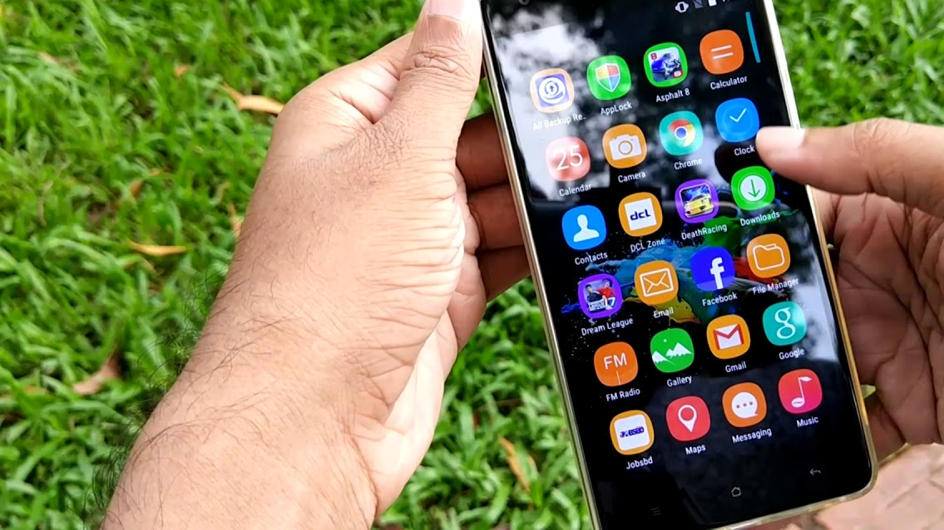
Use of Smartphones and Apps
Getting a good smartphone can be a very good investment to have for your career and professional life. There are now lot of variations of smartphones and you can even get a good smartphone on a budget now a days. Smartphones make your life easy as you can keep note and track your works easily with it on the go. Many apps are also available to be downloaded in your smartphone which can make your communication and team management easier.

Slide 71

Concluding Words

Slide 72

1
Delegation/Execution through proper authority
2
Circulate findings and keep record then track back to decide
3
Avoid meeting and delegate jobs to specific people with relevance
4
Create models by documenting your works and utilize them for future use.
Follow Four Rules for Implementation

Slide 73

Let us promise to:
Inspire each other instead of finding faults
Forget the past and work for a bright future
Overcome problems together
Establish a new Daffodil where we are family, friends, leaders and the best.
Let us support the new leaders by keeping this promise.

Slide 74
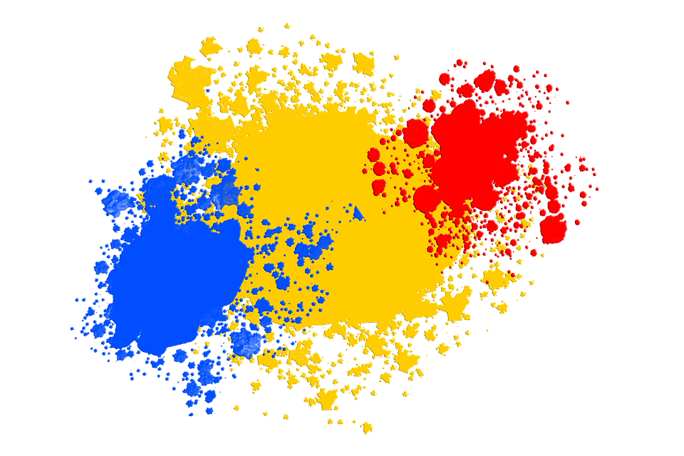
Thanks!

