Slide 1
Industry-University Collaboration: A Way for Innovation and Employment
Theme: Industry meets Education
Md. Sabur Khan
Chairman
Daffodil International University
5th-8th July 2017, Hofburg, Vienna, Austria

Slide 2
SUSTAINABLE DEVELOPMENT GOAL (SDG) 4: QUALITY EDUCATION
Ensure inclusive and equitable quality education and promote lifelong learning opportunities for all.
Education for all has always been an integral part of the sustainable development agenda.
Over the years the fostering and enhancement of industry-academia collaboration has involved the establishment of many new facilities such as “technology transfer offices” and “research and development units” within universities themselves.

Slide 3
Human Development
Since human development is a key input to the goal of inclusive and shared economic growth and poverty alleviation, policy makers, including stakeholders need to put considerable emphasis on human development.

Slide 4
Higher Education and Bangladesh
University Education acts as the engine of growth for economic and social development of a nation. Universities instil necessary skills and technical expertise that expedite economic and social development.

Slide 5
Higher Education and Bangladesh (Contd…)
The growth trajectory of Bangladesh economy requires a highly skilled labour force equipped with the necessary technical and professional expertise. In this backdrop, formulation of strategies for higher education will be considered with these factors in mind.

Slide 6
Higher Education and Bangladesh (Contd…)
Growth of the Higher Education System:
Higher education was traditionally dominated by the public sector, but in recent years, private universities have proliferated. There are 117 universities in the country of which 37 are public and 80 are private universities. The University Grants Commission (UGC) is the regulatory body for both public and private universities.

Slide 7
Higher Education and Bangladesh (Contd…)
Four streams of higher education are offered in Bangladesh: general education; science, technology, and engineering education; agriculture education; and medical education.

Slide 8
Key Strategies in University Education during the 7th FYP of Bangladesh

Slide 9
Delta Planning Learning Community
As the GoB is formulating ‘The Bangladesh Delta Plan 2100’ with a long term perspective, the plan will promote holistic delta planning using many knowledge based concepts and themes related to state of the art adaptive delta governance. Thus the delta planning ought to be knowledge based continuously.

Slide 10
Delta Planning Learning Community (Contd…)
A delta planning learning community, therefore, is needed in Bangladesh focused on international oriented knowledge creation, building a knowledge infrastructure and on application of knowledge for policy making and planning purposes.

Slide 11
Delta Planning Learning Community (Contd…)
A knowledge infrastructure should be established as a set of physical, informational, scientific, educational and organizational resources needed to facilitate a delta planning learning community (universities, knowledge institutions and relevant agencies, societal organizations and companies) and action toward a desired collective future.

Slide 12
Matching Skills and Labour Market
Skills mismatch has become more prominent in the global economic crisis. However, it is primarily a structural issue and as such existed prior to the recent global economic slowdown. For the same reason, contrary to what some commentators believe, current record-high unemployment rates cannot be attributed to skills mismatch. Indeed, there is no evidence that skill levels have collapsed during the crisis.
Skills mismatch, the gap between the skills required on the job and those possessed by individuals, raises the question of the ability of societies to capitalize on their workforces. Skills are also a critical asset for individual workers and firms in a rapidly changing and globalized world.

Slide 13
Forms of Skills Mismatch
Source: Cedefop, 2010; OECD, 2011

Slide 14
Skill matching
Skill matching requires a collaborative long-term strategy
Effectively reducing skills mismatch requires creation of a comprehensive long-term strategy.

Slide 15
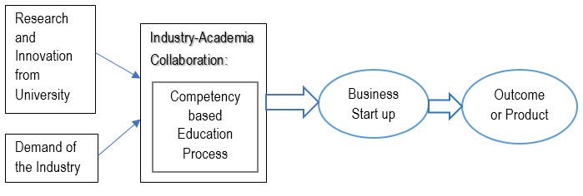
Industry-Academia Model

Slide 16
Comparing Available and Required Skills in OECD Economies

Slide 17
Curriculum development considering the expectations of the industry
Curriculum refers to a well-defined and prescribed course of studies, lessons and activities, which students must complete to fulfill the requirements for acquiring the degree. The curriculum plays a crucial role in achieving the mission and objectives of the university including the intended learning outcomes and overall effectiveness of the programs.

Slide 18
Employability of student and Employability 360 degree
Employability of any student means the character or quality of the student for being employable which plays a significant role in meeting the gap between the expectations of demand side and resources provided by supply side.

Slide 19
Employability of student and Employability 360 degree (Contd…)
The concept of Employability 360 degree reflects a holistic and participatory approach of enhancing the employability of students with a collaborative way. This paper strives to define the concept, initiatives taken nationally and internationally, effective procedure/approach for implementation, advantages, impact on education sector. The paper attempts to trace the development of the concept along with the role of higher education institutions in facilitating and to identify as well as develop an approach for implementing the concept with a view to enhancing employability of students both at home and abroad.

Slide 20
DIU Industry Academia Lecture Series on Entrepreneurship Development
Aim to inform and motivate the youths for being entrepreneur
Learning from taking the lesson from the struggle and challenges faced en route to success by the well-known entrepreneurs of the country
country’s renowned 12 successful well known Entrepreneurs to take part in these lecture series gradually in different episode and will deliver their success story.
9 Lecture series held so far.

Slide 21
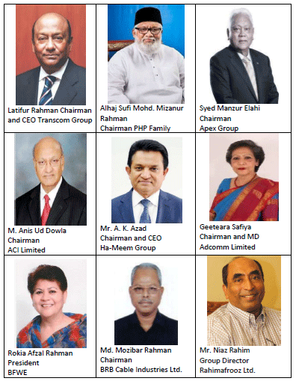
DIU Industry Academia Lecture Series

Slide 22
Innovation and Industry Academia Collaboration
Innovation is a complex phenomenon that involves a complex series of processes to be managed towards the objectives set.
Defining and identifying strategic directions for successful collaboration between universities and industry and economic partners contribute to shaping the proposal of the proposed model. The focus is on knowledge transfer between universities and industry to attract new collaborations.

Slide 23
Innovation and Industry Academia Collaboration (Contd…)
Transfer of knowledge plays an important role in innovation and growth. Therefore emphasis on culture contributes to the innovation, but the balanced way to create culture leads to better transfer and exploitation of knowledge produced by universities in order to stimulate innovation.

Slide 24
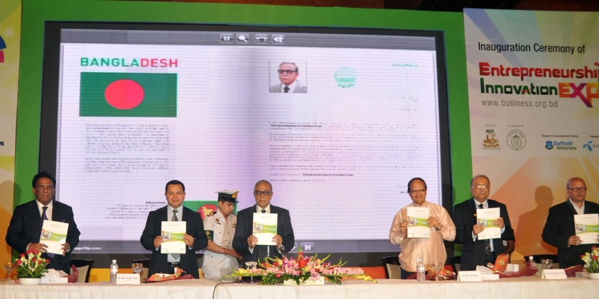
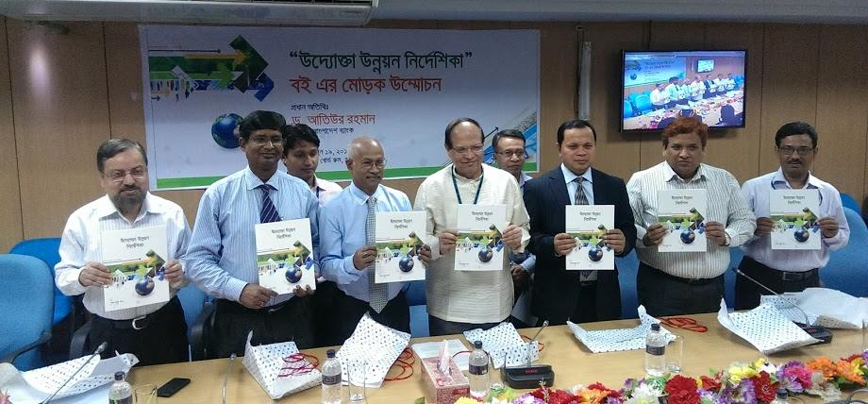
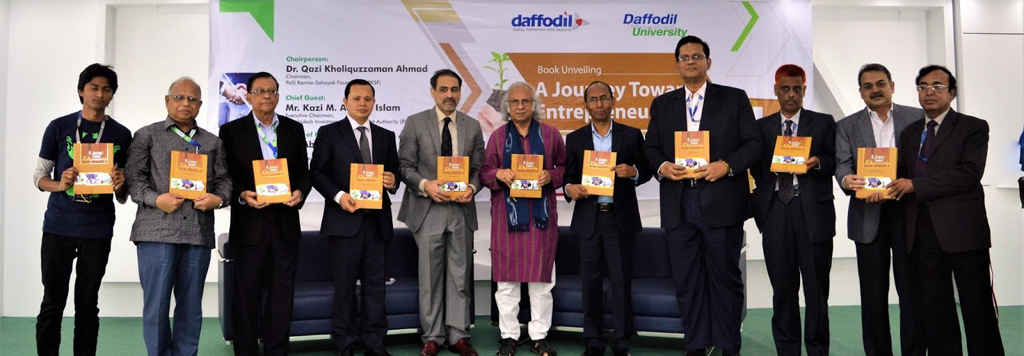
Publications on Entrepreneurship
Handbook of Entrepreneurship Development (2013)
Uddokta Unnoyon Nirdeshika (2014)
A Journey Towards Entrepreneurship (2016)

Slide 25
Department of Entrepreneurship as pioneer in Bangladesh
The Program aims at creating graduates equipped with entrepreneurial skills, knowledge, values and attitudes for their businesses. After successful completion of this program, graduates will be able to transform themselves not only as self-employed but also as creator of employment through becoming an entrepreneur.

Slide 26
Department of Entrepreneurship as pioneer in Bangladesh
The Program aims at creating graduates equipped with entrepreneurial skills, knowledge, values and attitudes
for their businesses.
Graduates will be able to transform themselves not only as self-employed but also as creator of employment through becoming an entrepreneur.
A group of country known entrepreneurs and leading
academicians are offering this course through blending
of both theoretical and practical exposure.

Slide 27
Practical Involvements of Students
Startup Market
Startup Fest
Global Entrepreneurship Summer Program
Global Youth Entrepreneurship Summit
Get in the Ring (GITR)
Entrepreneurship and Innovation Expo
Entrepreneurs MeetUp
Social Business Students Forum
Are You the Next Startup
DIU Social Business Design Lab
Arranging Mega Iftar for 1500+ people

Slide 28
Recommendations
Measures need to be taken
to enhance education at universities and other institutions in order to meet future needs for human resources in the industrial world (including strengthening basic academic skills, improving professional education, and cooperating with the industrial world).
to promote job opportunities for postdoctoral personnel in enterprises.
to formulate Action plans for the collaboration of industry, academia, and government based on the Strategy for Human Resources Development in every fields, for example, measures for elementary and lower secondary students to actually experience industry through presentations by lecturers dispatched from the industrial world.

