Slide 1
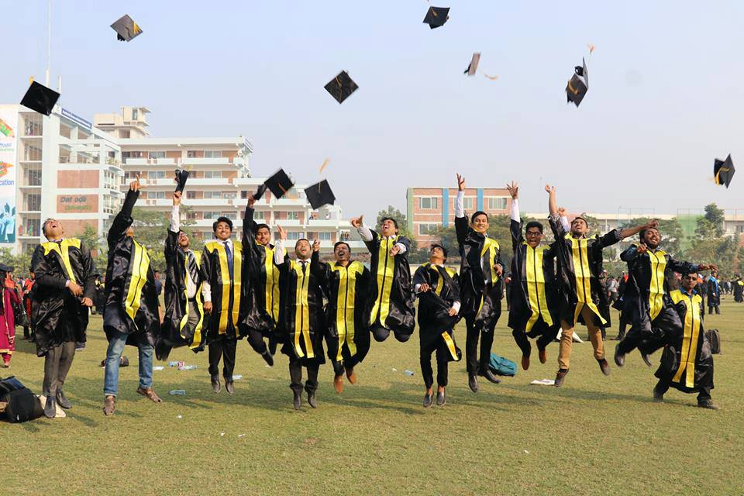

8th CONVOCATION CEREMONY of
DIU
Mr. Md. Sabur Khan,
Chairman, BoT,
Daffodil International University

Slide 2
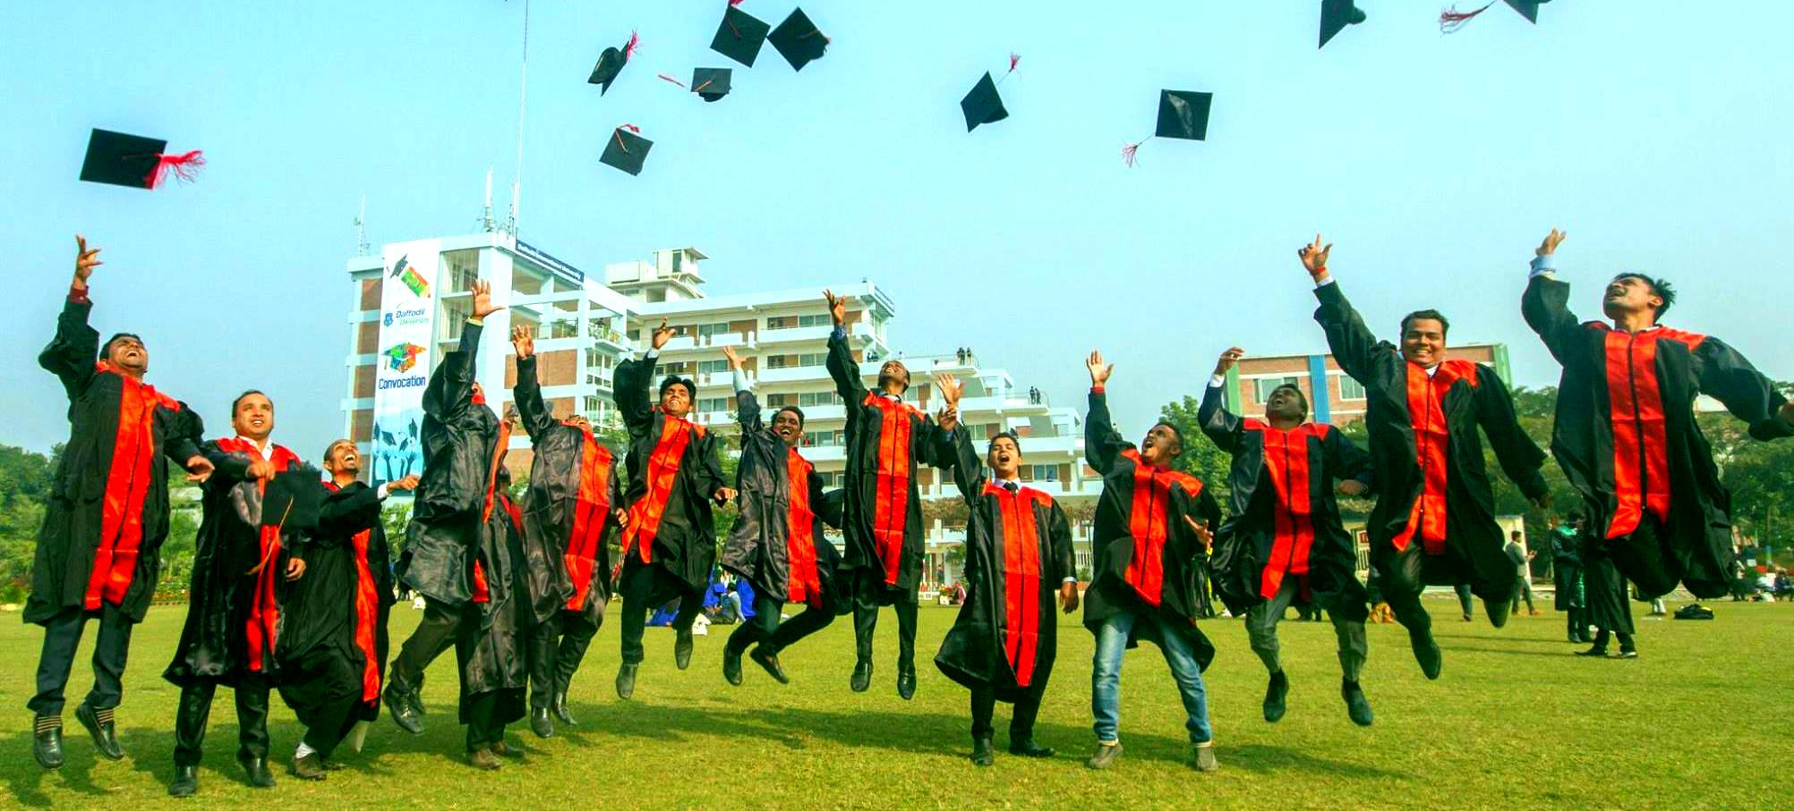
CONGRATULATION !!!

Slide 3
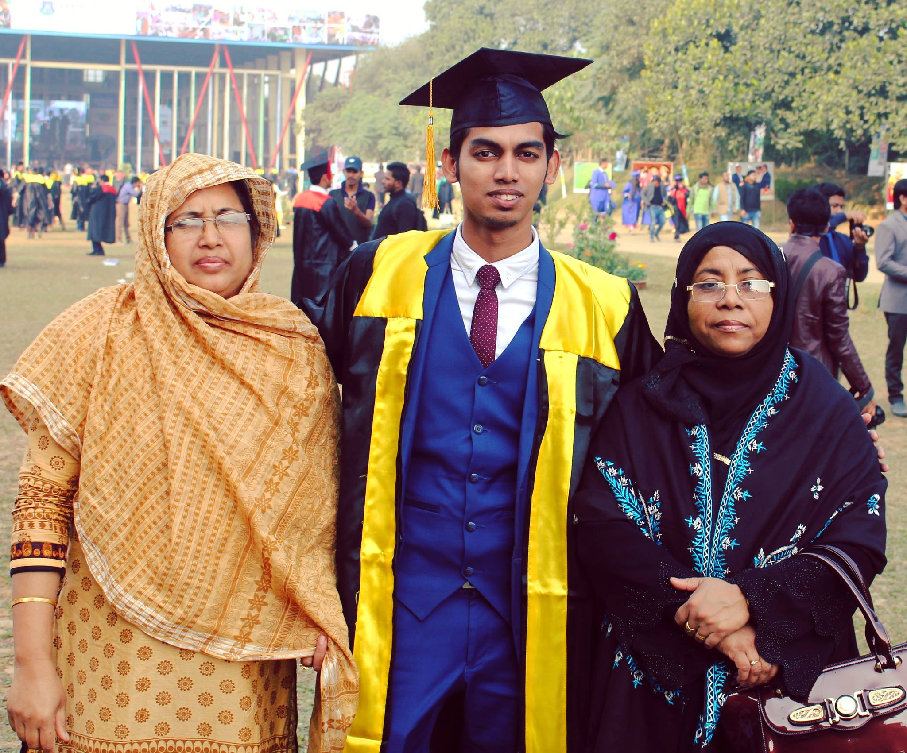
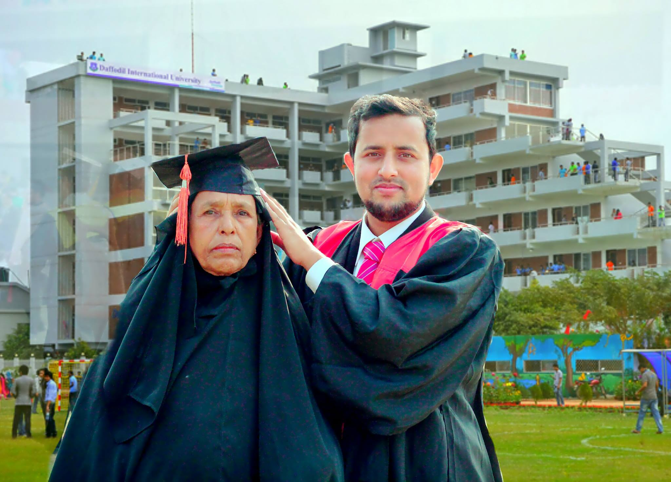
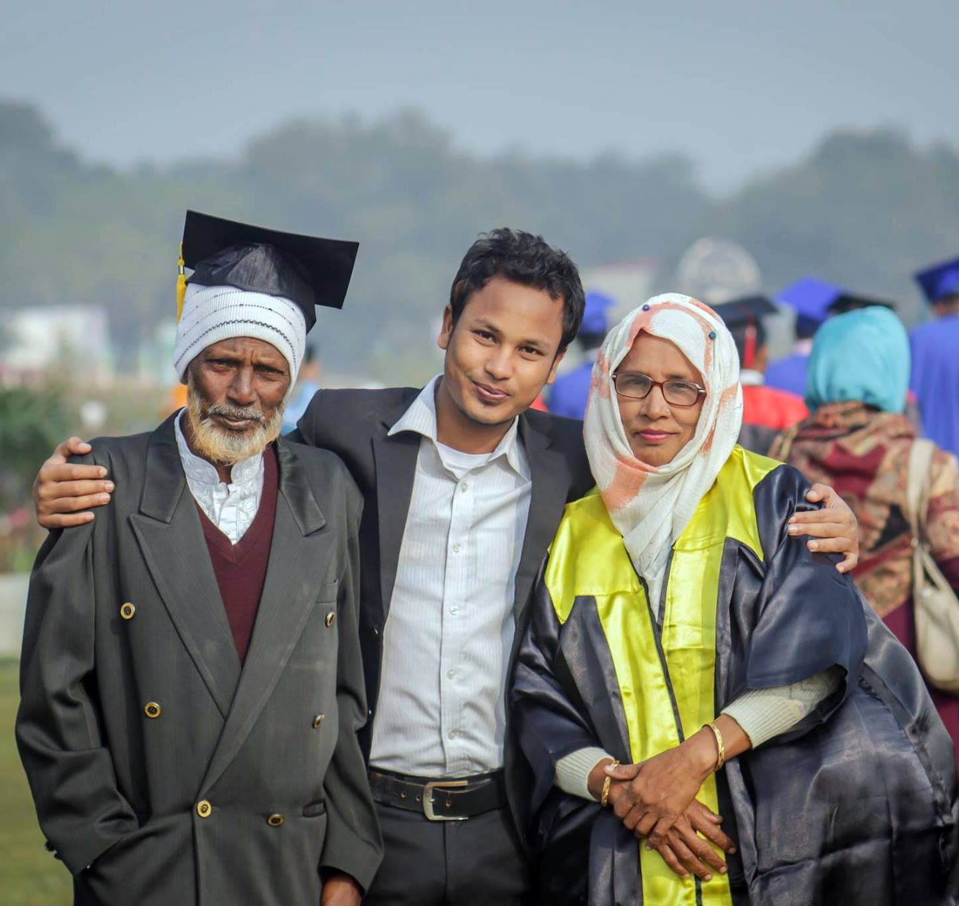
YOU ARE THE PRIDE
of
YOUR PARENTS

Slide 4

NOW, ALL YOU NEED TO…

Slide 5


Slide 6


Slide 7
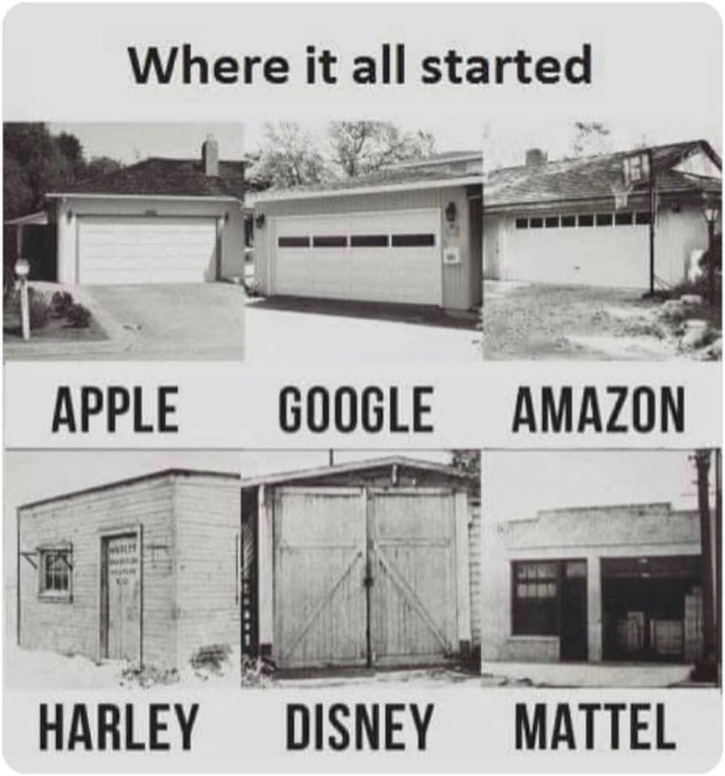
ALWAYS
FOLLOW
THE
EXAMPLES

Slide 8

EVERY HUMAN HAS UNIQUE IDENTITY

Slide 9


Slide 10
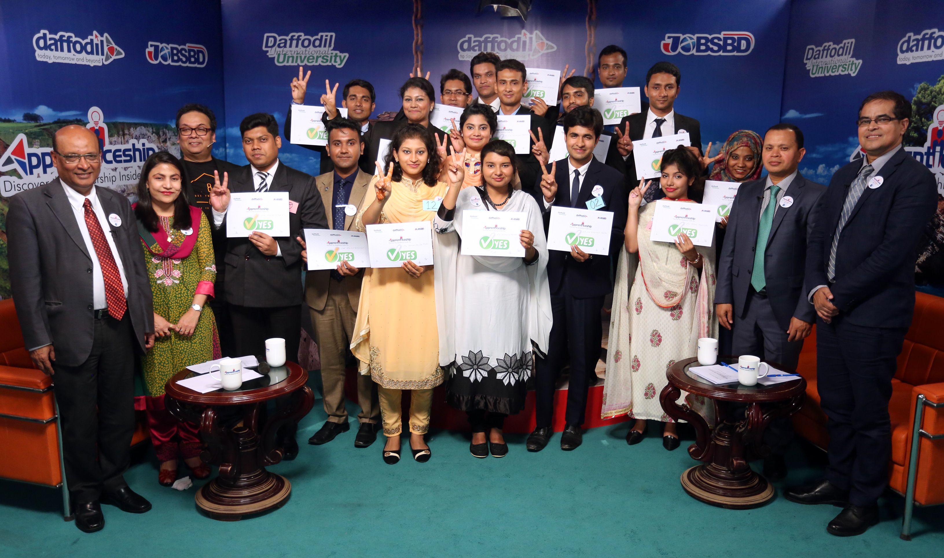


Slide 11

BE AN ENTREPRENEUR
& CREATE
EMPLOYMENT

Slide 12



HOW TO BE AN ENTREPRENEUR

Slide 13
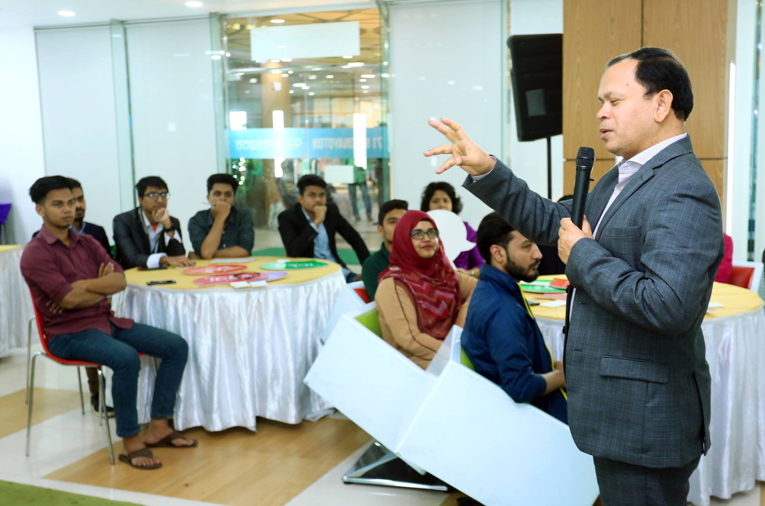
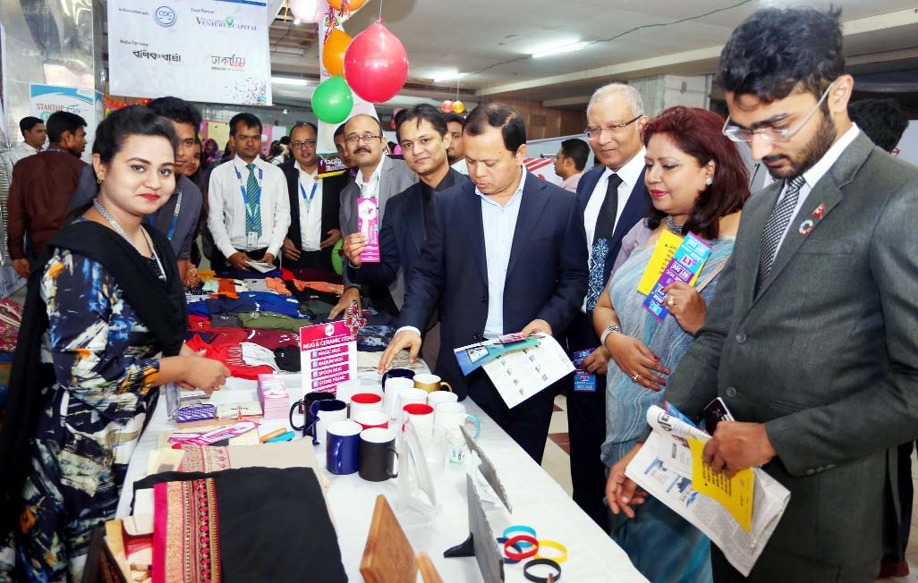
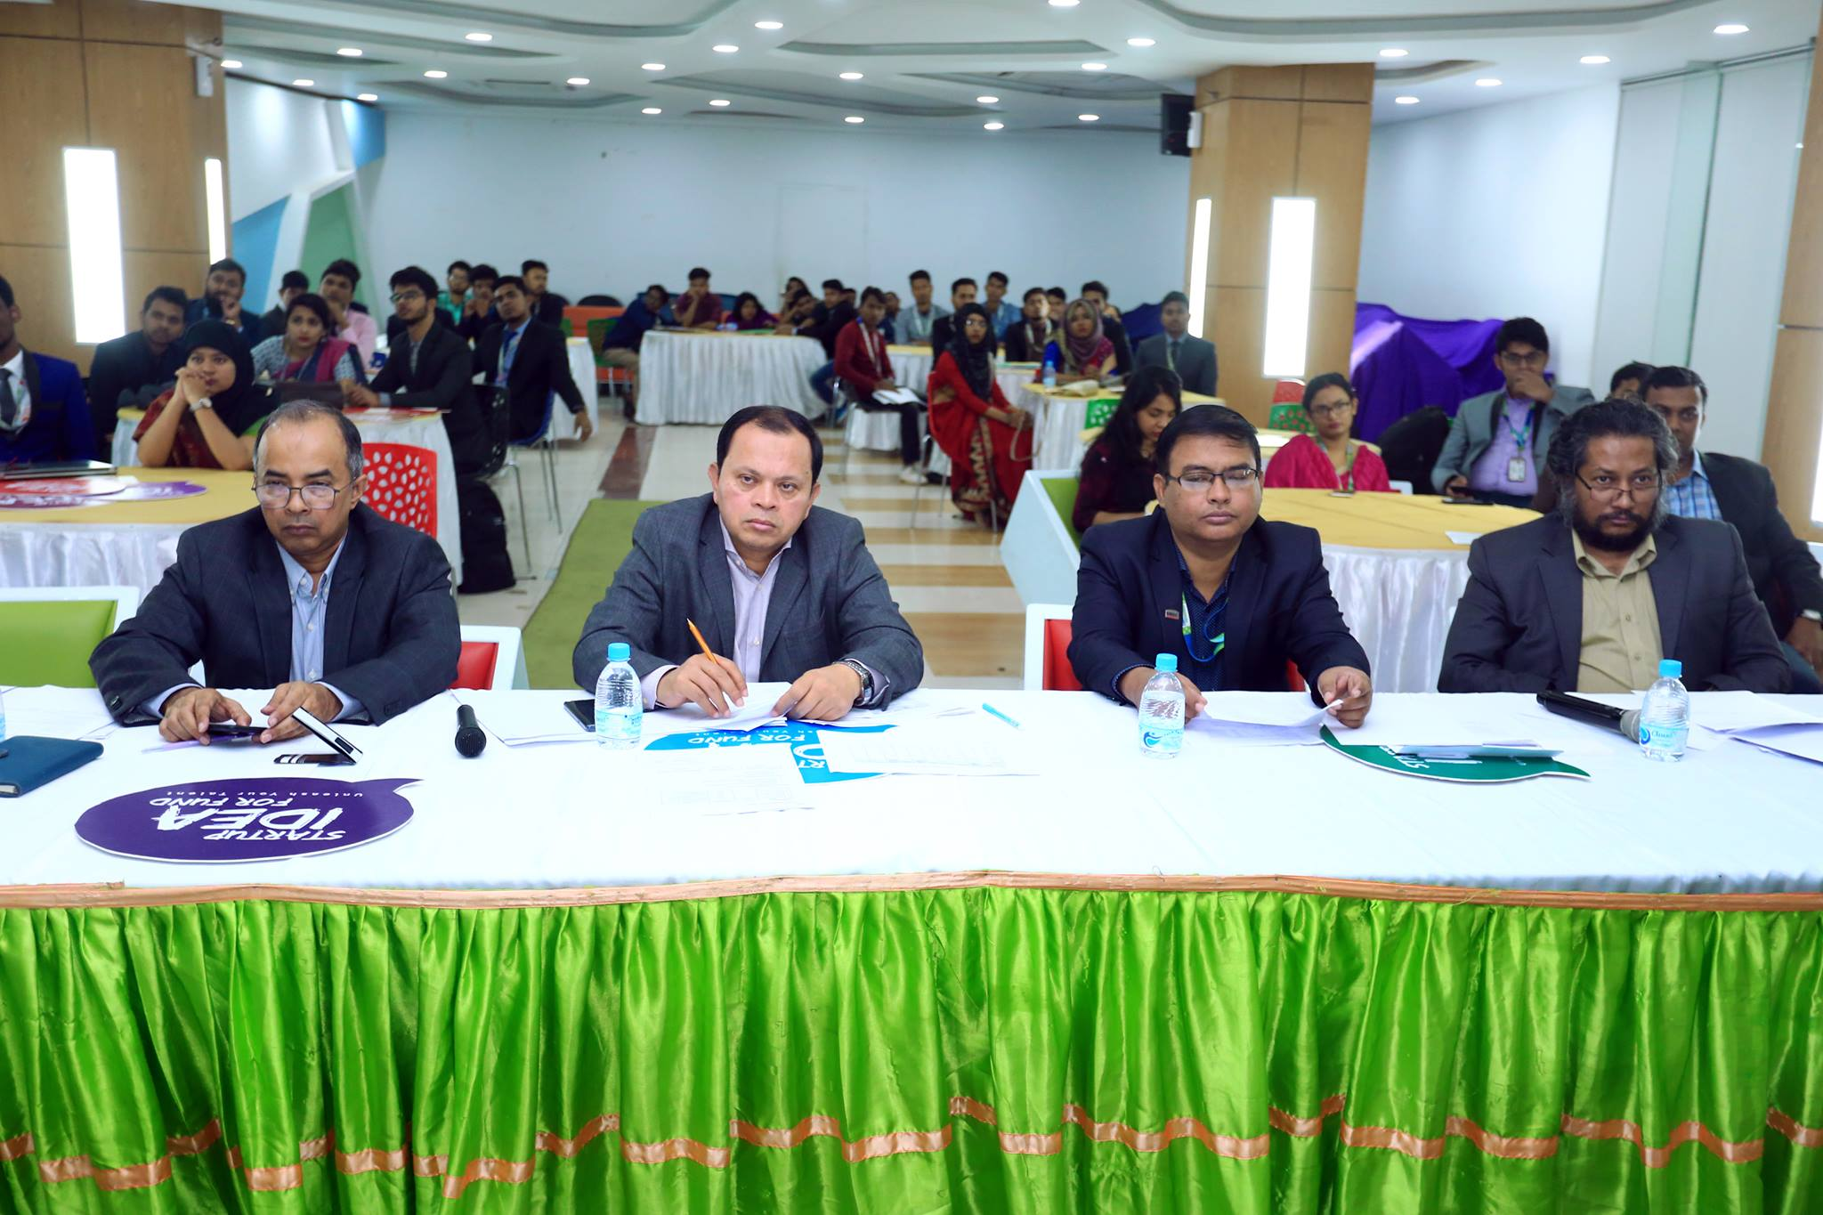
ENTREPRENEURSHIP DEVELOPMENT FUND (EDF)

Slide 14

Bangladesh Venture Capital Limited (BVCL)

Slide 15

Collect Your Copy: http://gg.gg/entrepreneurshipdiu

Slide 16
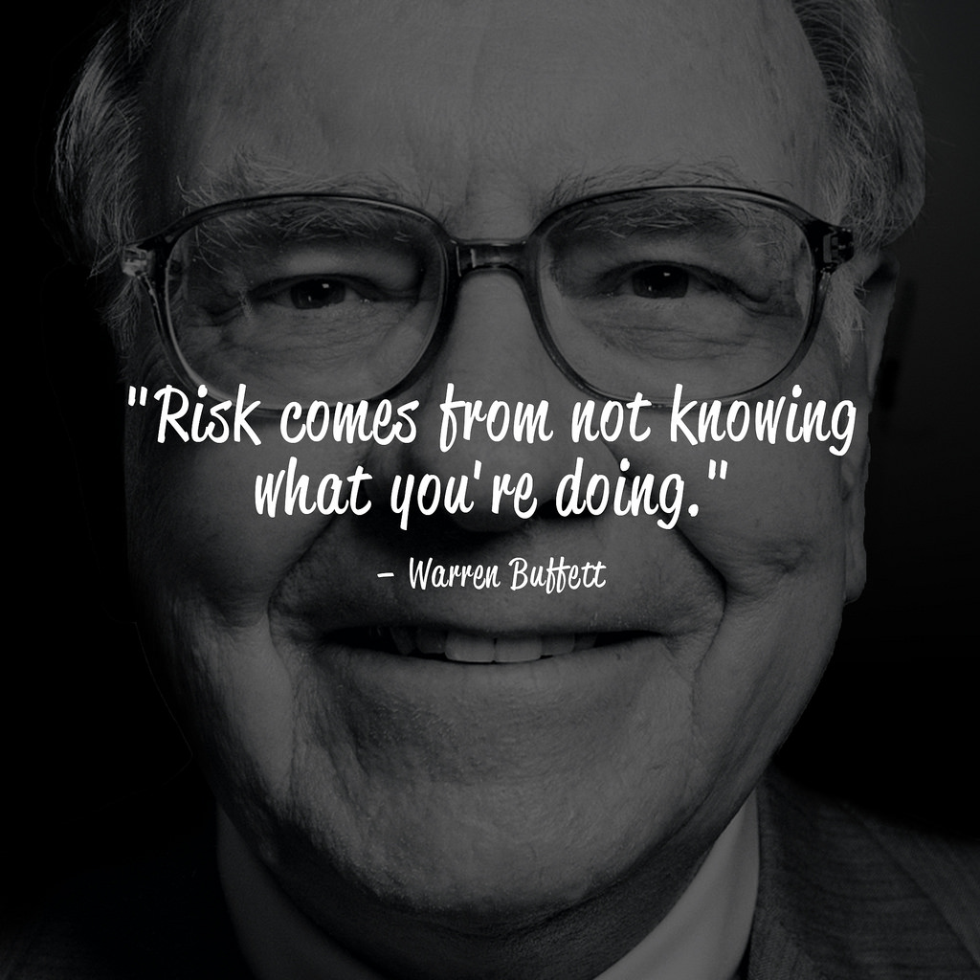
Warren Edward Buffett is an American business magnate, investor, speaker and philanthropist who serves as the chairman and CEO of Berkshire Hathaway. He is considered one of the most successful investors in the world and has a net worth of US$84.9 billion as of February 12, 2019, making him the third wealthiest person in the world
Source: https://www.cagrfunds.com/blog/learning-warren-buffet-letter-1/

Slide 17
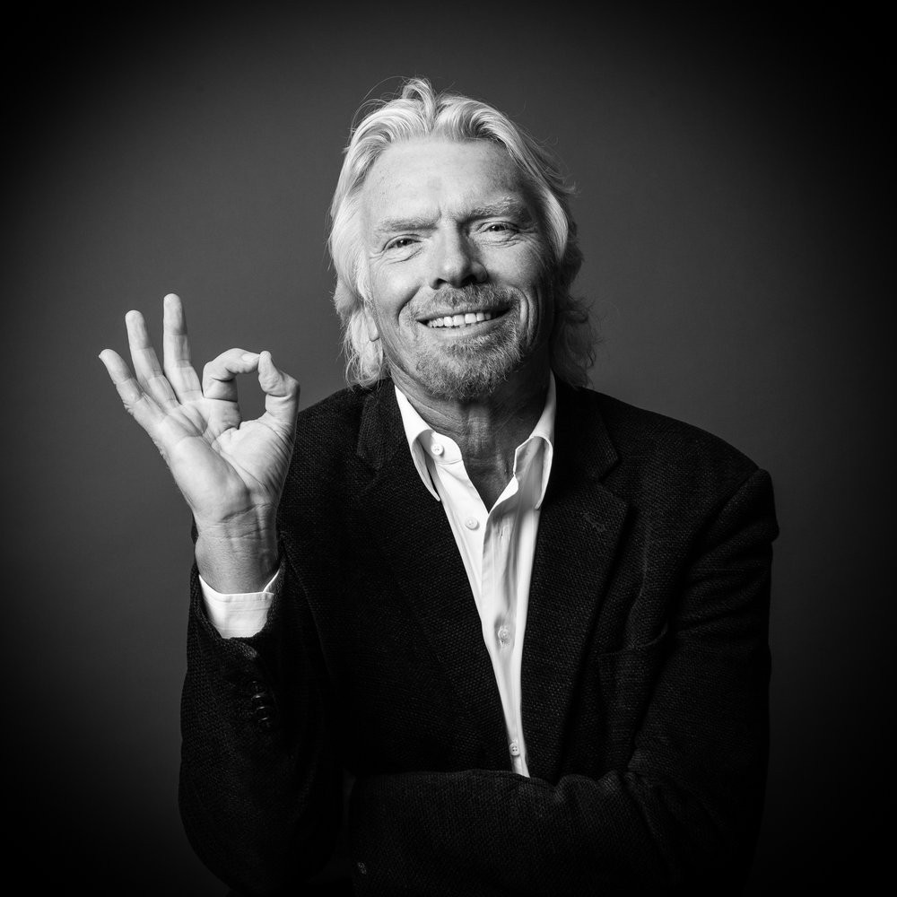
Richard Branson is an English business magnate, investor, author and philanthropist. He founded the Virgin Group, which controls more than 400 companies.
His first business venture, at the age of 16, was a magazine called Student. In 1970, he set up a mail-order record business. He opened a chain of record stores, Virgin Records later known as Virgin Megastores in 1972. Branson's Virgin brand grew rapidly during the 1980s, as he set up Virgin Atlantic airline & expanded the Virgin Records music label.
In June 2018, Forbes listed Branson's estimated net worth at US$5.1 billion.
Source: https://static1.squarespace.com/static/5705b523356fb026ac048e1a/t/57081a2559827ec1cb0fb6f7/1461352592670/

Slide 18
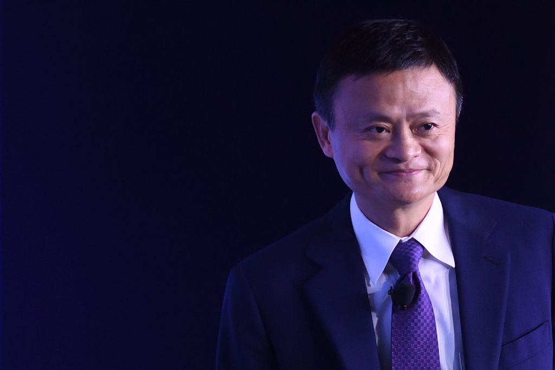
Jack Ma Yun is a Chinese business magnate, investor, and philanthropist. He is the co-founder and executive chairman of the Alibaba Group, a multinational technology conglomerate. as of January 2019, he is one of China's richest men with a net worth of US$36.2 billion, as well as one of the wealthiest people in the world
Ma resigned from the position of the CEO of Alibaba Group and reportedly decided to eventually resign as chairman to focus on philanthropy.
Source: https://thriveglobal.com/stories/jack-ma-davos-sleep-habits-key-success-emotional-intelligence-benefits//

Slide 19

Don’t Feel Handicapped, Take Challenge & Win!
“
When You Feel Like Giving Up Your Dream, Force Yourself To Work Another Day, Another Week, A Year. You’ll Be Amazed What happens When You Don’t Give Up.
”
- Nick Vujicic

Slide 20
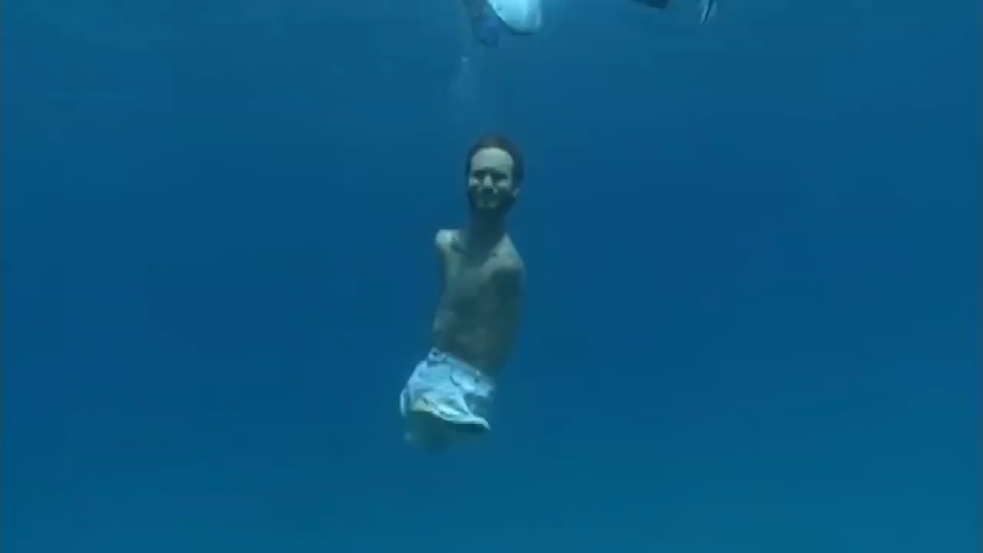
Born Without Arms & Legs - Nick Vujicic Inspires Millions of People
Source: https://www.youtube.com/watch?v=o9SE6IlYHp8

Slide 21

UPDATE & UPGRADE IN TECHNOLOGY

Slide 22
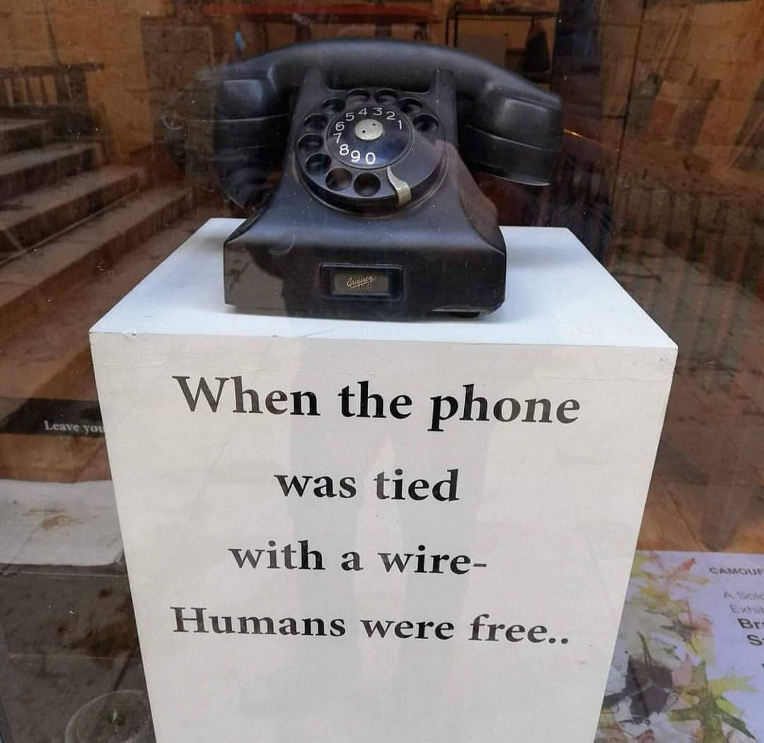
Don’t Become a Slave of Technology & Modernization

Slide 23


INCREASE YOUR PRODUCTIVITY

Slide 24
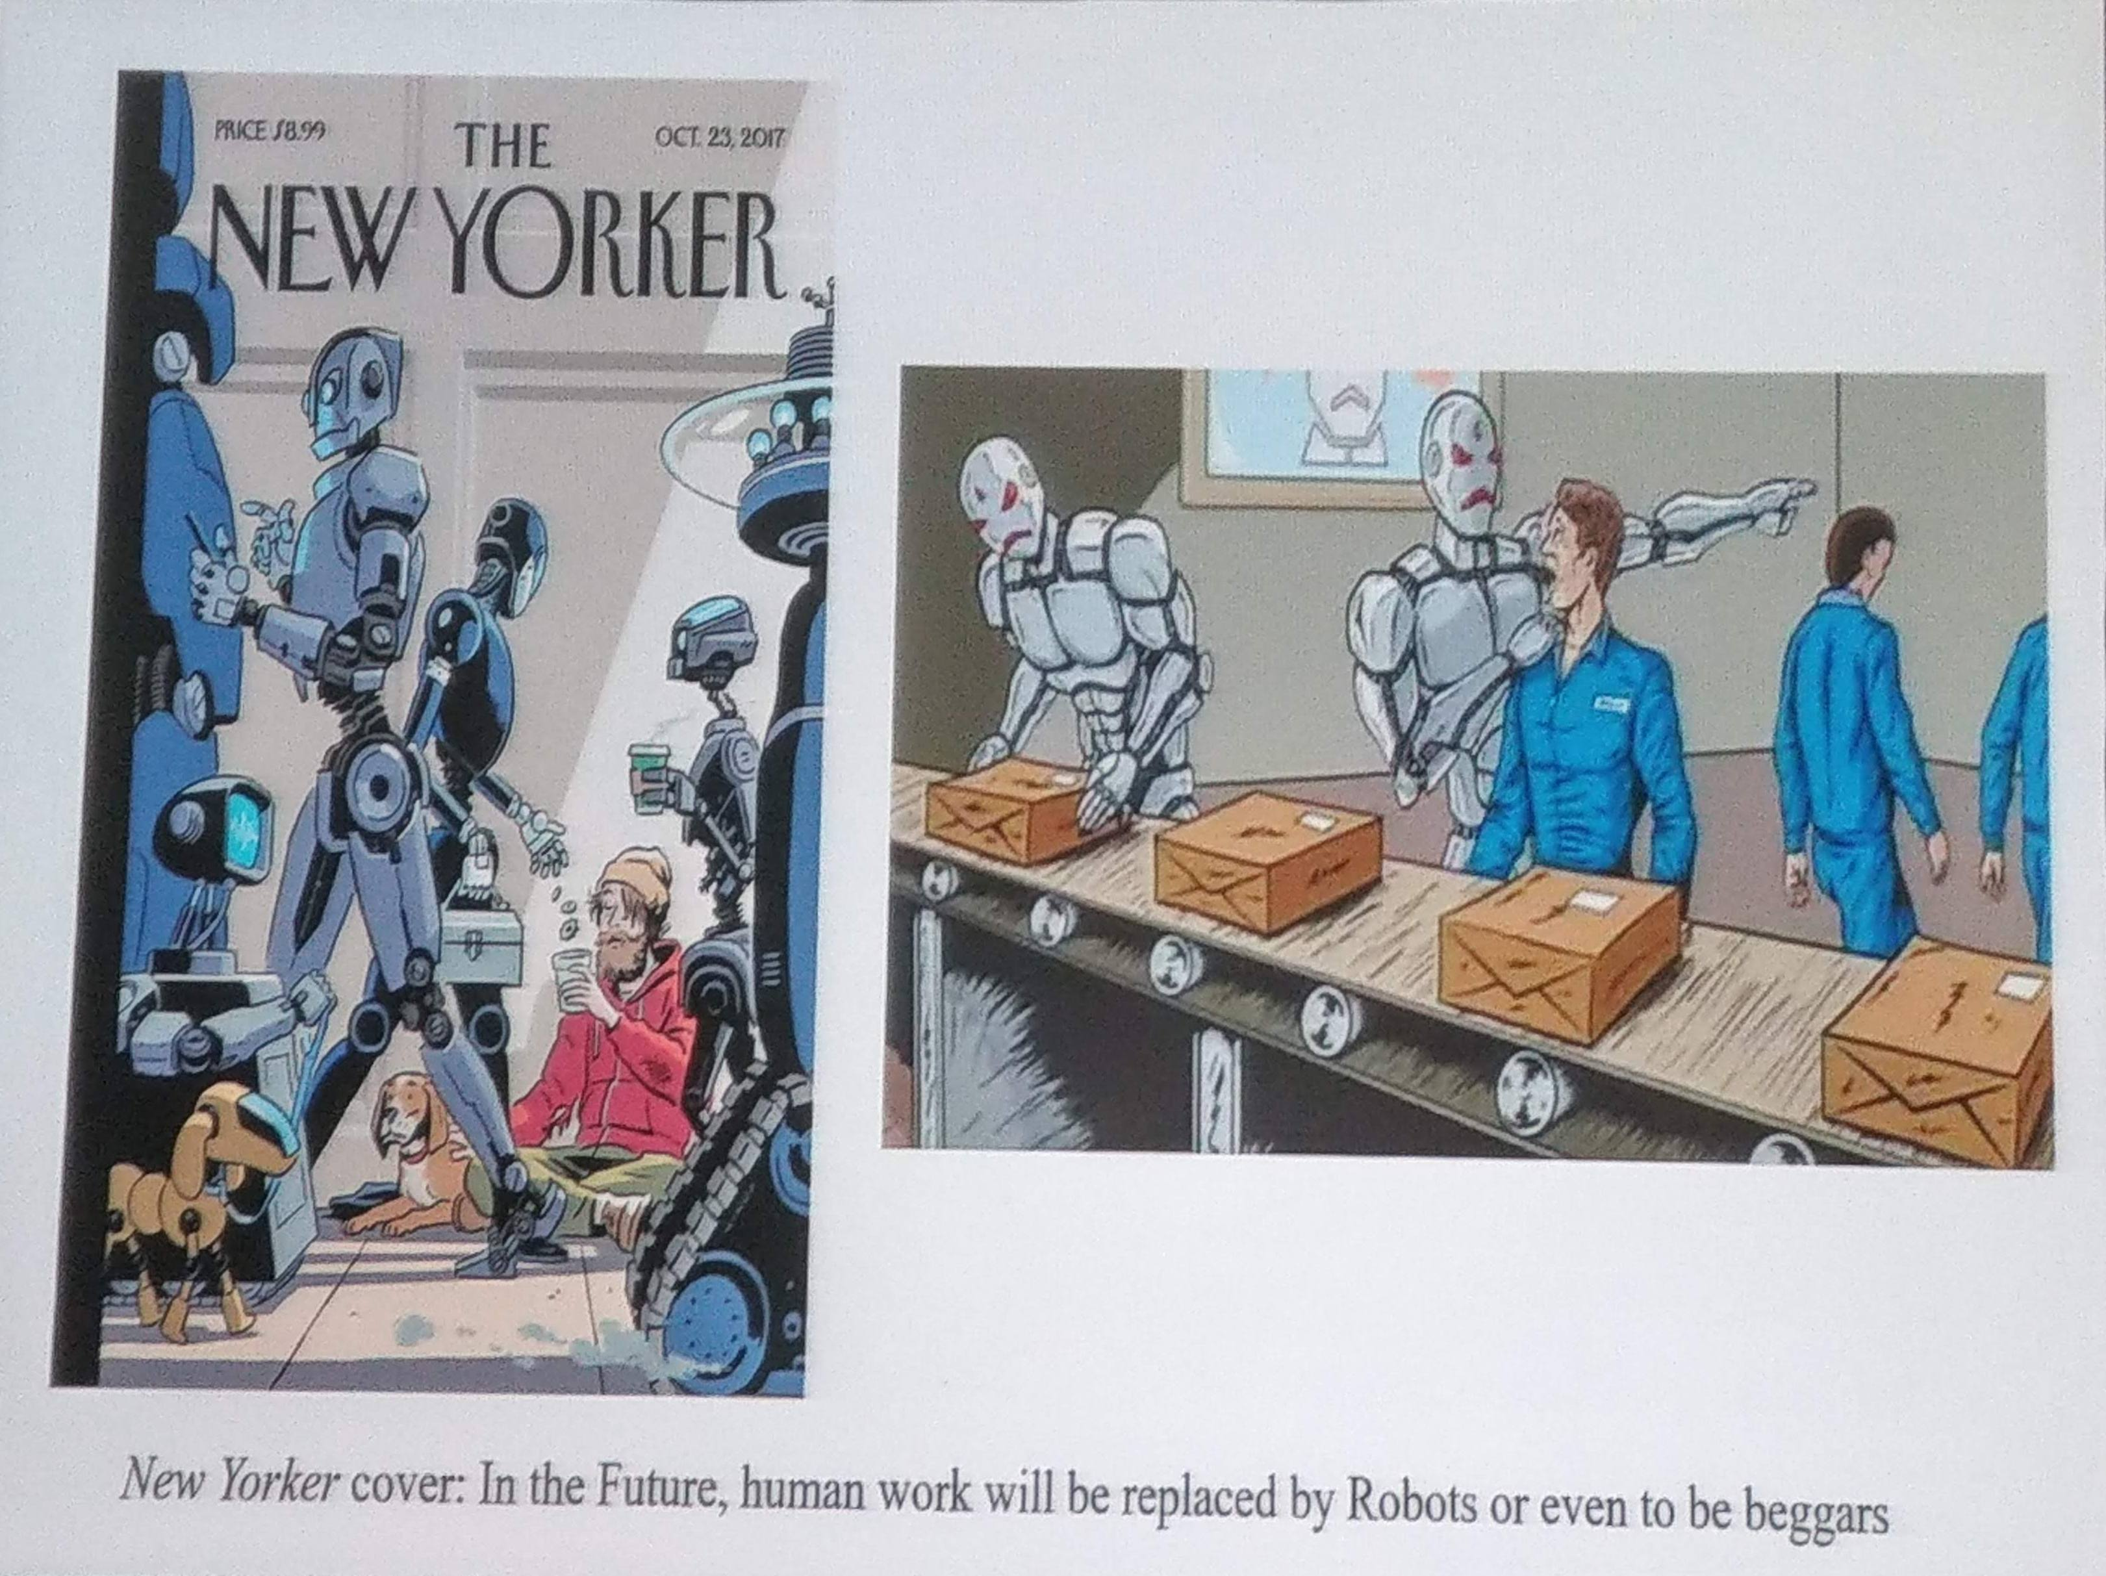
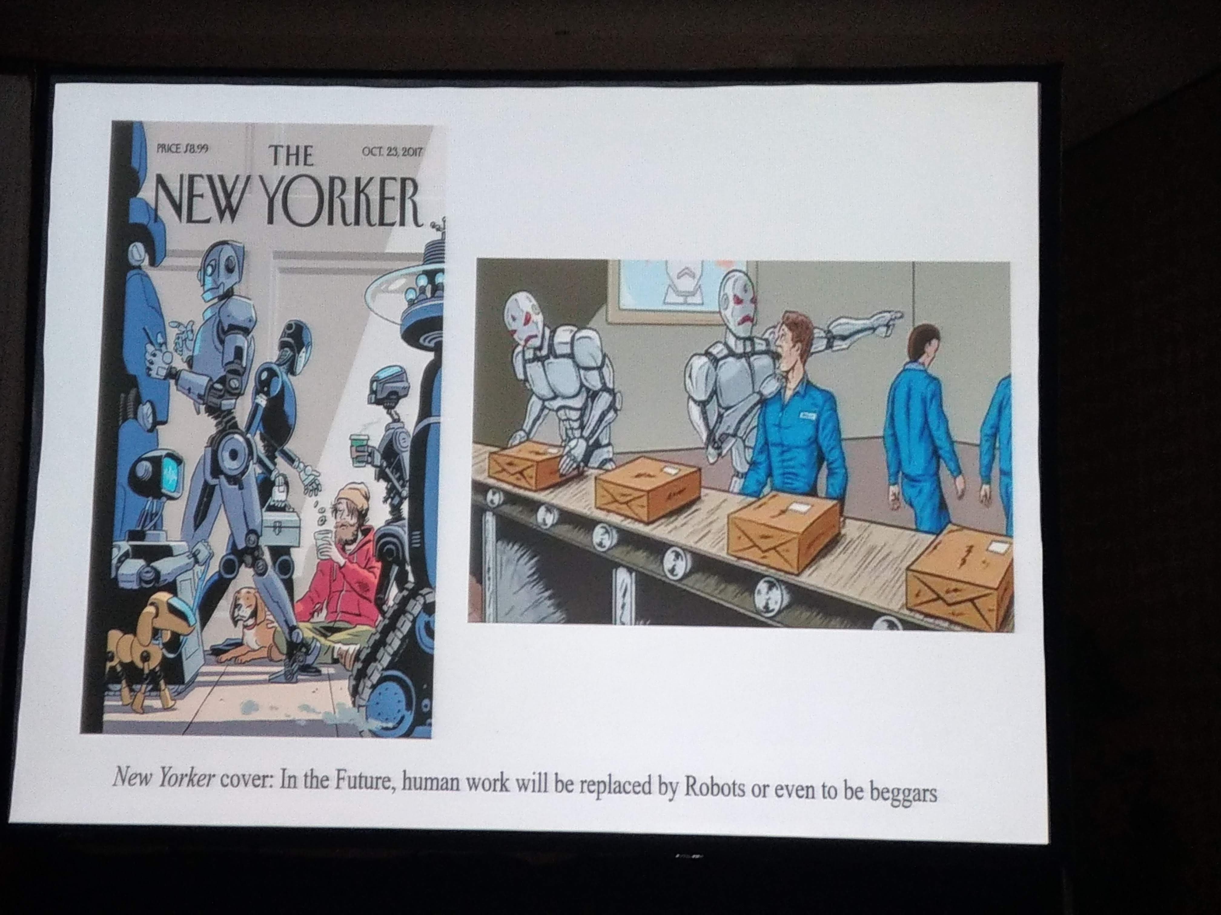
PREPARE FOR THE FUTURE

Slide 25

THANK YOU

