Slide 1


Venue: Auditorium 71, DIU
HR TRENDS & PRACTICES
In 21st Century
Dr. Md. Sabur Khan, Chairman, Daffodil Family
30/04/2018

Slide 2








THE TIME
FACTS
We are going through a time where multiple generation is at work and the time is moving even faster than ever before.
Today’s Human Resources are changing rapidly because of the changes in society, social trends, technology, global practices, changes in nature of families and individual nature, etc.
HR management, thus require a lot of changes and doing it requires tackling a lot of challenges especially for a country like Bangladesh.
SKILL GAPS
Industry development and human resource development is not moving at same pace resulting major skill gaps.
INNOVATION
Innovation is everywhere. With innovation comes changes which we need to adapt to sustain.

Slide 3
DATA & INSIGHTS
Who will be the Future Workforce?
FUTURE WORKFORCE
46%
46% of Gen X and Millenials will become about 100% of the future workforce.
40%
34%
12%
10%
WILL NOT BE IN WORK
50%
50% of the present workforce will not longer be in any job.
TRADITIONALISTS
BABY BOOMERS
GEN X
MILLENIALS
Born < 1946
Loyal
Same Company
Born 1946-1963
Live to Work
Born 1964-1979
Work to Live
Born 1980-1995
Own Career, Meaningful Work

Slide 4

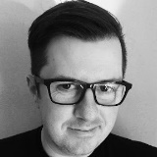
Work Rules by Laslo Bock Summary by Readitfor.me

Slide 5

Manager of Employee Employment
Director of Learning
Responsible for bridging virtual and in-person training sessions and exercises; produce content that will be consumed by program participants; champion the program across the organization;
An Employee Engagement Manager will not only manage the technology required to communicate across the company, but will also craft the approach to internal engagement.
NEW HR ROLES
Diversity Officer
Mindset Coach
Responsible for ensuring that the workforce is made up of talented individuals from many walks of life and craft inclusion training programs that will foster understanding between many different types of people and teams.
Responsible for devising interactive ways to encourage participation and openness across the workforce and to facilitate work-life balance processes, stress management and therapy programs, and facilitating an open dialogue around mental health and illness.
Talent & Skills Manager
Responsible for navigating transformative trends in the talent marketplace, salary expectations, hot skillsets, and prospect track records that will be crucial to the competitive offers an organization may submit to potential prospects.
Source: www.forbes.com

Slide 6

By Monash Business School

Slide 7

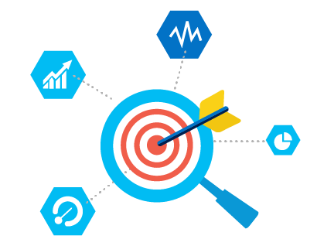
NEW HR APPROACHES
Strategic
Data Driven
Facilitate organizational goals and targets. Makes necessary decisions that drive the organization success and ensure organizational sustainability.
Makes sure that the resources are properly being utilized, talents are driven appropriately to facilitate organizational goals, sustain organizational growth.
Automation

Slide 8

Where We are Today?
?

Slide 9
Accountability Crisis
Lack of Process Up-gradation
Present
Scenario
Improper Documentation
Not Strategic
Lack of Automation
Lack of Data Analysis

Slide 10

Accountability
Human Resources Managers need to work for employee engagement which means to ensure that they have competence, commitment and contribution.
Ensure that the invest done on employees gets proper return by properly tracking their works, driving them systematically and maintaining proper discipline by guiding line managers/supervisors.

Slide 11

Documentation
Human Resources Management requires a lot of documentation. From creating necessary approval document to different forms, policies, procedure design, process flow etc. are part and parcel of Today’s HR Management. To say it more clearly, every process of HR must have documentation and should be included in the HR Policy Manual.

Slide 12

Automation
HR processes can sometimes be lengthy and involves a lot of Human Resources. Therefore, modern HR is adapting technology and process automation to minimize the time required for each process and the involvement of Human Resources in most clerical level activities.

Slide 13

Data Analysis
Today’s HR Management requires data analysis to take decisions so that the accuracy of those decisions increase. With technology it is possible to tap into a lot of data related to the employees of an organization. It can be related to organizational growth, employee growth, employee performance, financial statements, employee behavior, customer/stakeholder’s feedback, market trends, global aspects and trends etc.

Slide 14

Strategy
Strategic HR is the combination of performance culture and Measurement & Evaluation of leadership development, performance management, talent management, employee engagement, and succession planning.
HR Strategy
Performance Culture
Measure and Evaluate
Leadership Development
Performance Management
Talent Management
Employee Engagement
Succession Planning
Source: Aspector A/S

Slide 15

Up-gradation
HR managers need to continuously up grade the processes, procedures, plans, strategies according to the time demands, trends and best practices to ensure that both the organization and its employees sustain in the long run. These developments and up-gradation need to be properly tracked and maintained for further assessment and evaluation of the developments that are adapted.

Slide 16

ELEMENTS OF DIGITAL
HR TRANSFORMATION

Slide 17

Avoid Complication
On board all
Always start simple and small. Look at the areas of your HR processes that could do with a digital makeover
You need all the support you can get when it comes to HR Transformation.
B
C
Clear Goal
Before going off on a big transformational HR journey, first establish a clearly defined goal.
A
Prioritize ideas
Start with the ideas that are high impact and low effort.
D
F
E
Assess Performance
Culturing
need to critically assess what works and what doesn’t
Culturing throughout the organization is essential for a successful transformation
Source: www.digitalhrtech.com

Slide 18


By Jacob Morgan

Slide 19

“
Future Employees are those who are changing their behavior and mindset to adapt to the changing workforce no matter they are 22 or 62.

Slide 20

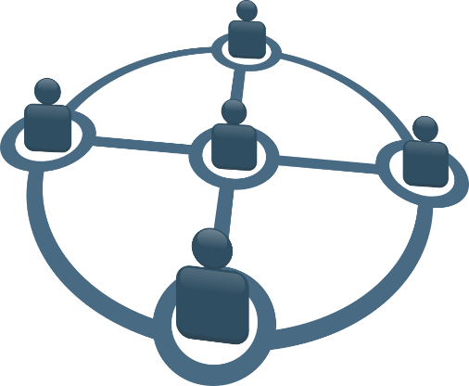

TRENDING HR TRANSFORMATIONS
Working Away from Office
Networked
Innovation on People & Culture
If you create great place to work, great work will happen.

Slide 21
?
THANKS!

