Slide 1


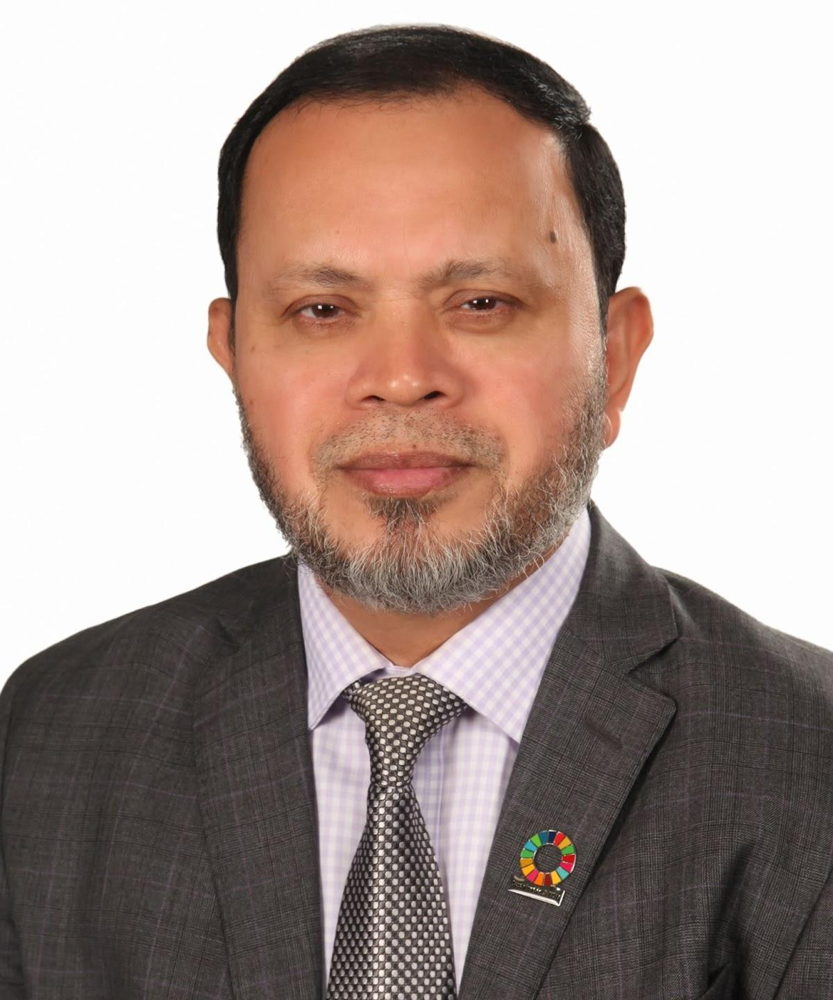




Bangladesh Blockchain Summit- 2022
How Leaders can Create Value in the Digital Age
Dr. Md. Sabur Khan
Chairman,
Daffodil International University & Daffodil Family

Slide 2

Creating a high performance environment where success is inevitable

Slide 3

Awakening possibility in people to deliver extraordinary results

Slide 4

Operating with boldness, simplicity and speed

Slide 5

Striving to be 100% Authentic

Slide 6

Inspiring Action

Slide 7

Creating
HIGH PERFORMANCE TEAMS

Slide 8

Unleashing INNOVATION

Slide 9

Continuous LEARNING AND DEVELOPMENT

Slide 10

RESEARCH
should be focused on
REAL-WORLD IMPACT.

Slide 11

Understand scenario with
Data and Analytics

Slide 12

Ensuring
SMART FUNDING
and
DIGITALISATION

Slide 13

Enable
Physital Education
for better teaching and learning

Slide 14

Support students in a more effective way both Mentally and Academically

Slide 15

Understand scenario with Data and Analytics

Slide 16

Update Curriculum and focusing on Outcome based Education

Slide 17


Slide 18
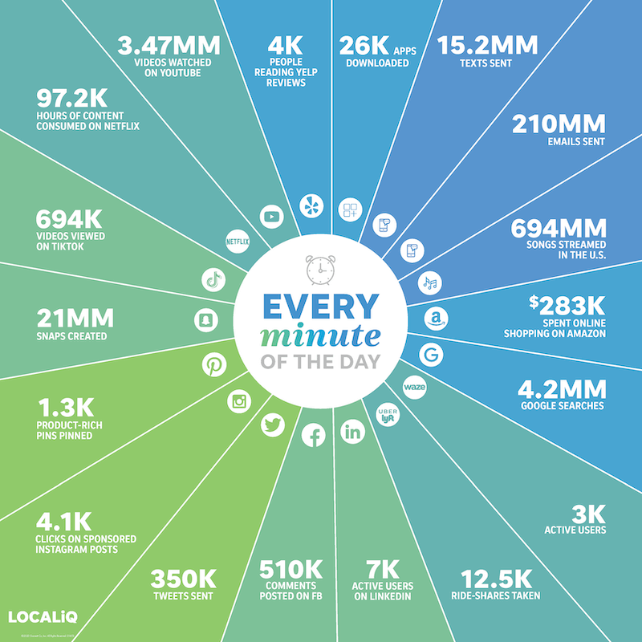
What happens online in
60 SECONDS
in
2021
?

Slide 19
THANKS
Do you have any questions?

