Slide 1



NEED to
Dr. Md. Sabur Khan, Chairman, BoT,
Daffodil International University & Daffodil Family

Slide 2
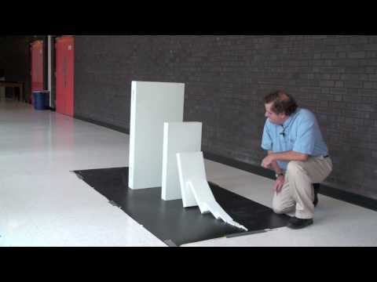

Domino Chain Reaction
(short version)
-
Stephen Morris

Slide 3


Let’s Start with some
SUCCESS and Failure
STORIES

Slide 4
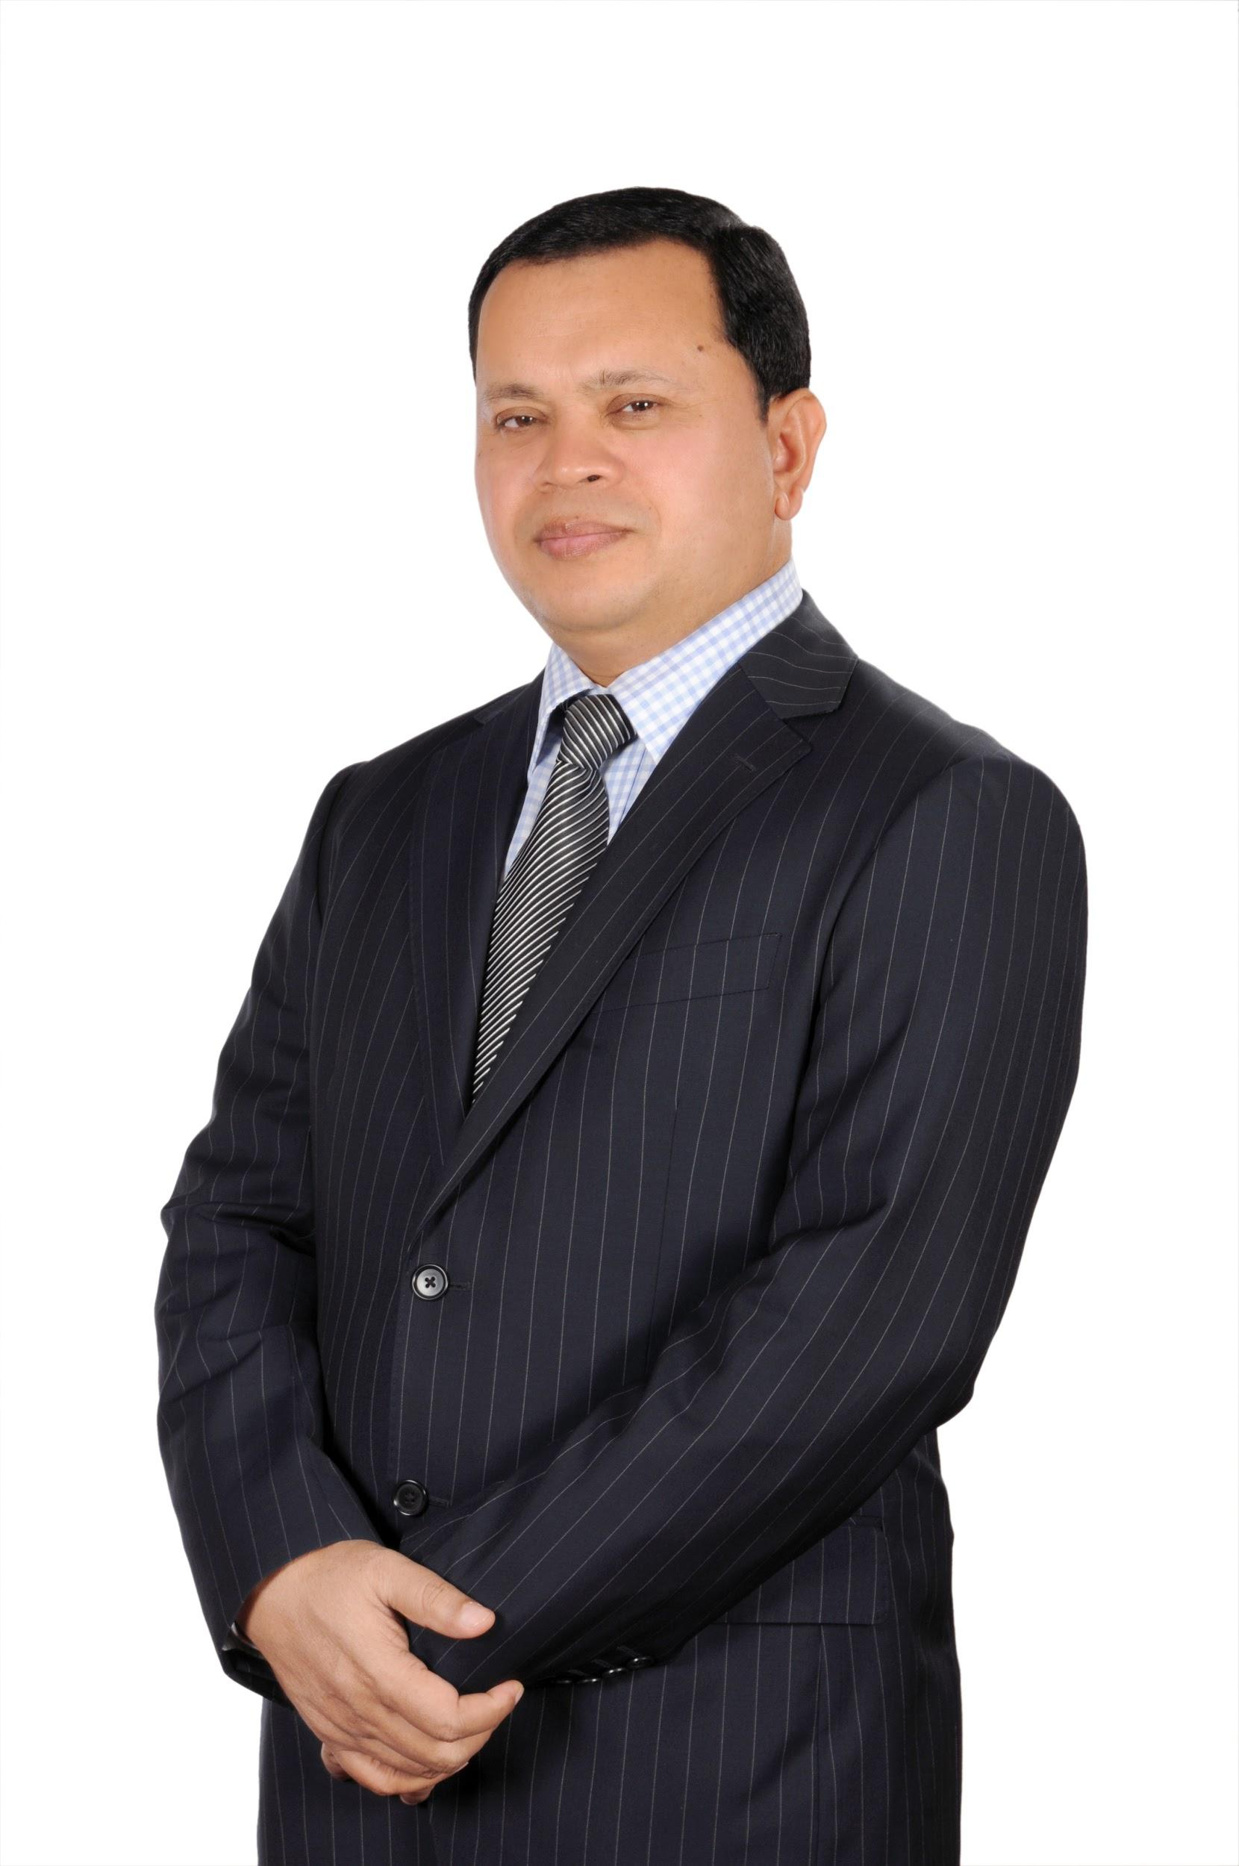

1990
Daffodil Computers Ltd
1st public listed IT company

Slide 5
1991
Started to sale COMPUTER ACCESSORIES and
operate as desktop publishers

Slide 6
1992
Started
IMPORTING
various spare parts and PC

Slide 7
1993
Started assembling
CDCOM clone PC with imported parts from Singapore and Taiwan. The idea earned huge popularity in clone PC marketing

Slide 8
1994
Entered to
Government & Corporate market
for
IT product and solution

Slide 9
1995
Instigated the
SUPERSTORE IDEA
for the first time in Bangladesh

Slide 10
1996
Started to represent Internationally reputed brands like
HP Intel, Microsoft, Ingram Micro, Dr. Solomon Antivirus (which is now NAI), and Quantum

Slide 11
1997
Set up Daffodil Institute of IT (DIIT) with affiliation of NCC
DCL got registered with Joint Stock Company as Limited Company

Slide 12
1998
Set up of
Computer Clinic
DCL started in Sylhet and Khulna Division
DCL -sole distributor of FIC, Mitsumi, Chintax, APC brands, etc.
Became partner of Ingram Micro South Asia

Slide 13
1999
Introduced
FIRST LOCAL BRAND PC from
DCL in the name
“DaffodilPC”

Slide 14
2000
First Job Portal www.jobsbd.com emerged
Daffodil Web & E-commerce launched
First ISP www.daffodilonline.com was established
DCL is appointed as HP authorized service provider
DIIT started in Chittagong & got National University approval
DCL became the sole distributor of GIS (Geographic Information System) products

Slide 15
2001
DCL incorporated Daffodil Software Ltd
Established Daffodil Multimedia
Published 1st Digital Magazine of Bangladesh Digibangla
Elected as President of Prime IT Association, “Bangladesh Computer Samity (BCS)” for 2002-03

Slide 16
2002
Daffodil International University
got approval of the Ministry of Education under Private University Act of 1992
Chairman of Bangladesh Computer Samity (BCS) from 2002 to 2003

Slide 17
2003
Established
Daffodil International College
to ensure quality
education at
college level

Slide 18
2004
DIPTI was established
Daffodil took the ownership of “Technokids” and now it is running as “MyeKids.”
Daffodil and Grameen jointly formed DGITEL

Slide 19
2005
BSDI initiated a full free scholarship project with NTV for underprivileged women in Bangladesh where 500 women have been trained job skill and employed

Slide 20
2006
Started joint venture with popular Malaysian job portal, Jobstreet.com
Established a new venture JS e-Recruitment Limited in Bangladesh

Slide 21
2007
Started joint collaboration with the prominent software company “Britesoft” of Malaysia
Started Sprout International School (English medium) which is now merged with DIS Chandpur

Slide 22
2008
Daffodil owned
“Dolphin Computers Limited”,
a leading company of
country’s IT sector

Slide 23
2009
Daffodil International School (DIS)
was established with the Chain School concept, with a plan to set up branches in 64 districts of Bangladesh

Slide 24
2010
DIIT Chittagong campus got approval as a Polytechnic institute
BSDI achieved affiliation from Bangladesh Technical Education Board (BTEB)
DIPTI achieved affiliation from U&I Alliance, University of Dhaka
DIS got affiliated with My e-Kids and Computer Learning Centre for Kids

Slide 25
2011
ASOCIO team headed by its Chairman visited Chairman of DIU at his Office
Attended 10th Asian University Presidents’ Forum (AUPF)-2011

Slide 26
2012
DIPTI established a new 6 storied building as main campus at Panthapath, Kalabagan
Elected as the President of Dhaka Chamber of Commerce and Industries(DCCI)
“Art of Living (AOL)” was introduced in DIU and a book was also published

Slide 27
2013
Three new members added in Daffodil Group
DIIT launched new campus at Uttara
Premiere International College started
Set up new venture “Daffodil Japan Institute of Technology (DJIT)
Daffodil Group Malaysia started its operation in Malaysia
First book Unveiled- ”Handbook of Entrepreneurship Development”
admission.ac has started
DIU Permanent campus started
BSDI set campus in Chandpur
Initiated E2K project for creating 2000 new entrepreneurs (DCCI)

Slide 28
2014
Started a restaurant cum convention center
Started Bangladesh Venture Capital Limited
First Business Incubator setup
‘Handbook of Entrepreneurship Development (Bangla)’ published
Bangladesh Business Angel Network (BBAN) formed and Chairman, Daffodil Group was elected as the president
Inhouse Multimedia College, Malaysia

Slide 29






















Slide 30
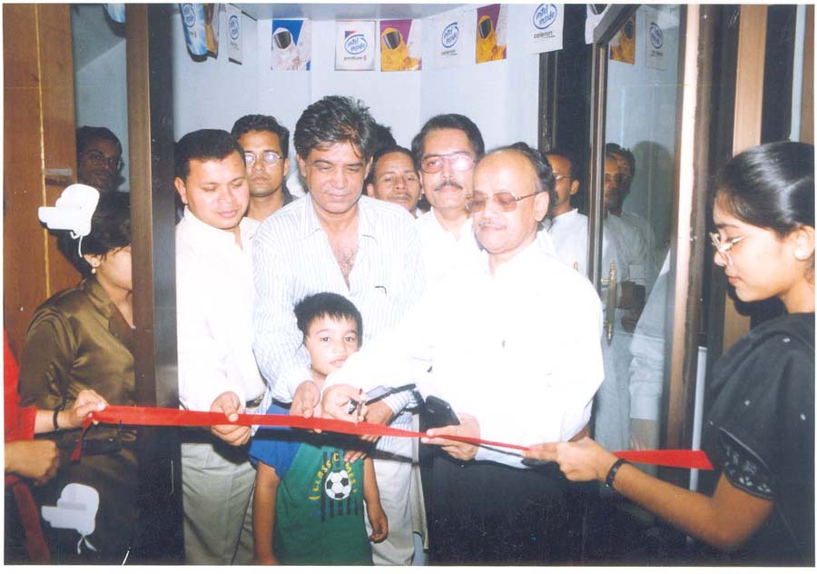
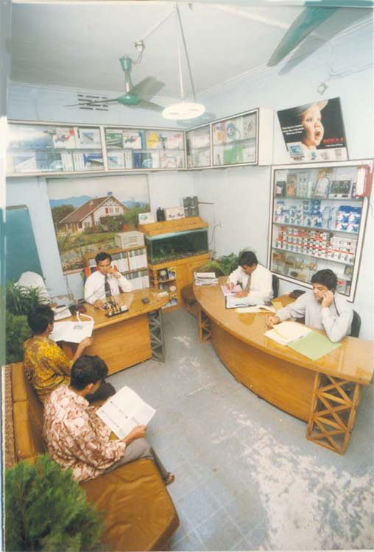
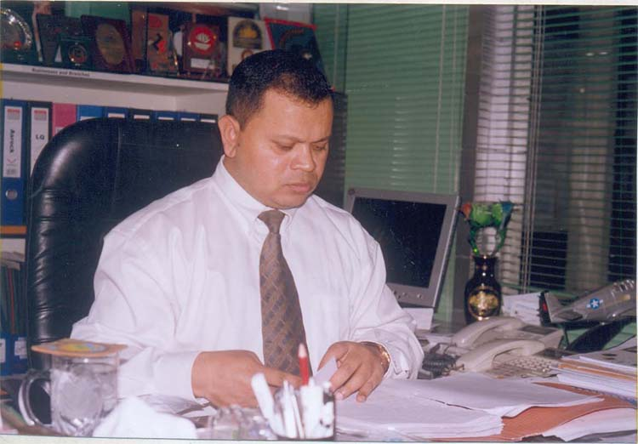
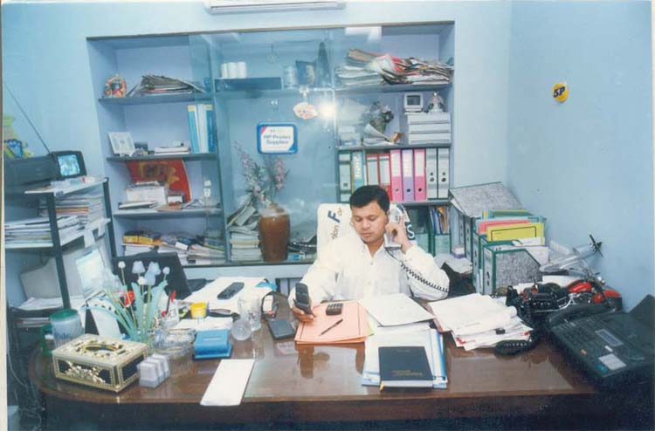
M
E
M
O
R
Y

Slide 31
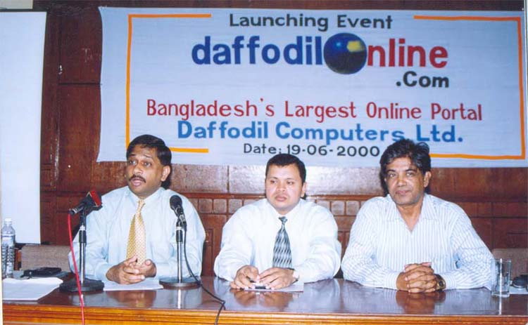
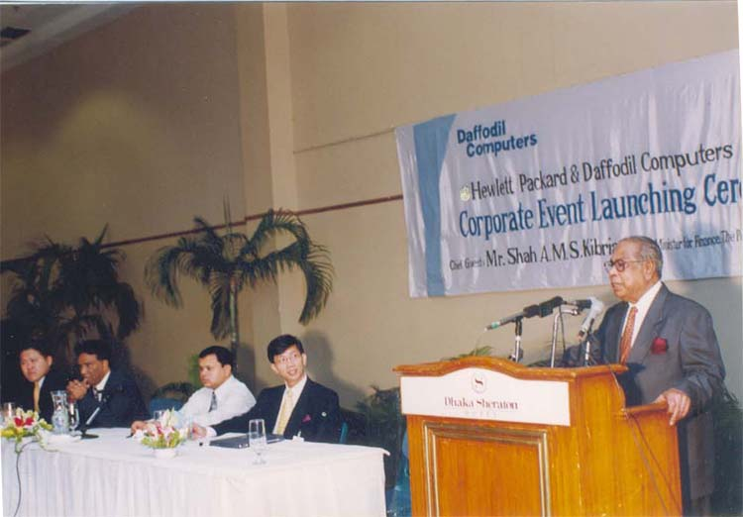
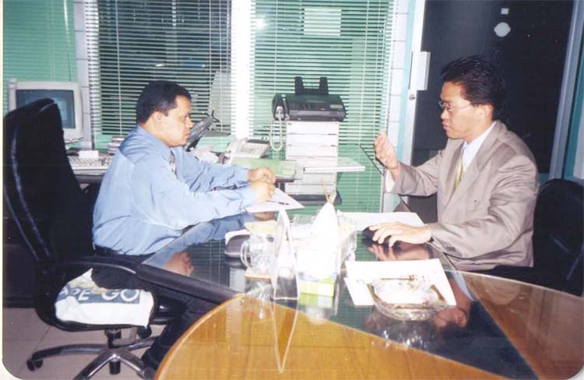
M
E
M
O
R
Y

Slide 32
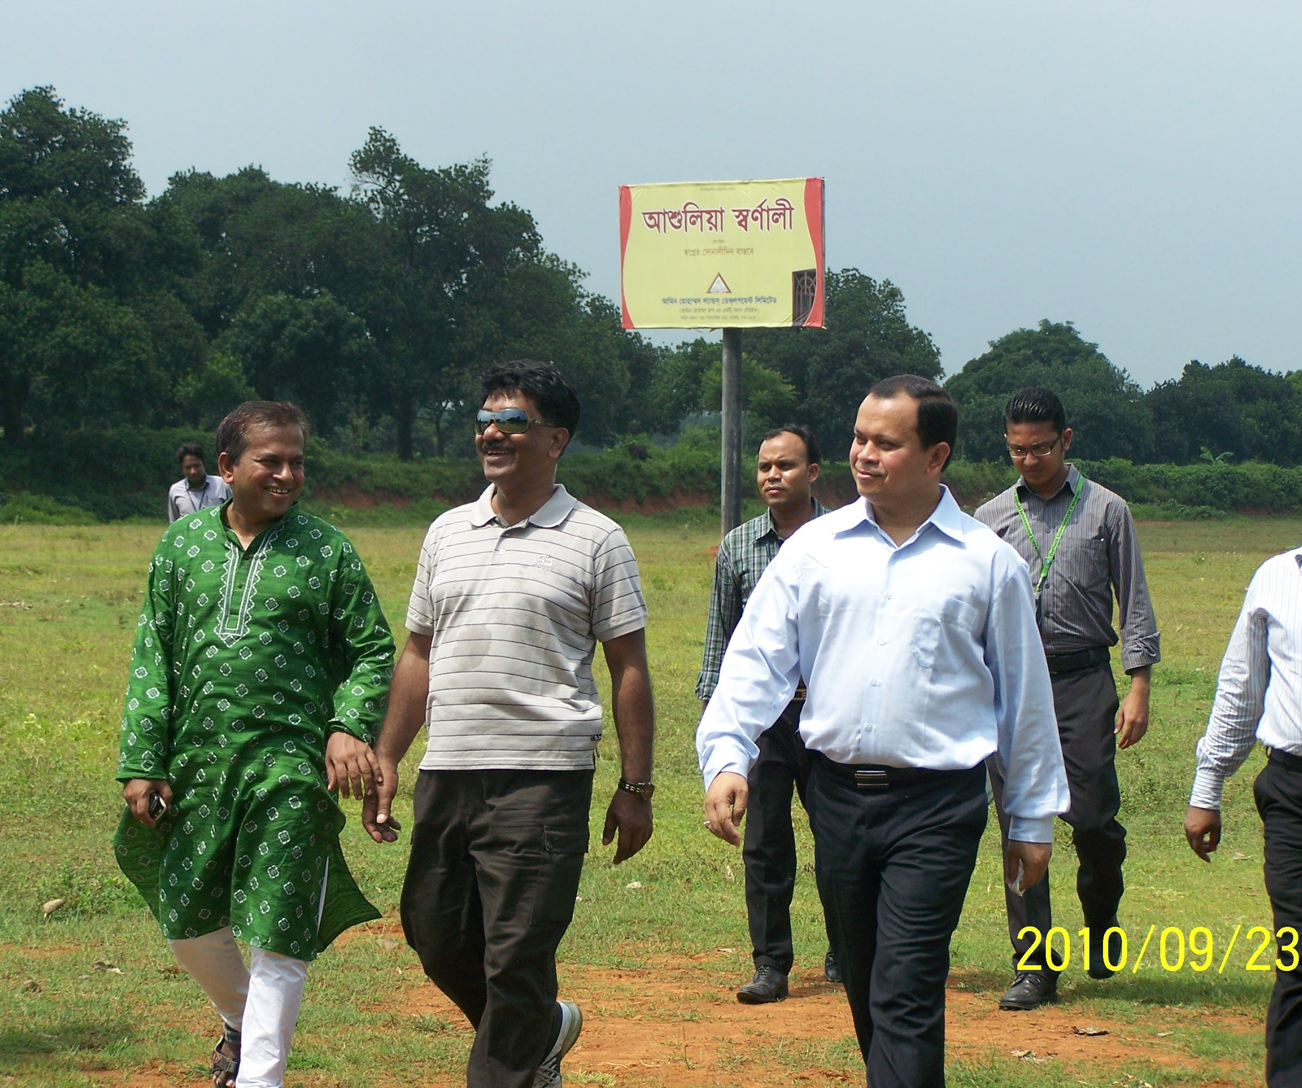
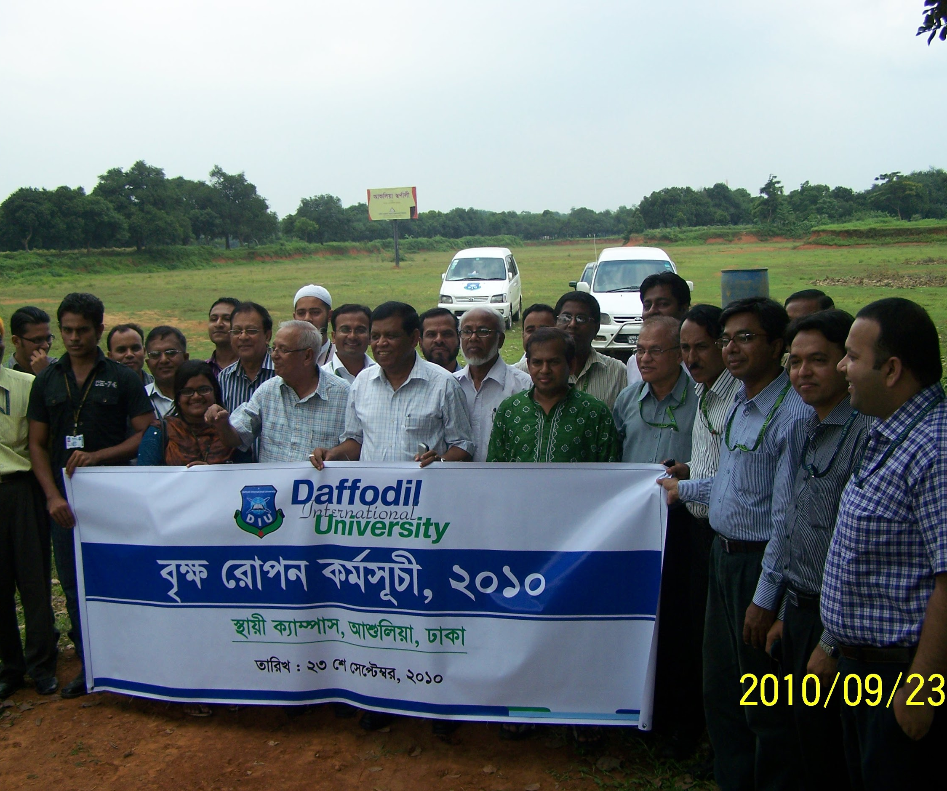

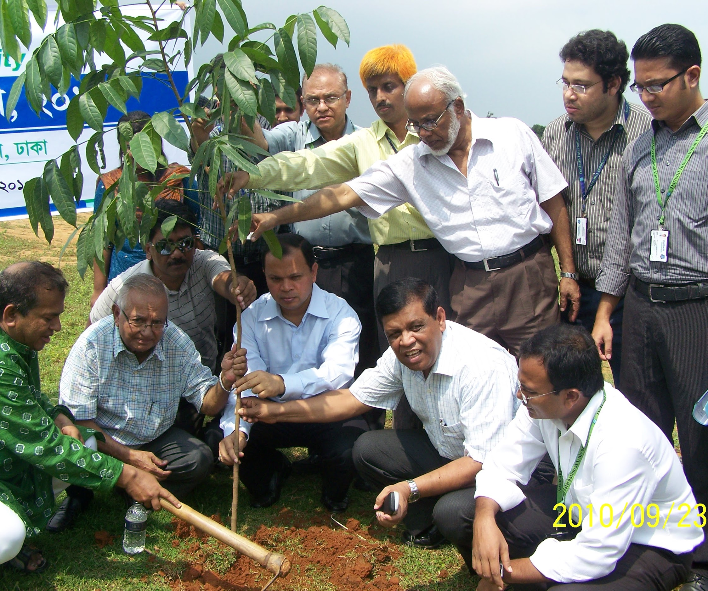
Do
you know this place?

Slide 33
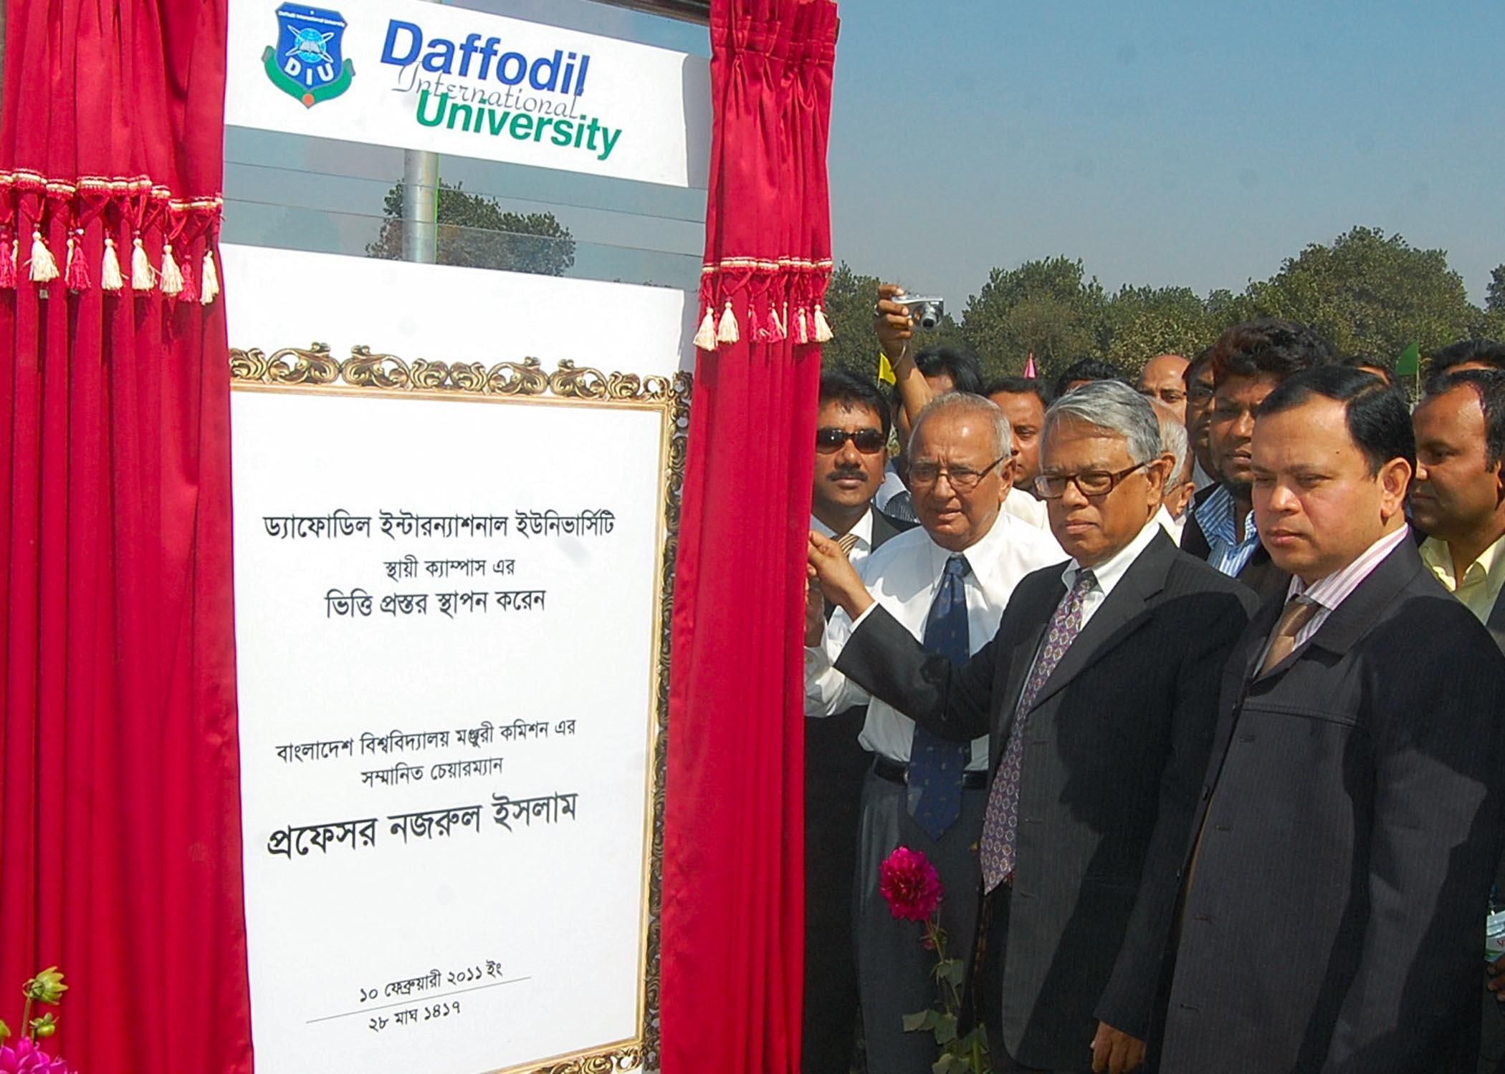

Slide 34

Do you know this place?

Slide 35
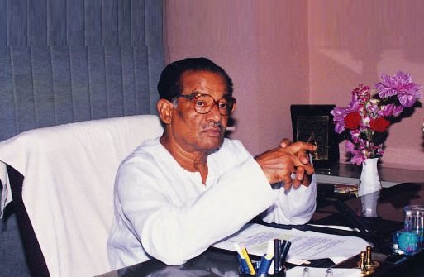

Sk. Akij Uddin
Founder,
Akij Group
Image by Ad-din

Slide 36

MOTHER

Slide 37


Baby Steps
Notes:
Ref: http://www.positive-focus.com/baby-steps-2/

Slide 38

1971

Slide 39

1952 Bengali Language Movement

Slide 40

GOD
made each of us
UNIQUE MASTERPIECES

Slide 41

Born Without Arms and Legs - Nick Vujicic Inspires Millions of People

Slide 42

A stitch in time saves nine
সময়ের এক ফোঁড় অসময়ের দশ ফোঁড়

Slide 43
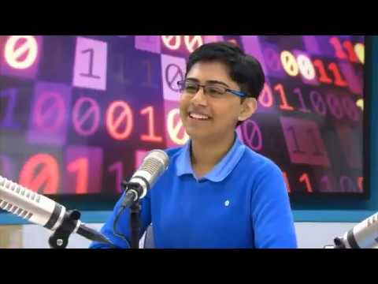

Slide 44


Slide 45

“If opportunity doesn’t knock, build a door”
-Milton Berle

Slide 46


Slide 47

What consumes your time?
How do you spend your money?
Why do you fear when other people Judges you?
When your heart beats fast?

Slide 48

Explore your SKILL

Slide 49


Slide 50


Are YOU ready to START?

Slide 51

QUESTION AND ANSWER

Slide 52

TAKEAWAY!

Slide 53
THANK YOU!

