Slide 1
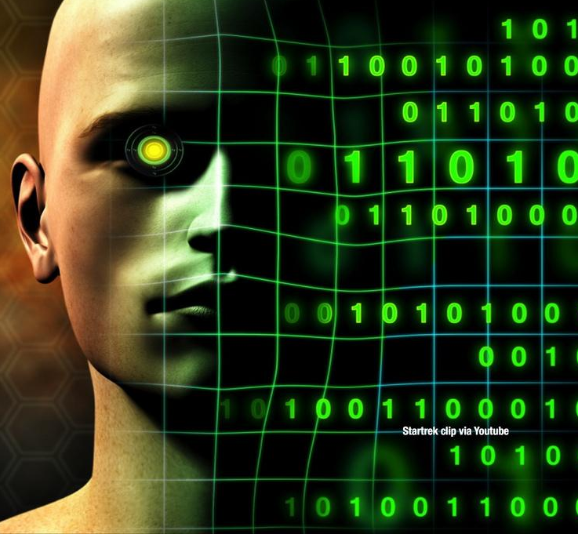

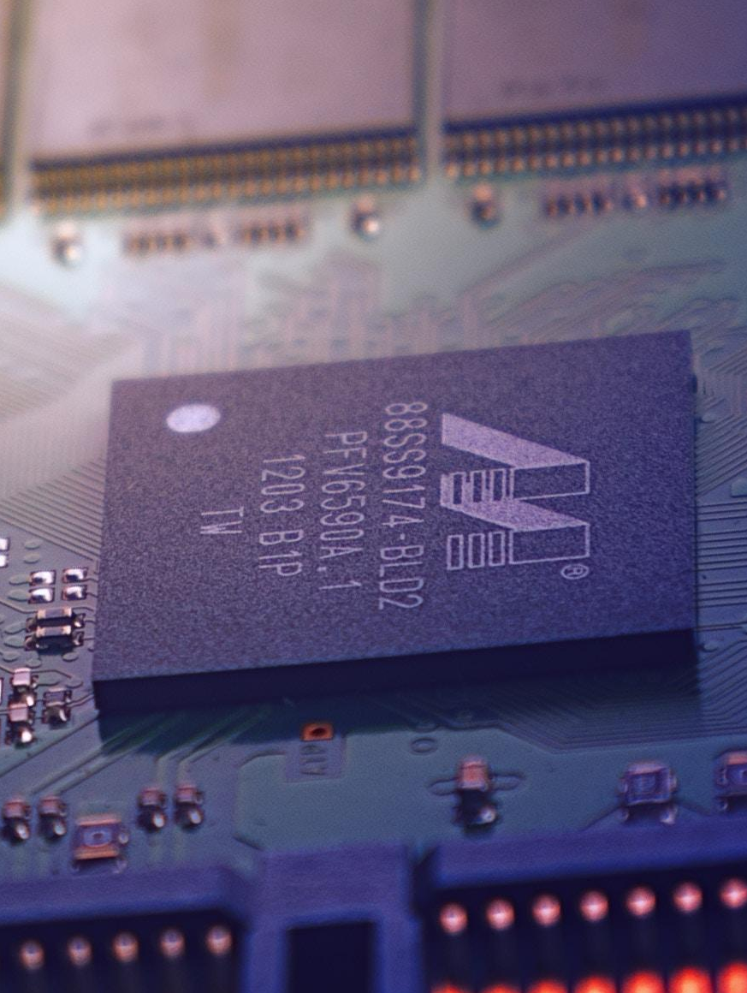


Smart Learner & Digitization
Dr. Md. Sabur Khan, Chairman, BoT,
Daffodil International University

Slide 2

Are YOU
READY
for the FUTURE?

Slide 3
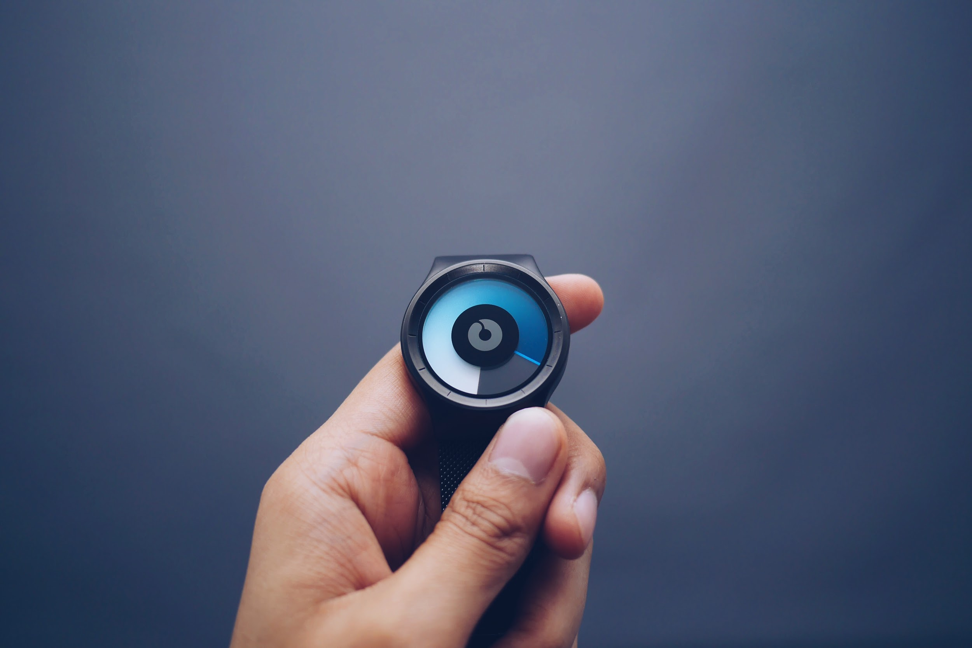
PRESENT
SCENARIO

Slide 4


BANGLADESH
JOB MARKET STATUS

Slide 5



Recently Took interview of about 100+ candidates at Jobsbd in Marketing & Salesman Positions where about -
60% students applied from CSE
20% ETE & EEE and
20% from others

Slide 6


Asked CSE people!!!
Why you guys applied in Marketing & Sales

Slide 7

Boost up
your Sales by using MODERN MARKETING TOOLS

Slide 8




Slide 9

Job Markets & Employability
are being changed

Slide 10



Software
Farms
are not doing good

Slide 11

Lack of Practical
and Experimental Knowledge

Slide 12

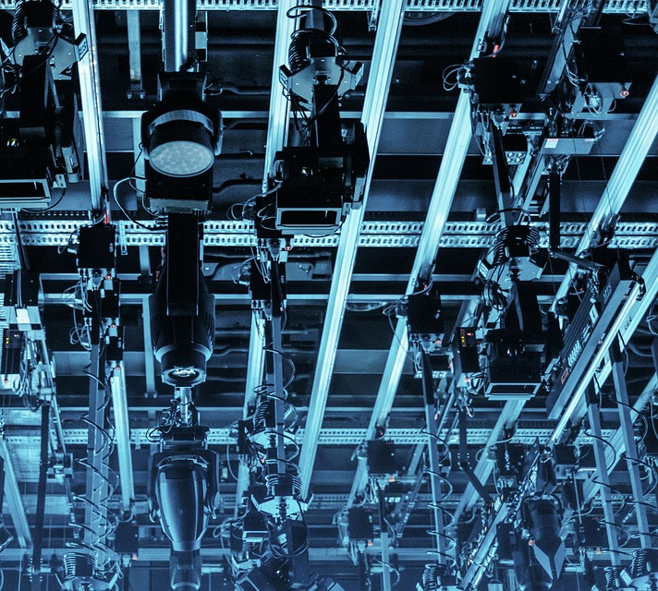

Trend of
Career Choice
by the
New Generations

Slide 13


200+
CSE students Claimed-
facing lot of troubles in basic knowledge
4th months’ semester is not enough.

Slide 14

A Big Number Of Students Couldn’t Set Their Career In Right Track
Social Concept &
Background
A major number of students of CSE are not getting confidence against the Jobs of CSE relevance
Huge Competition in Polytechnic/NU/NU-Private /Private-Public Universities
The image of CSE

Slide 15

What’s the Reality?

Slide 16


Students are not utilizing their
students life with heart & soul
according to their career track and
passion.
In CSE the average status of alumni are not still so successful

Slide 17
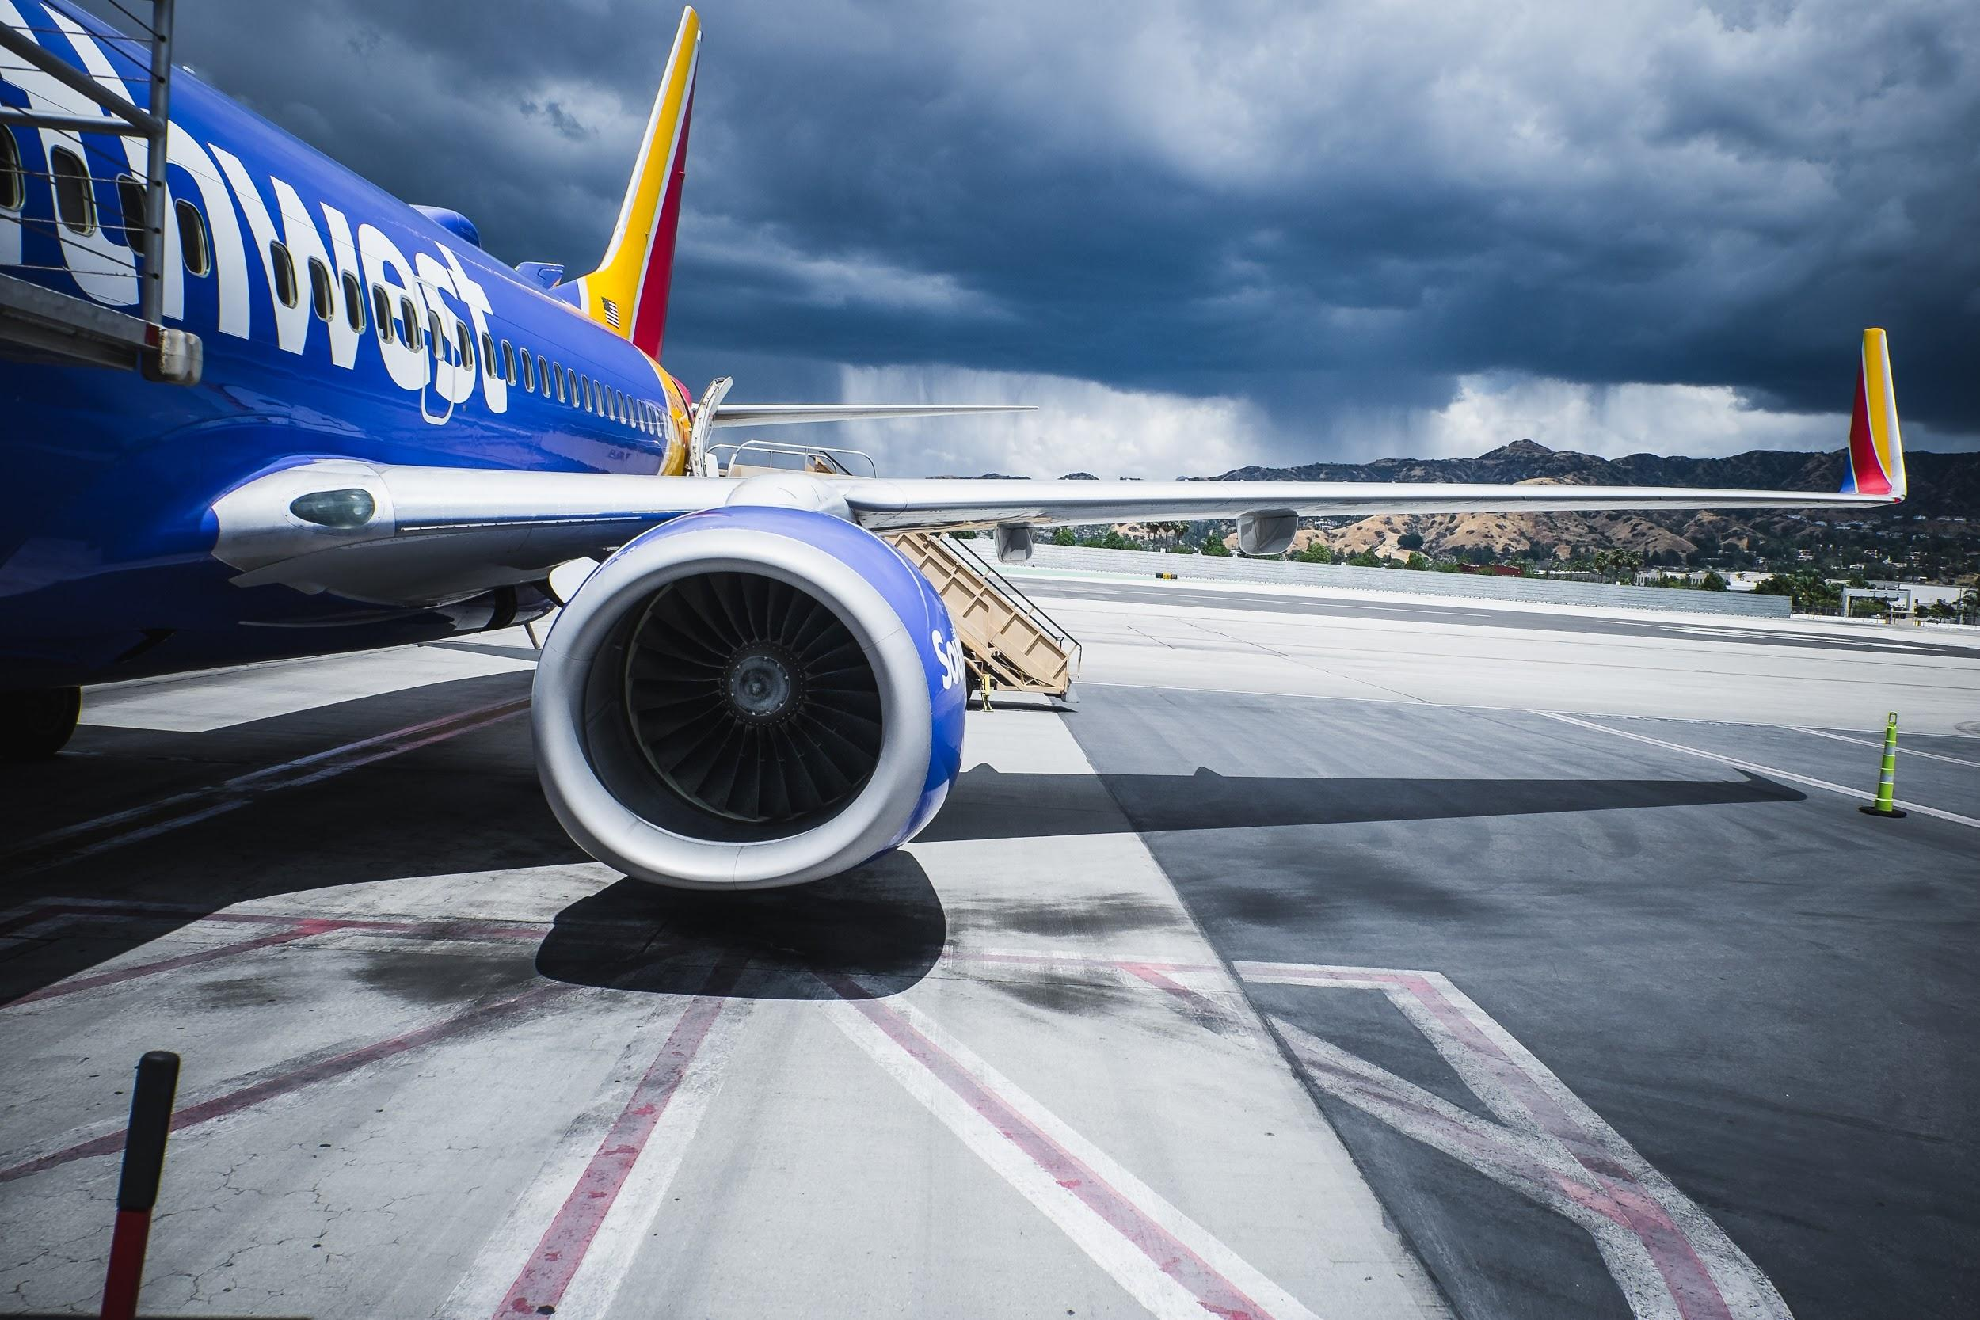

International
Market

Slide 18



Slide 19






Theory
Practical
Students & Teachers

Slide 20

Research based Project
In Association with Relevant Industry

Slide 21


“Real Life Software Development Program”
INTERNSHIP

Slide 22
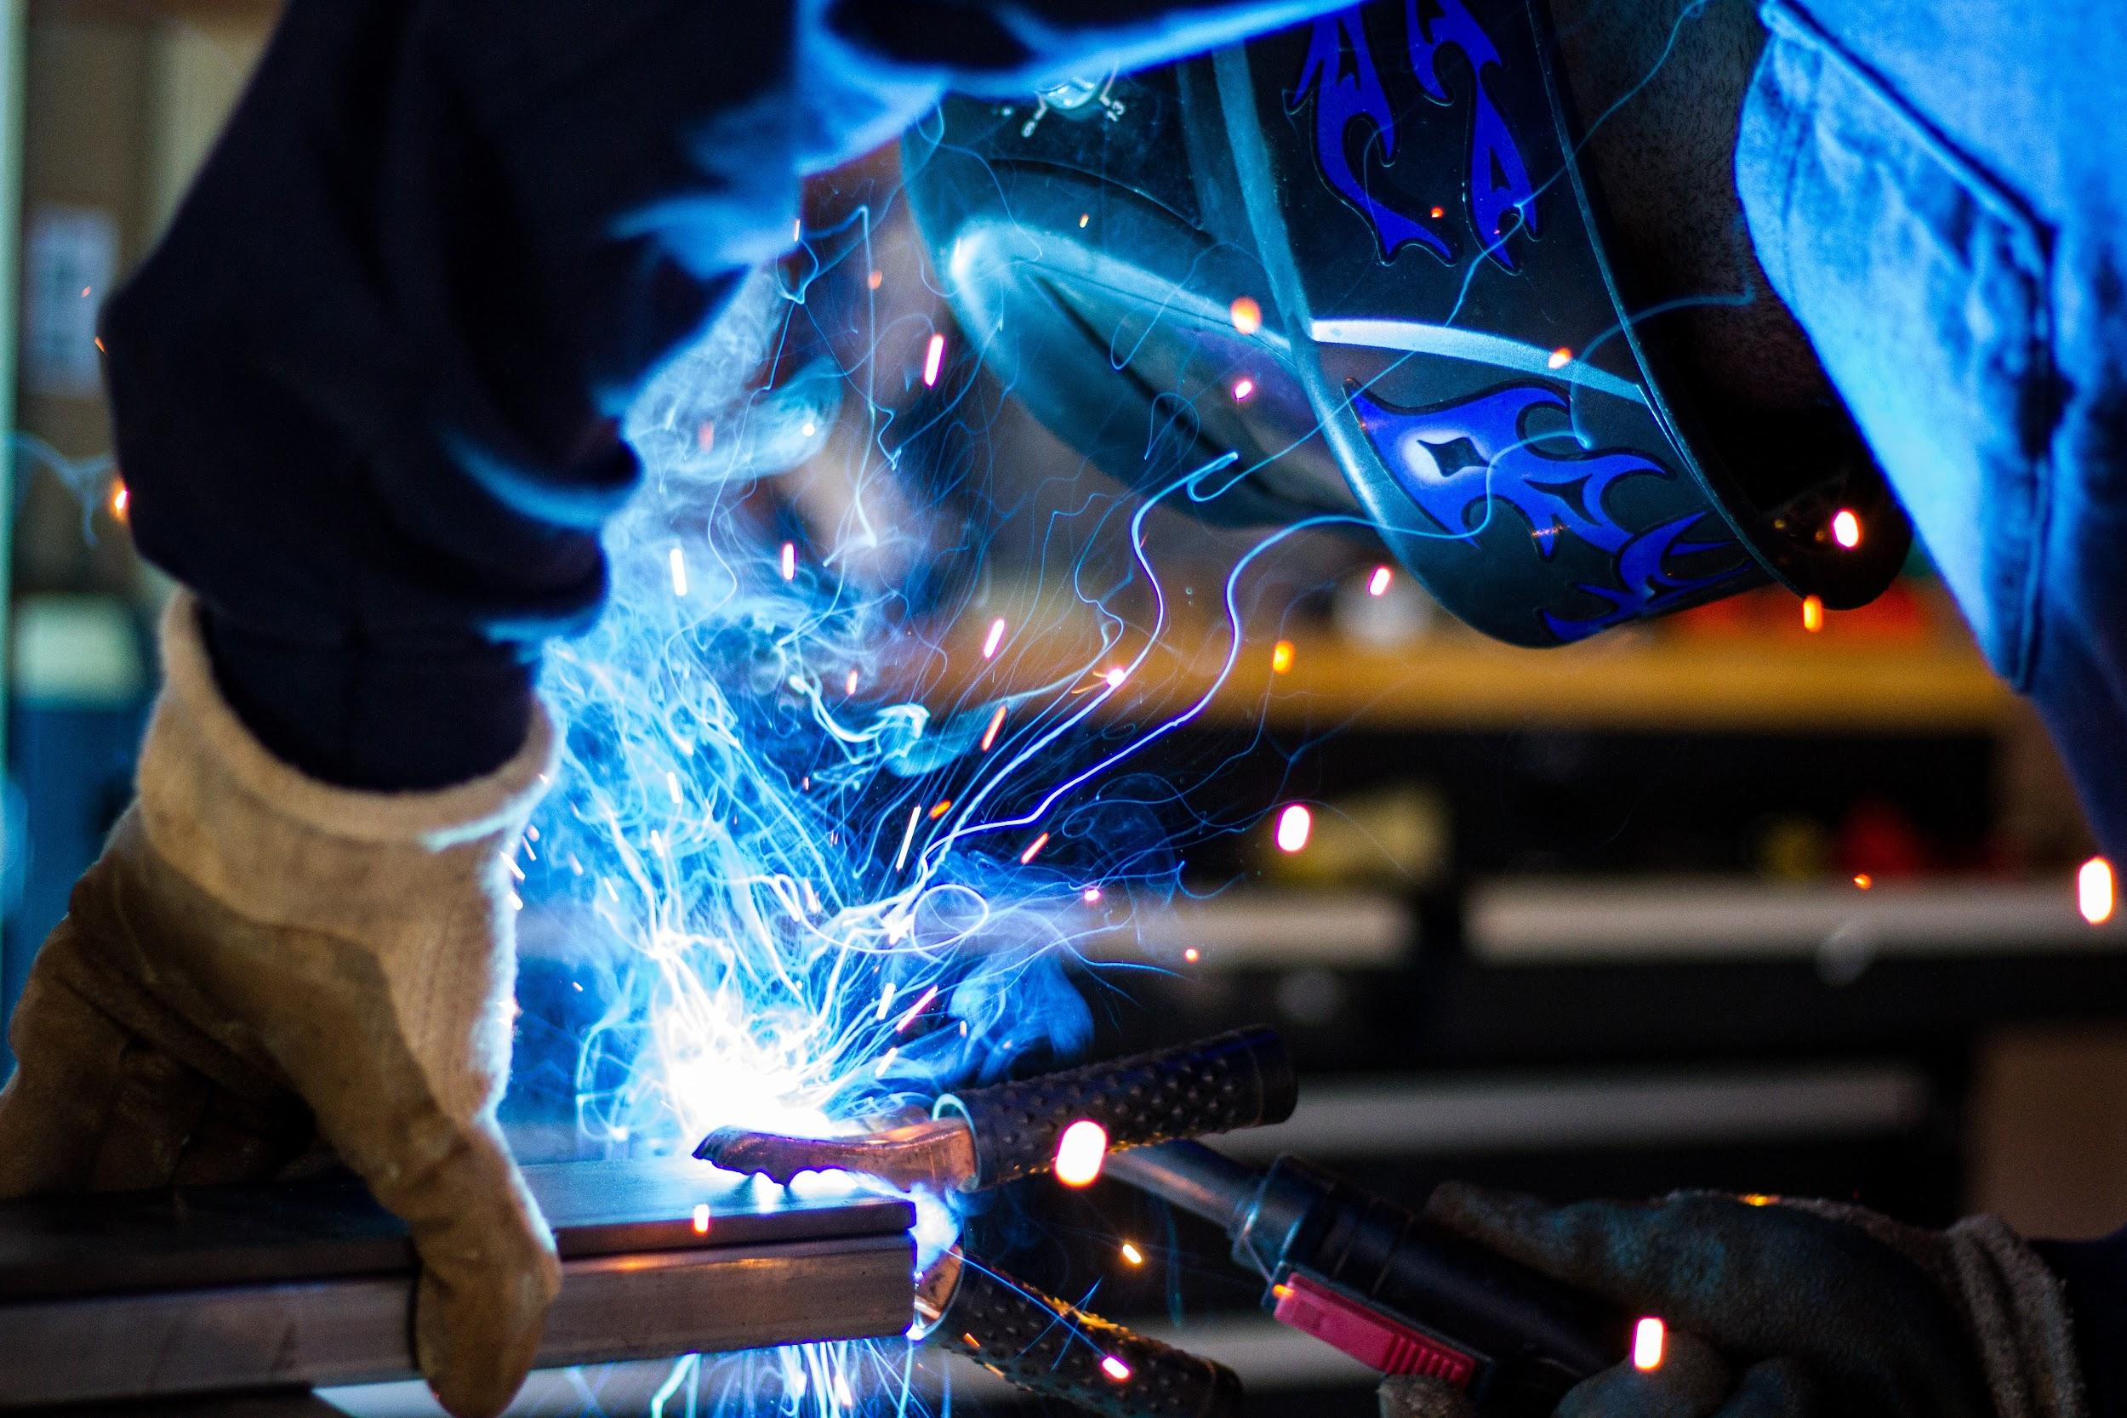


Research Center

Slide 23

Teaching
Materials
and
Industry base Teachers
Global Demands

Slide 24
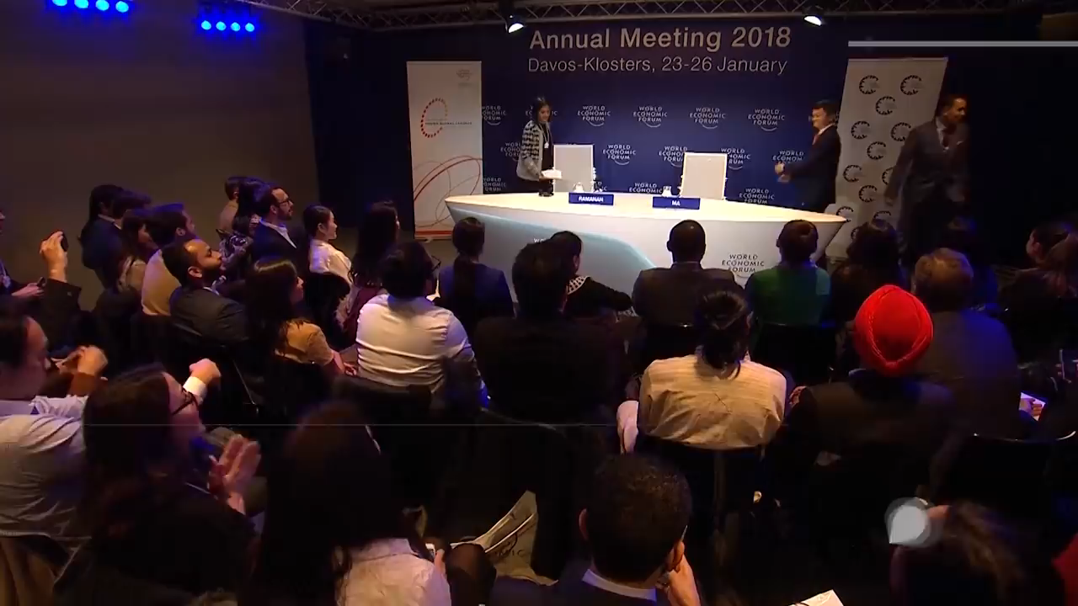

Slide 25
“A TEACHER always
EXPECTS his
STUDENTS to
BECOME BETTER”

Slide 26


Slide 27


Best Apps
for
Teachers And Students

Slide 28
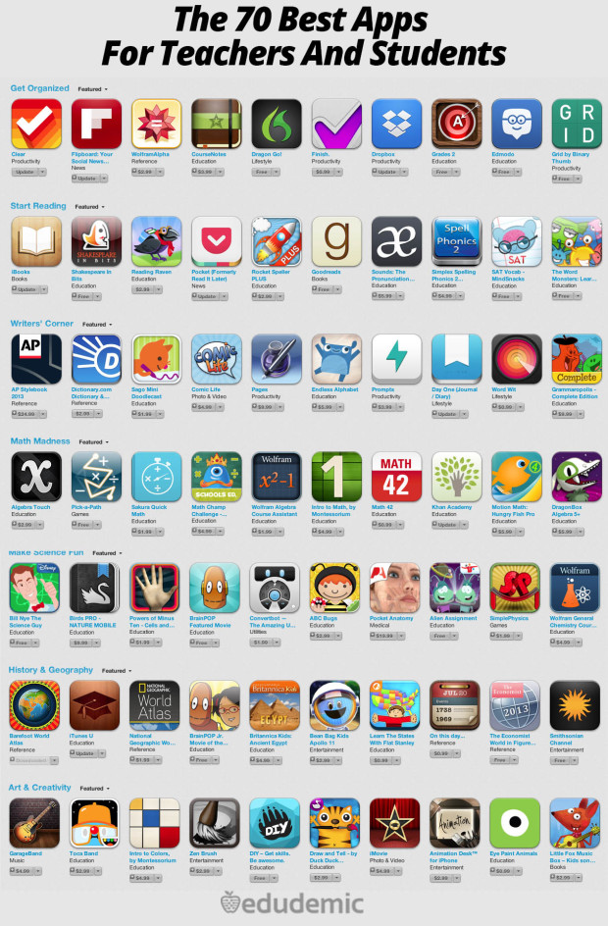
http://www.edudemic.com/70-best-apps-teachers-students/

Slide 29

ONLINE
LEARNING
SITES

Slide 30


Requirement
Analysis

Slide 31

CREATIVE
UI/UX Design

Slide 32
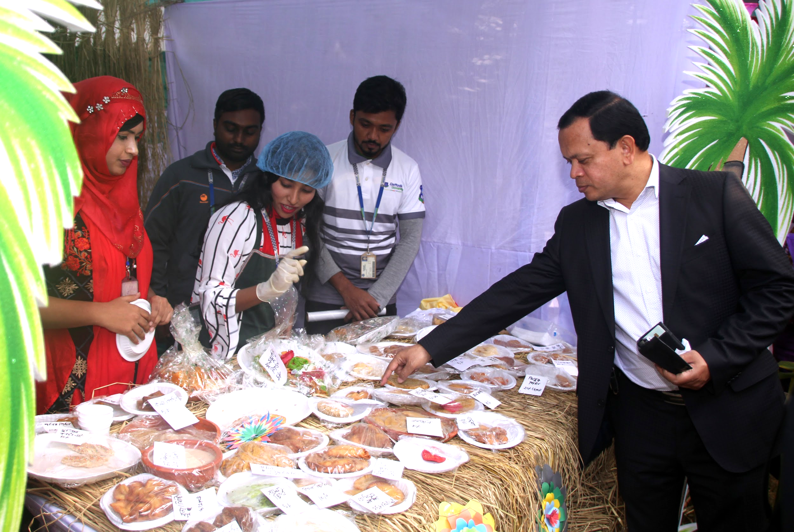
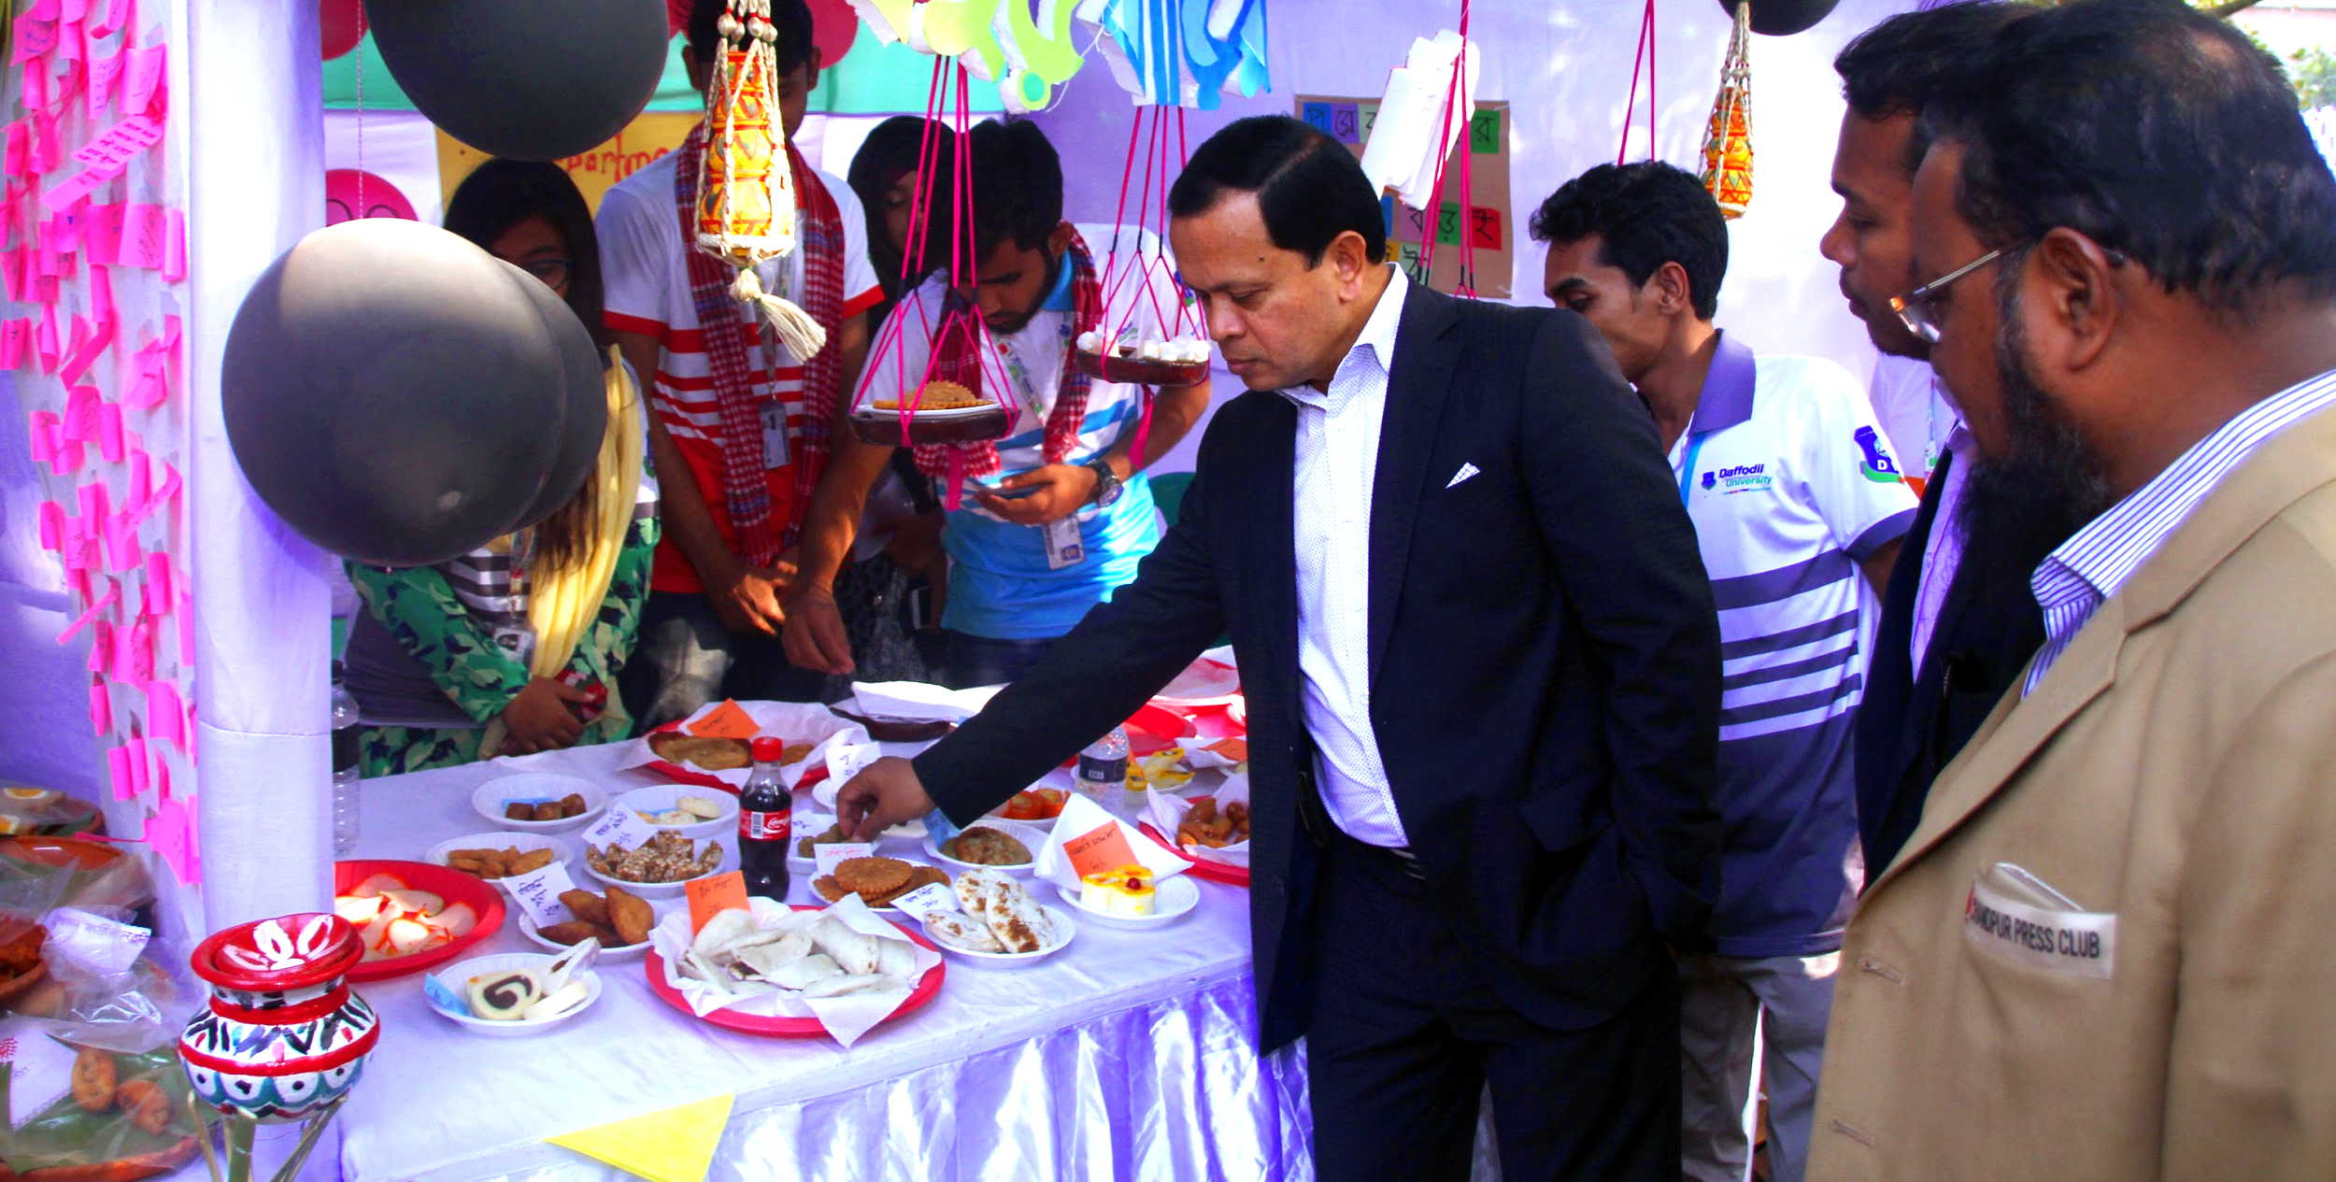
Entrepreneurial Attitude

Slide 33

TRENDING

Slide 34
Future Technology |
Digital World 2020

Slide 35


SMART
CITY

Slide 36

INTERNET
of
THINGS

Slide 37
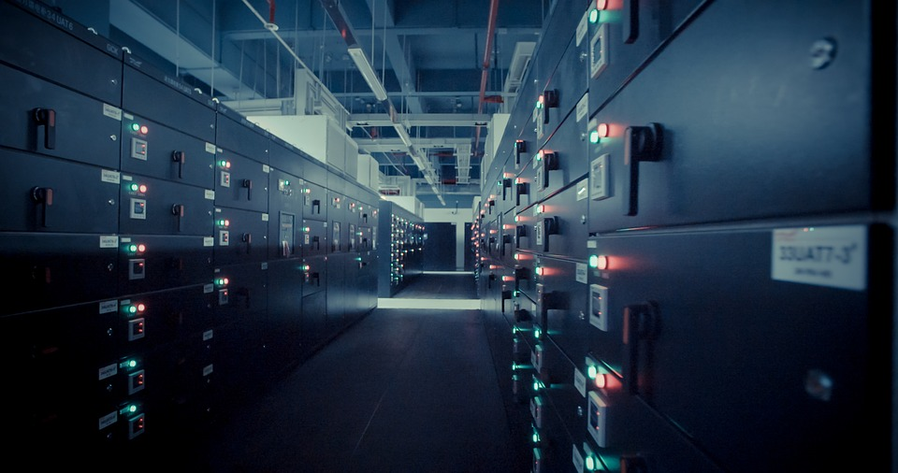

BIG
DATA

Slide 38





CLOUD COMPUTING

Slide 39

Artificial
Intelligence

Slide 40
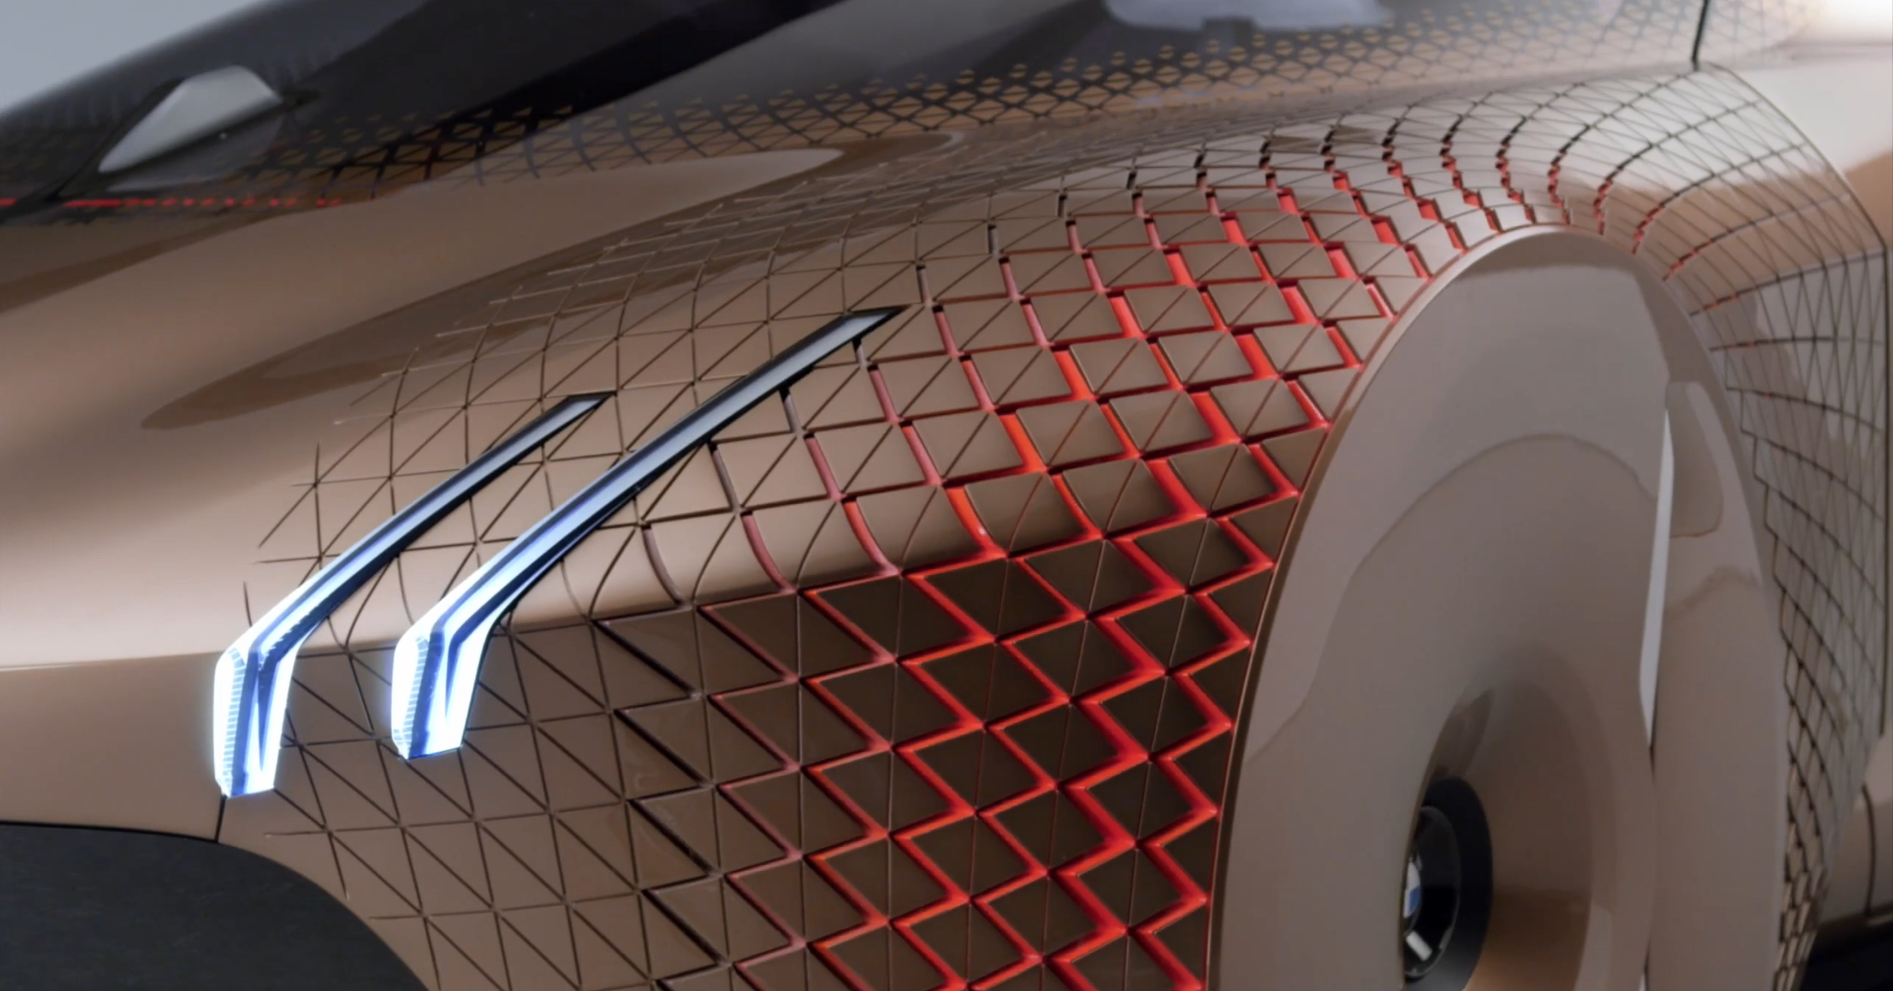
Self Driving Car

Slide 41


Bitcoin and Blockchain

Slide 42
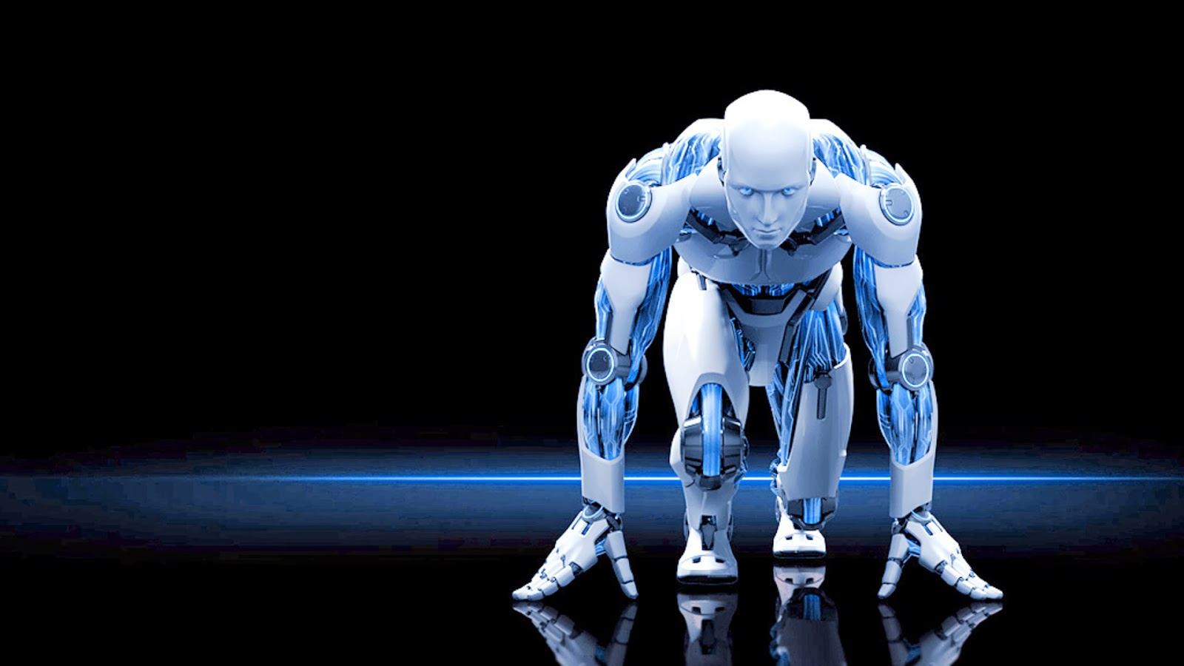
ROBOTICS
Notes:
https://www.analyticsinsight.net/wp-content/uploads/2018/01/Robotics.jpg

Slide 43



VIRTUAL
REALITY
& AUGMENTED
REALITY

Slide 44



Explore the new technology and turn our class in new technology.

Slide 45
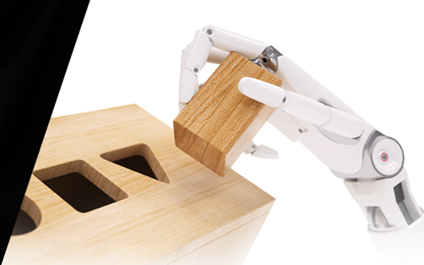
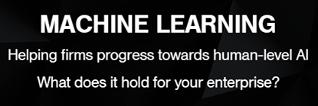

Slide 46

  We need to see our TEACHERS and STUDENTS are doing RESEARCH on this sorts of TOPICS and when any of STUDENTS come forward voluntarily to do this sorts of research we will evaluate them and give them MARKS and FUNDS on the basis of their Topics and Enthusiasm

Slide 47


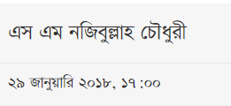

Slide 48

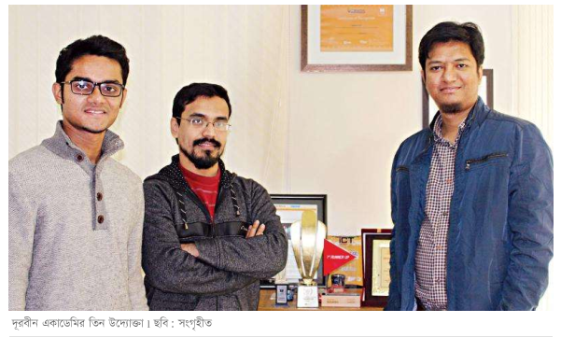
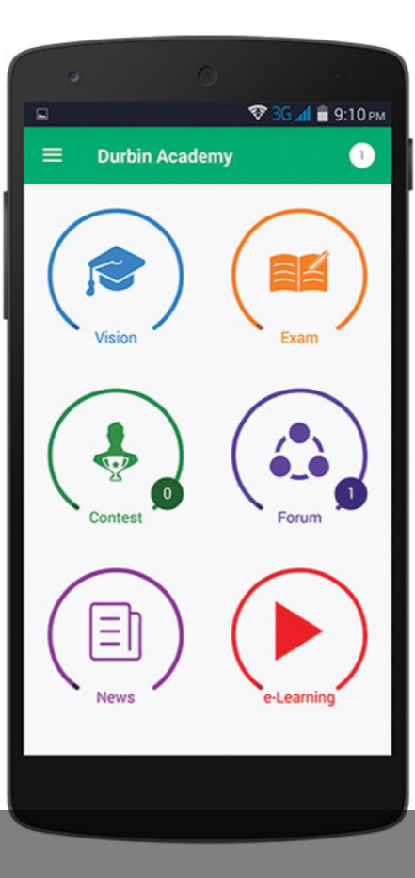
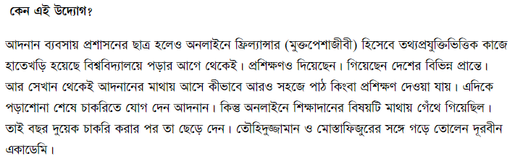

Slide 49
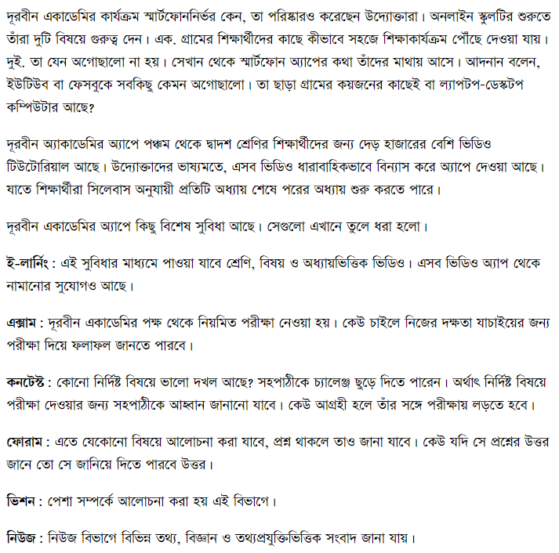
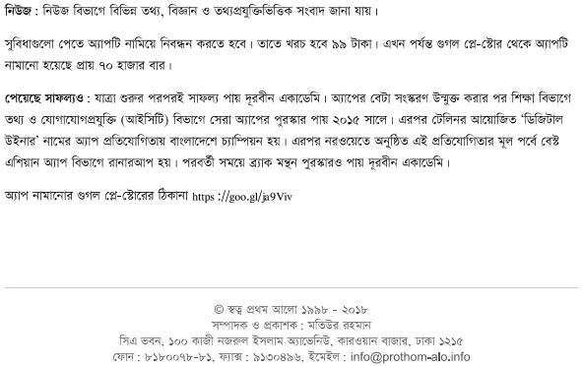

Slide 50

QUESTION AND ANSWER

Slide 51
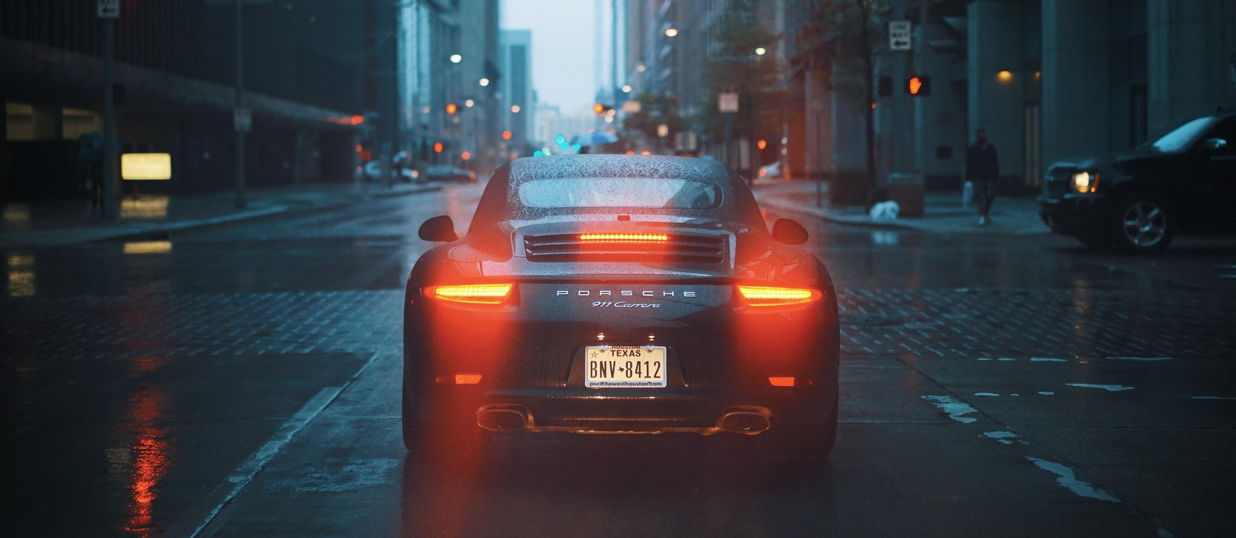
TAKE AWAY!

Slide 52
TAKE AWAY!

Slide 53
THANK YOU!

