Slide 1
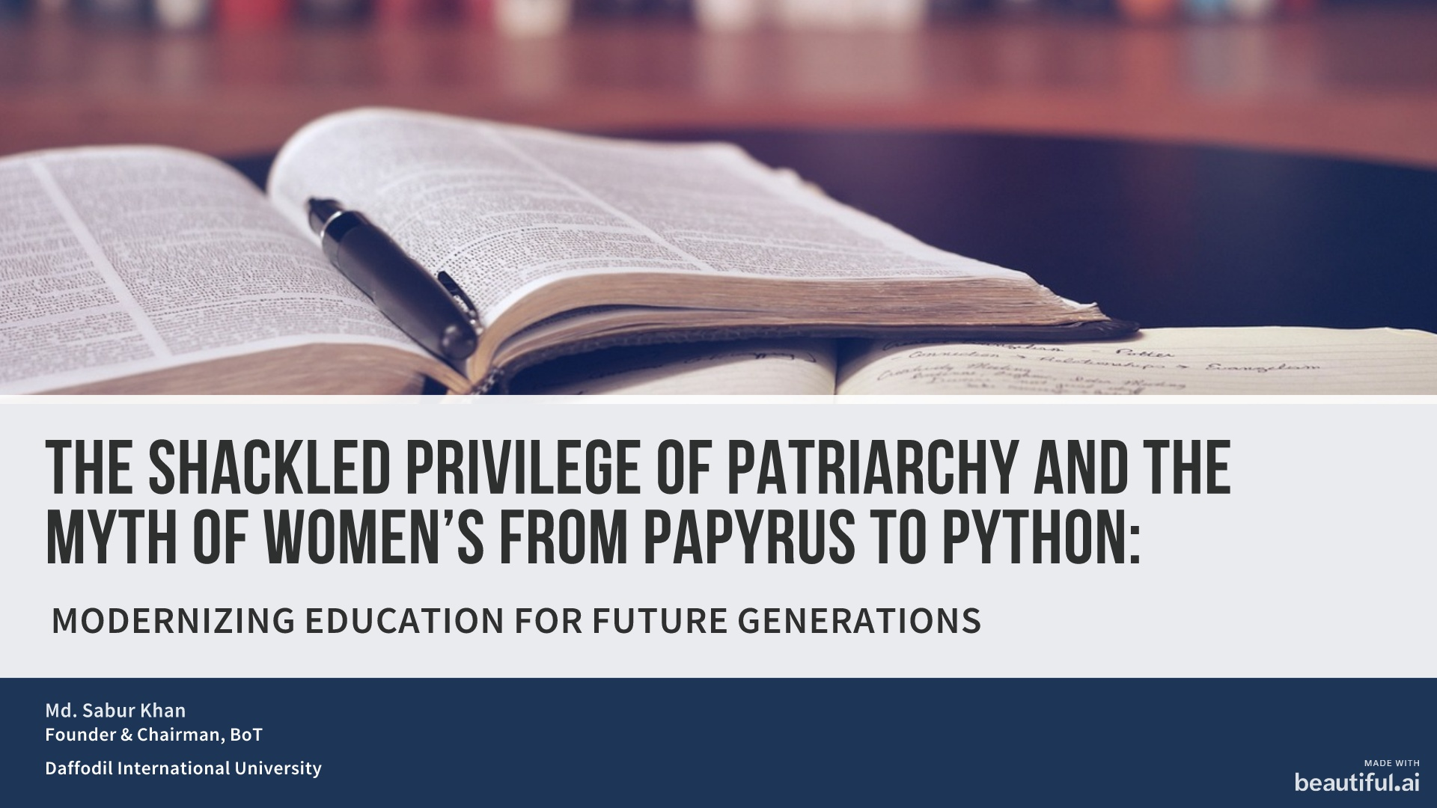

Slide 2


Slide 3
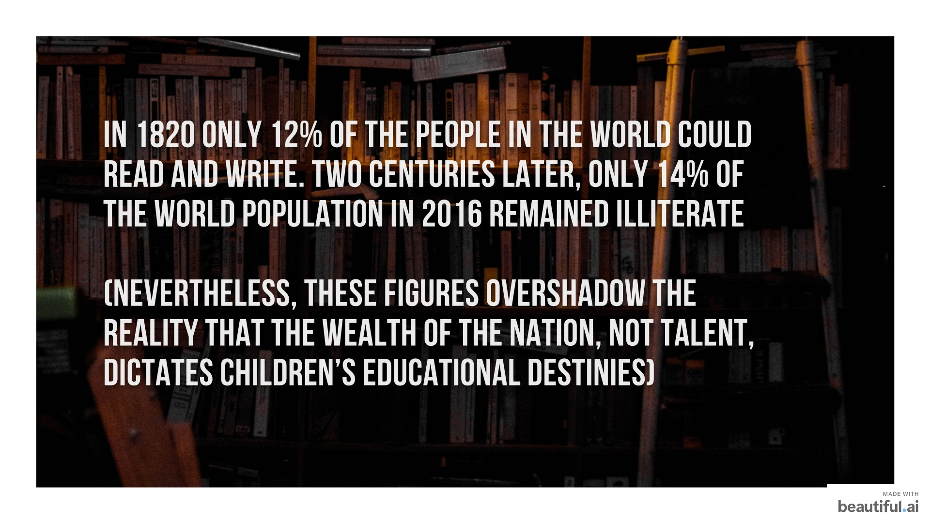
IN 1820 ONLY 12% OF THE PEOPLE IN THE WORLD COULD READ AND WRITE. TWO CENTURIES LATER, ONLY 14% OF THE WORLD POPULATION IN 2016 REMAINED ILLITERATE
(NEVERTHELESS, THESE FIGURES OVERSHADOW THE REALITY THAT THE WEALTH OF THE NATION, NOT TALENT, DICTATES CHILDREN’S EDUCATIONAL DESTINIES)

Slide 4


Slide 5
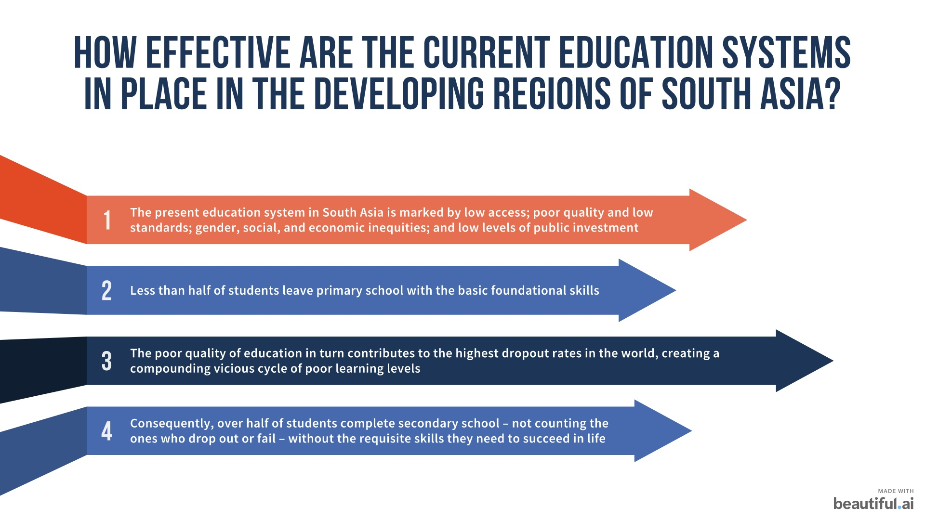

Slide 6
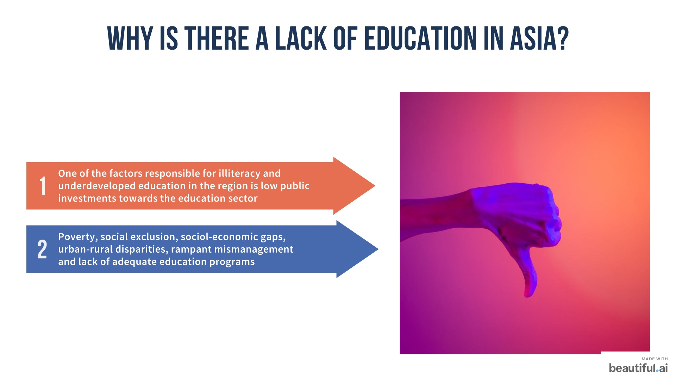

Slide 7
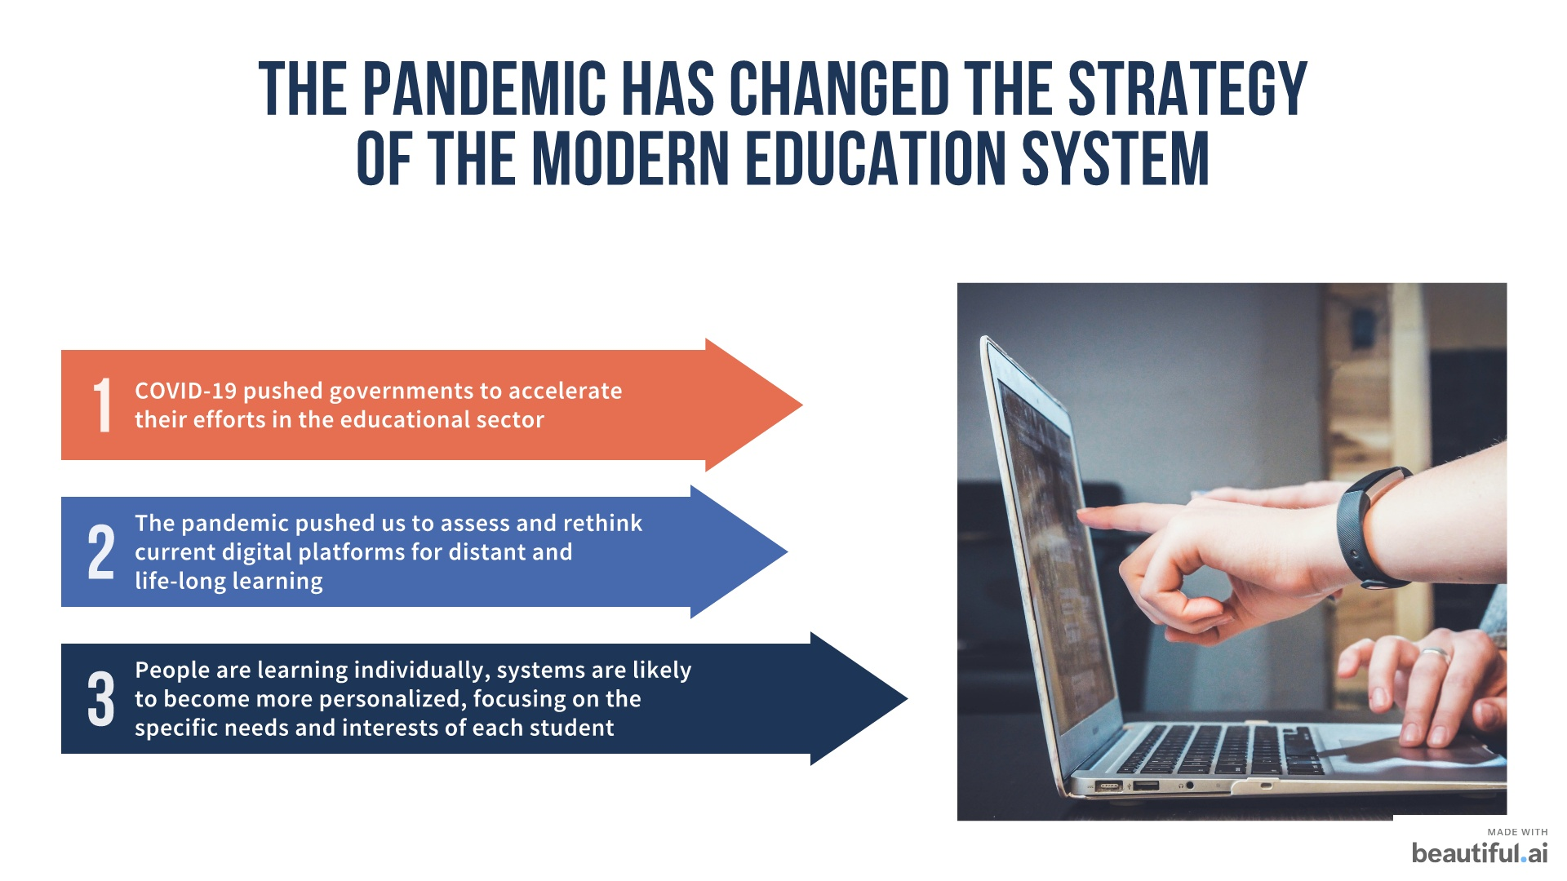

Slide 8
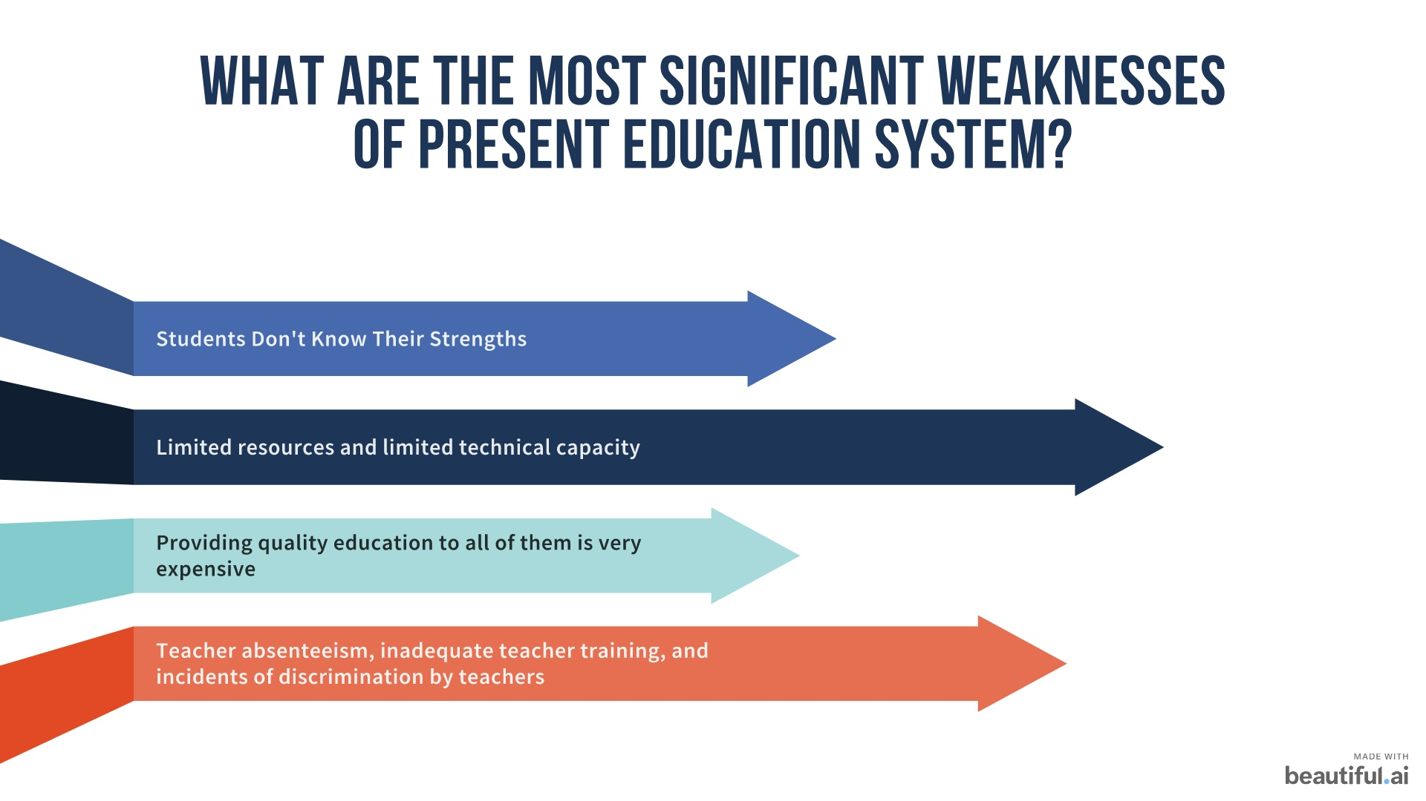

Slide 9
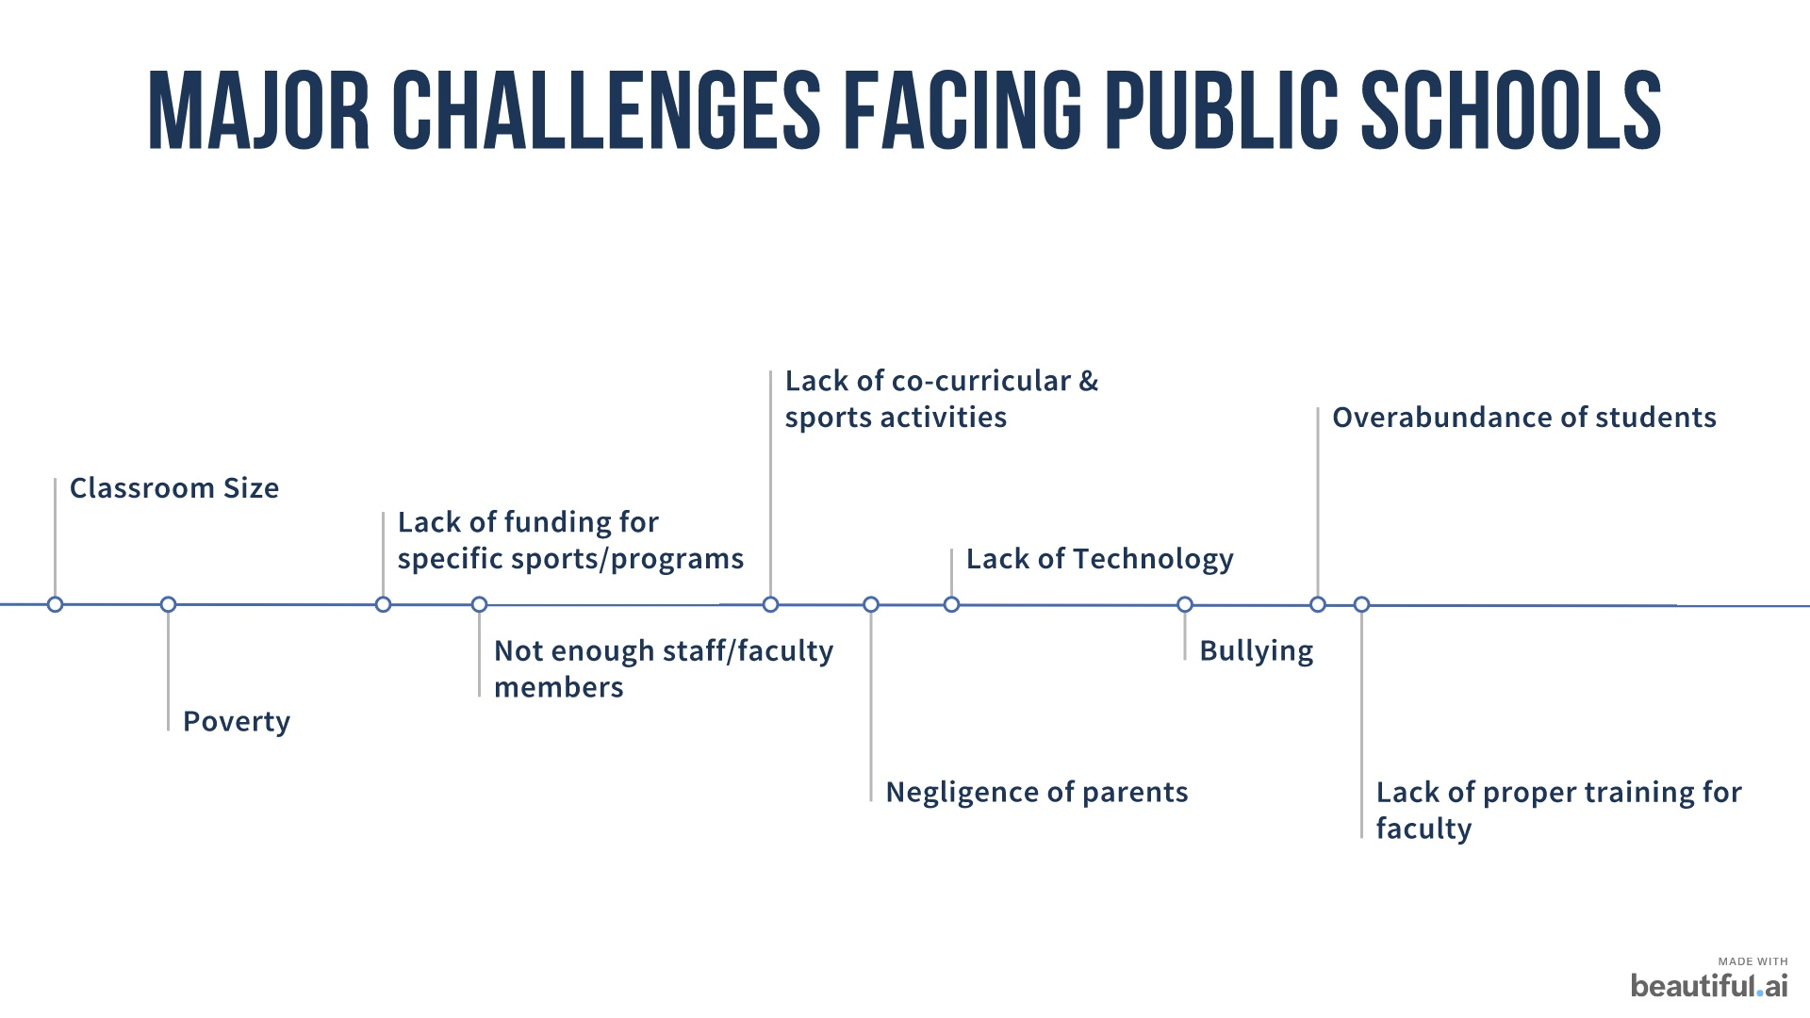

Slide 10
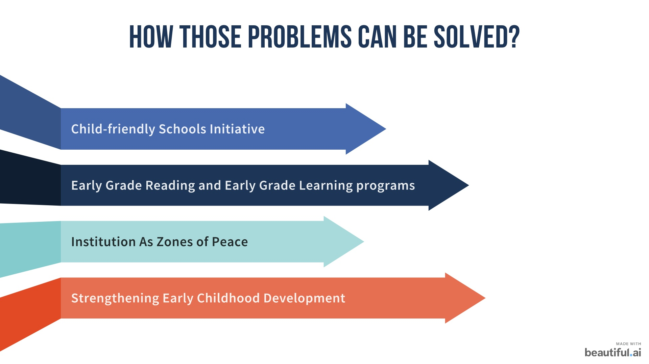

Slide 11
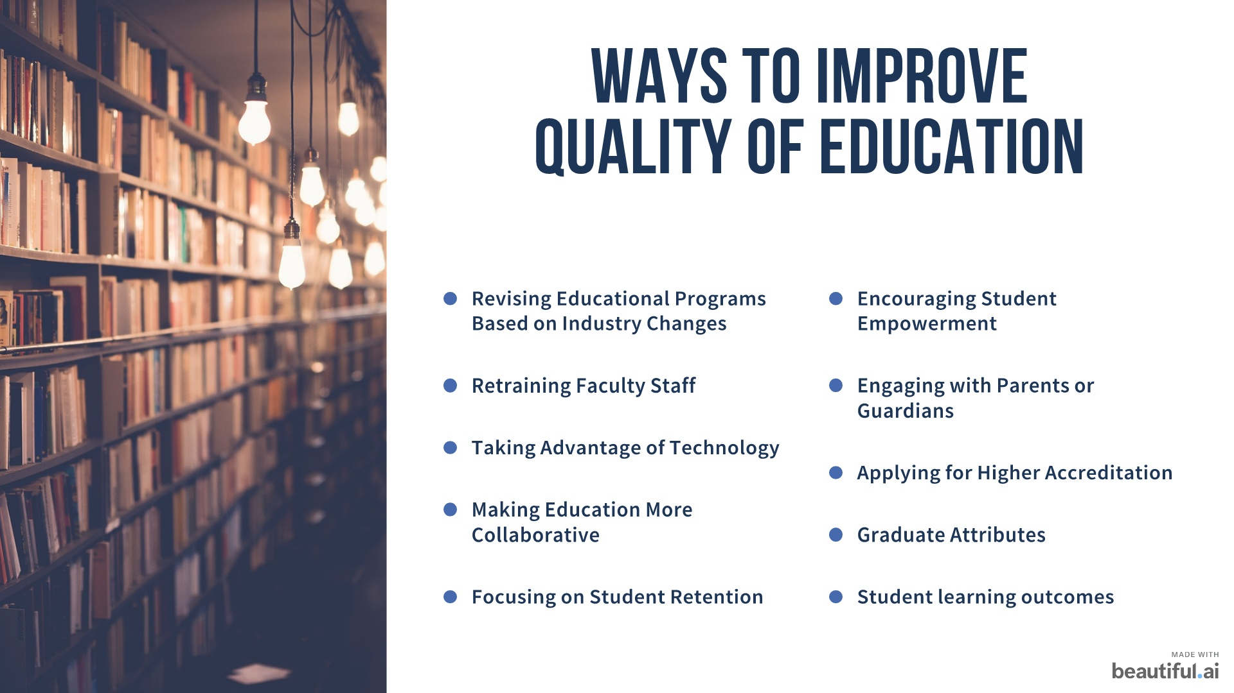

Slide 12
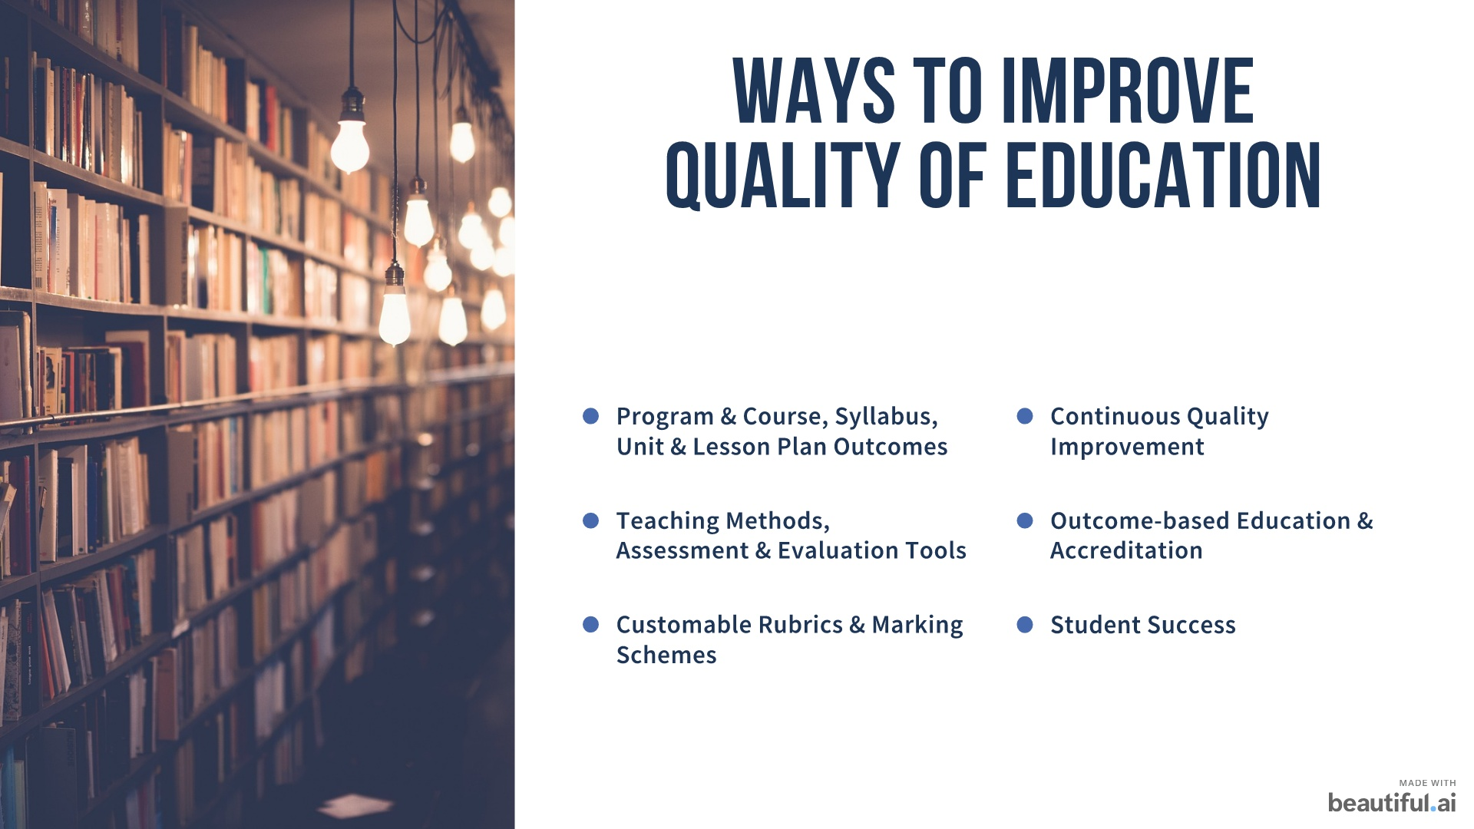

Slide 13
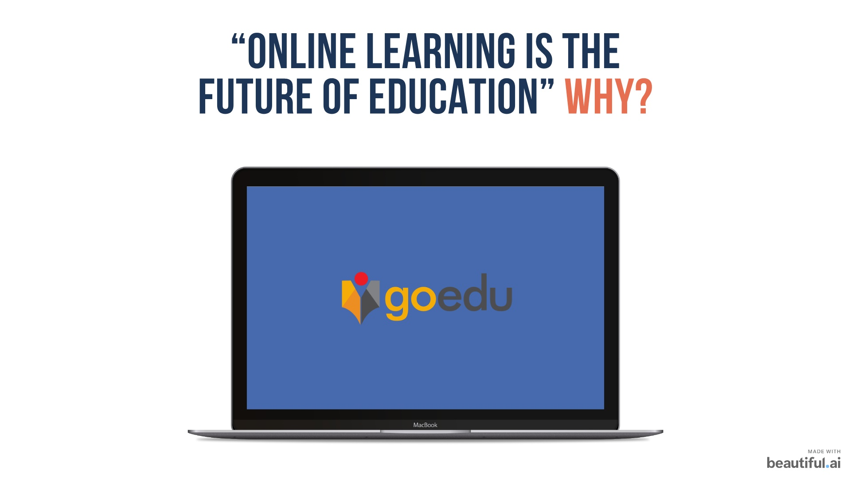
It's flexible
It offers a wide selection of programs
It’s accessible
It allows for a customized learning experience
It’s more cost-effective than traditional education

Slide 14
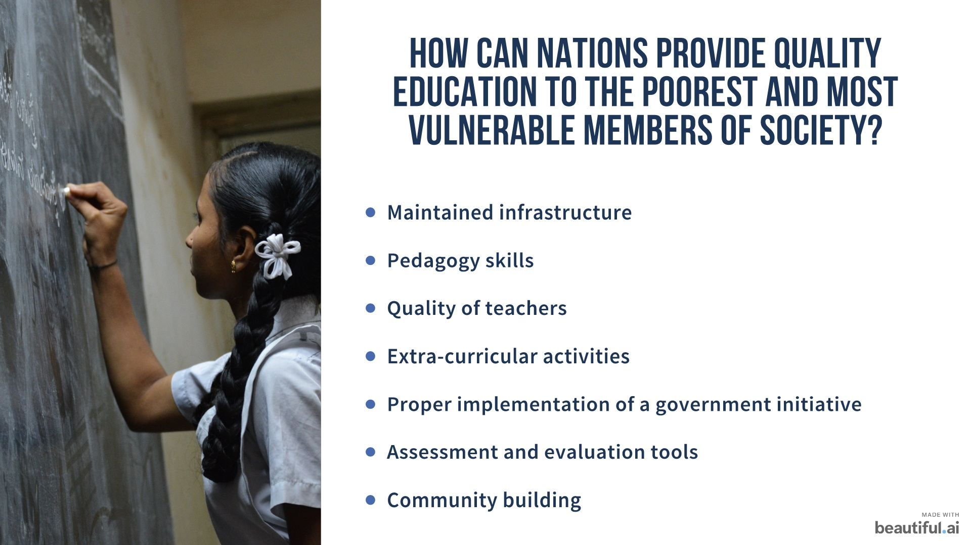

Slide 15
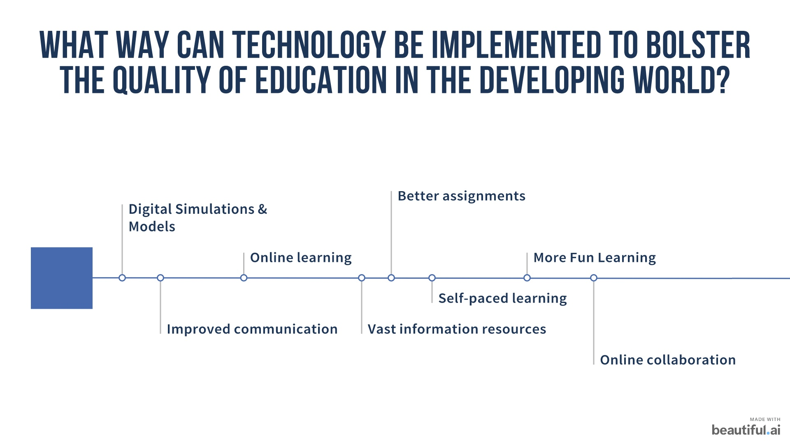

Slide 16
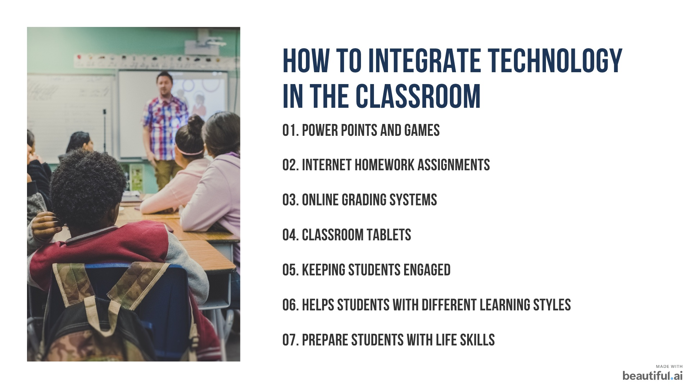

Slide 17
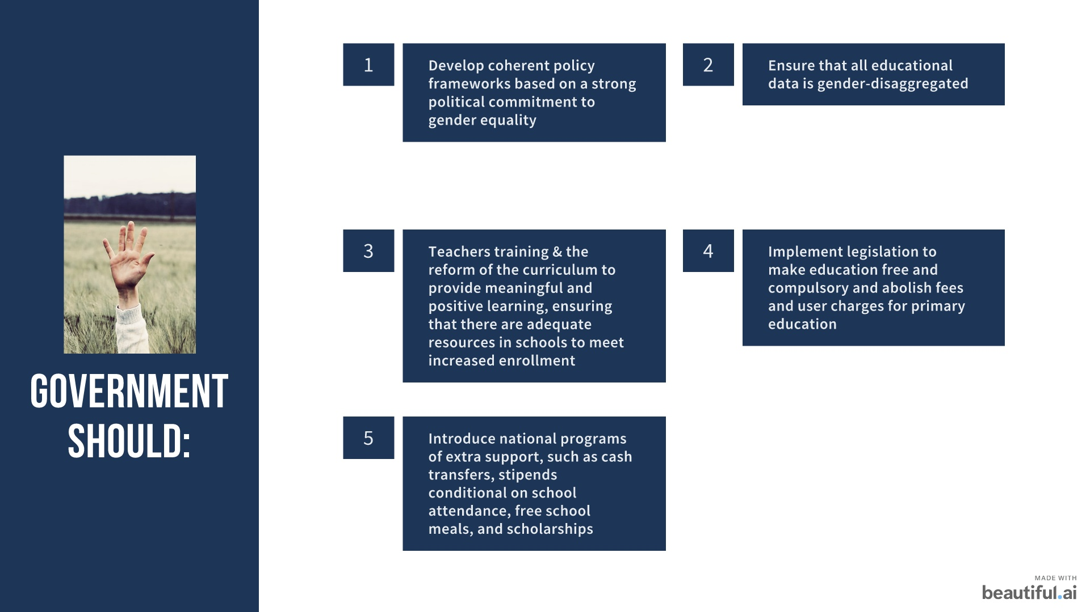

Slide 18
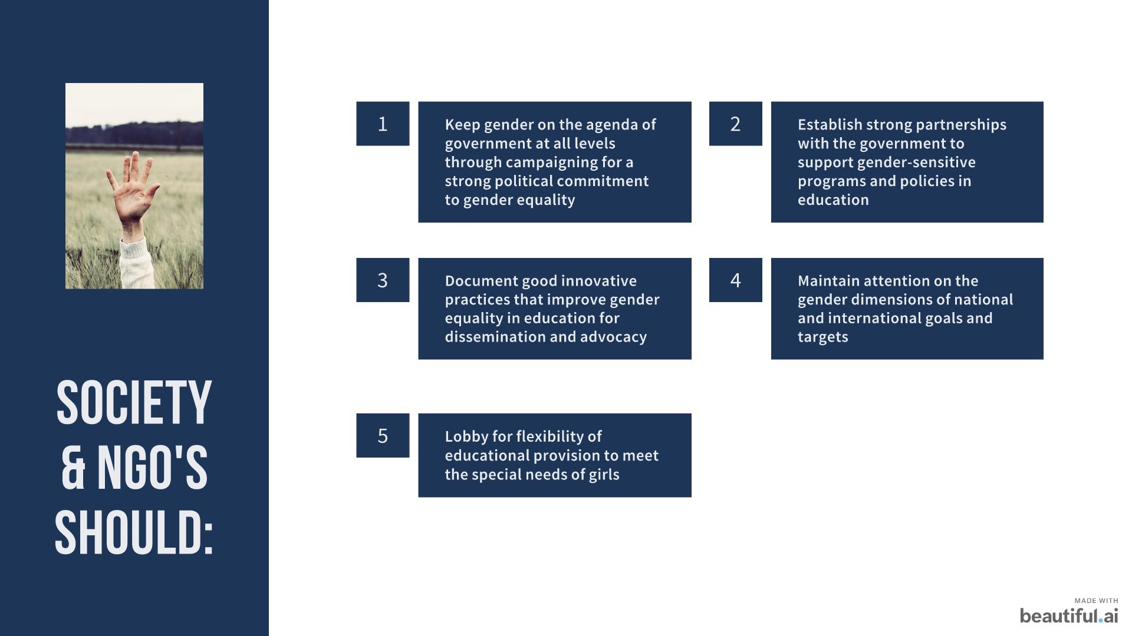

Slide 19
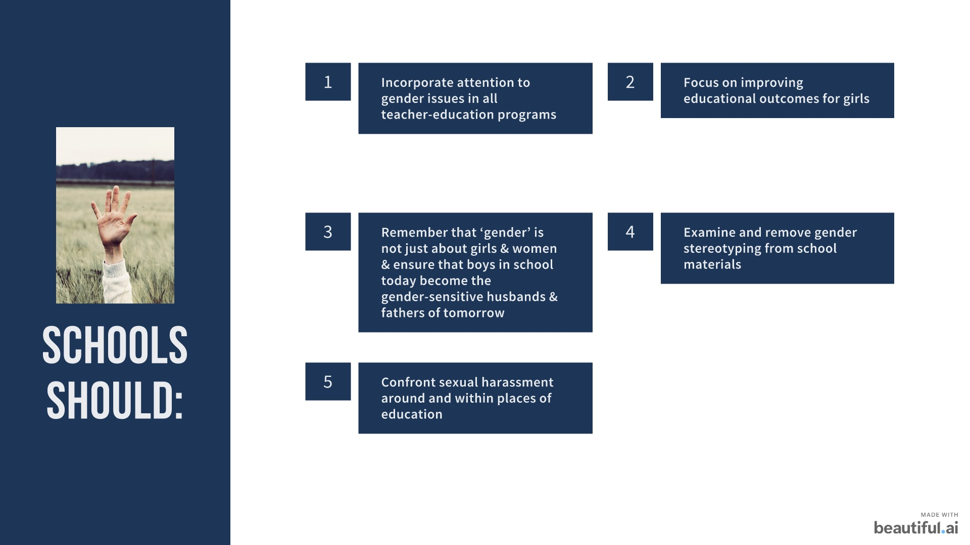

Slide 20
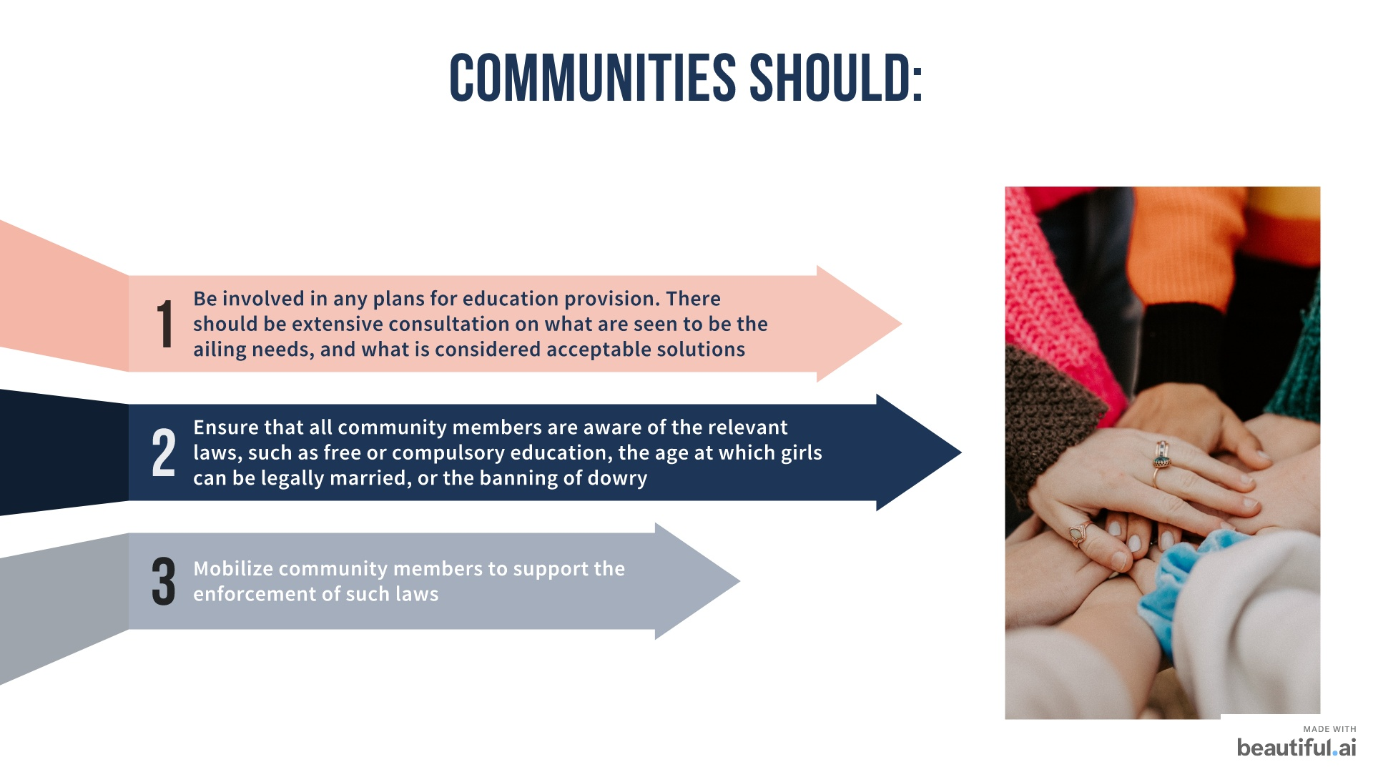

Slide 21
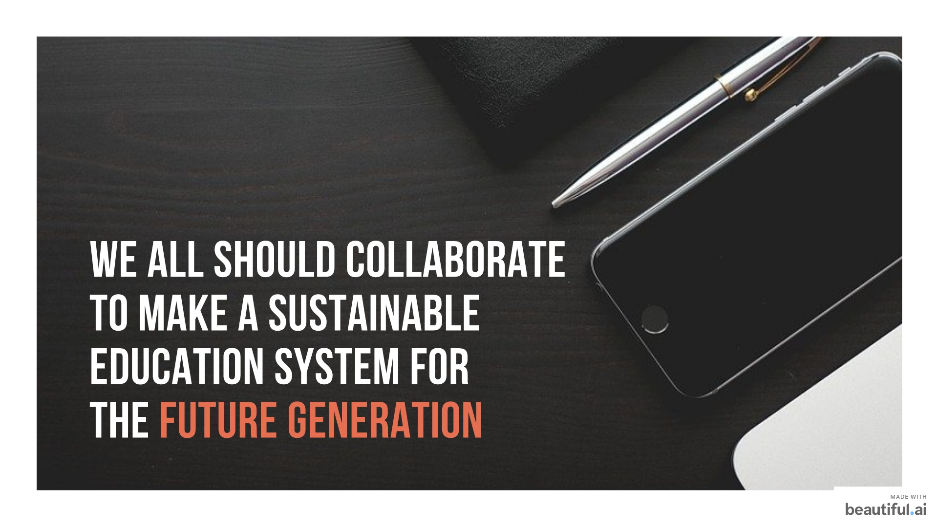

Slide 22


